Slide 1
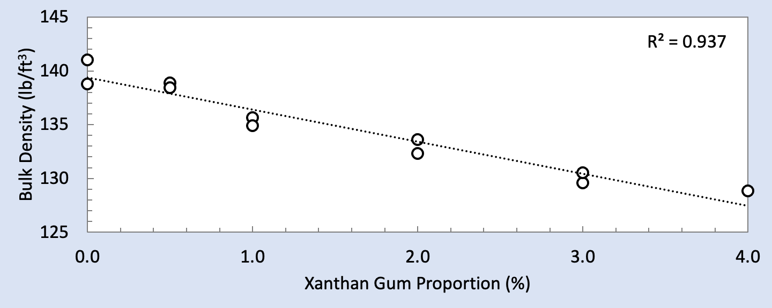
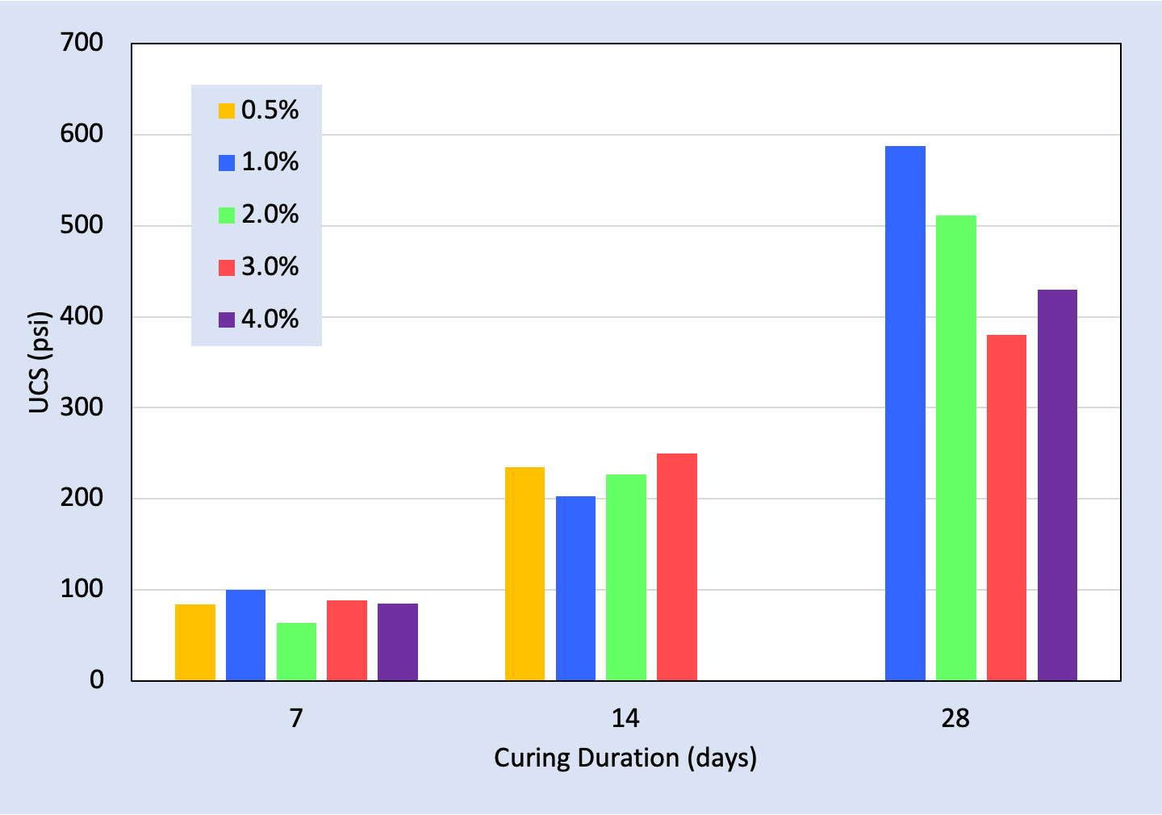
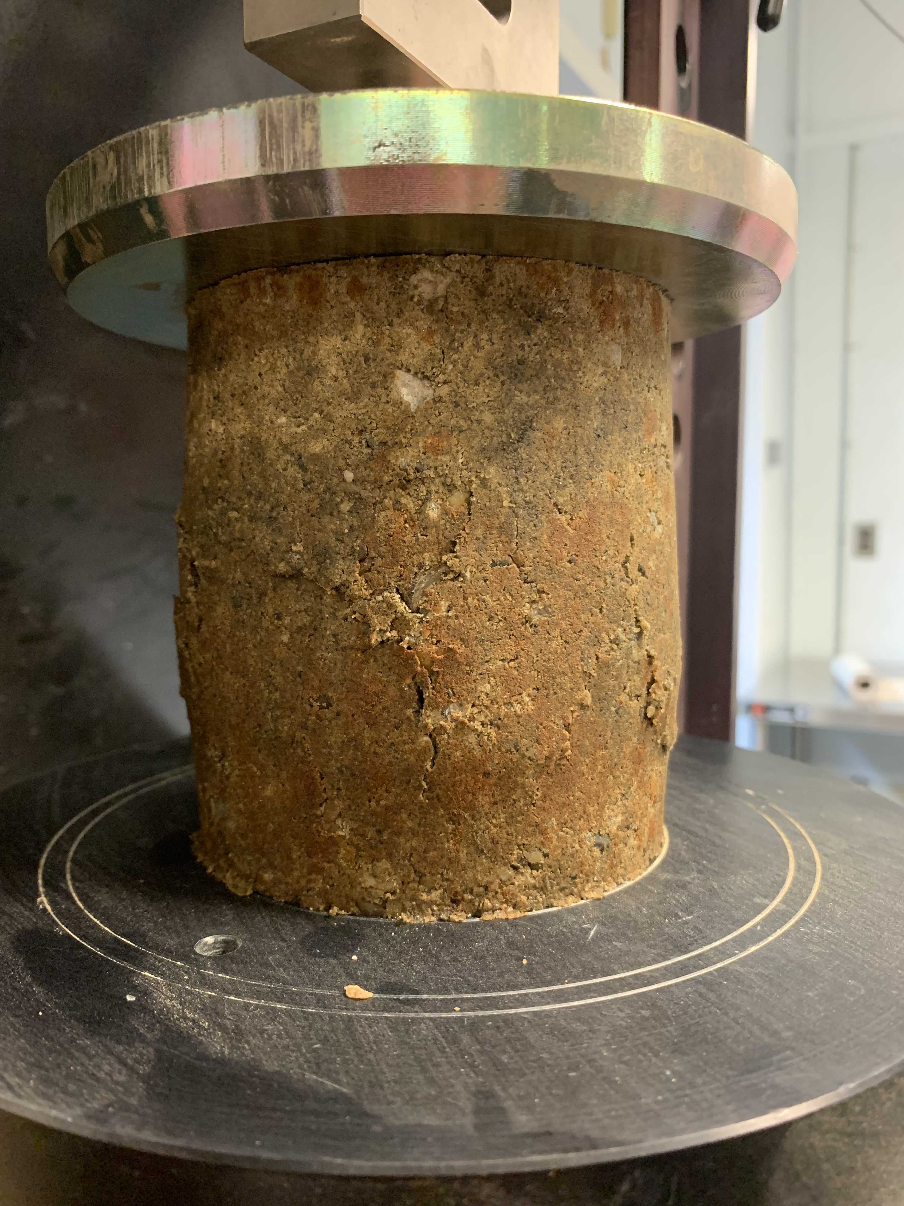
Non-Traditional Stabilizers for Road Base Materials
Ryan van der Heijden, Department of Civil and Environmental Engineering, University of Vermont | Advisors: Dr. Ghazanfari and Dr. Dewoolkar
Why Biopolymers?
Cement has traditionally been used to stabilize road base materials, but its production is environmentally costly—about 1 ton of CO₂ is produced for 1 ton of cement. Biopolymers may offer an alternative to cement for stabilizing roadway subbase. Many biopolymers are a “waste” byproduct of an existing manufacturing process or consume CO₂ in their production.^{[1]}
Background
Several biopolymers were initially investigated, but Xanthan Gum (XG) has been found to be the most promising. XG has been shown to be stable under a wide temperature and pH range, and under high-salt environments. XG is also FDA approved for human consumption and is biodegradable.^{[2]}
R² = 0.94
Coating of beads
Connections
SEM image of XG with glass beads. Image suggests glass beads are coated in the dried XG gel, with “connection bridges” clearly visible between beads.
Conclusion and Future
Findings of an initial investigation suggest that Xanthan Gum may be a promising non-traditional stabilizer for road base materials. Further research aims to expand our understanding of the mechanism of strength gain and the effect of adverse environmental conditions on XG.
Bulk density and unconfined compressive strength (UCS) of various XG concentrations.
Procedure and Results
Standard proctor specimens were created using a representative soil gradation and various concentrations of XG as a percent of dry soil mass. All specimens were cured under laboratory conditions for 7, 14, and 28 days.
XG-treated specimens exhibited considerable strength gain and increase in elastic modulus, especially at longer curing durations. Bulk density of the material was also shown to decrease, possibly a result of XG coating soil particles and partially filling void spaces.
Acknowledgements
Funding for this research is provided by the Transportation Infrastructure Durability Center at the University of Maine under grant 69A3551847101 from the U.S. Department of Transportation’s University Transportation Centers Program. Additional financial support from the Vermont Agency of Transportation is gratefully acknowledged. Graduate student Bijay KC and undergraduate student Greer Scambos contributed to this work, which is very much appreciated.
1% XG specimen exhibiting a “bulging” type failure during a UC test.
[1] BP statistical review of world energy June 2007. London: British Petroleum; 2007. p. 48.
[2] Chang, Ilhan, et al. Effects of Xanthan Gum Biopolymer on Soil Strengthening. Construction and Building Materials, 2015.
June 2019 – www.tidc-utc.org

