Slide 1
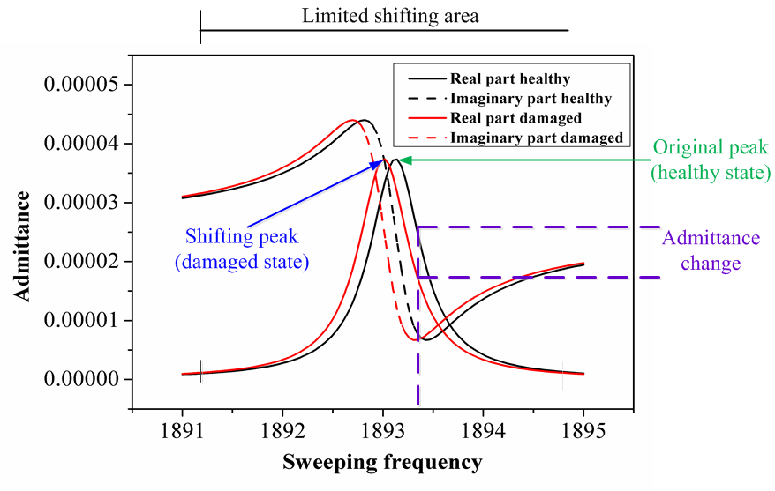
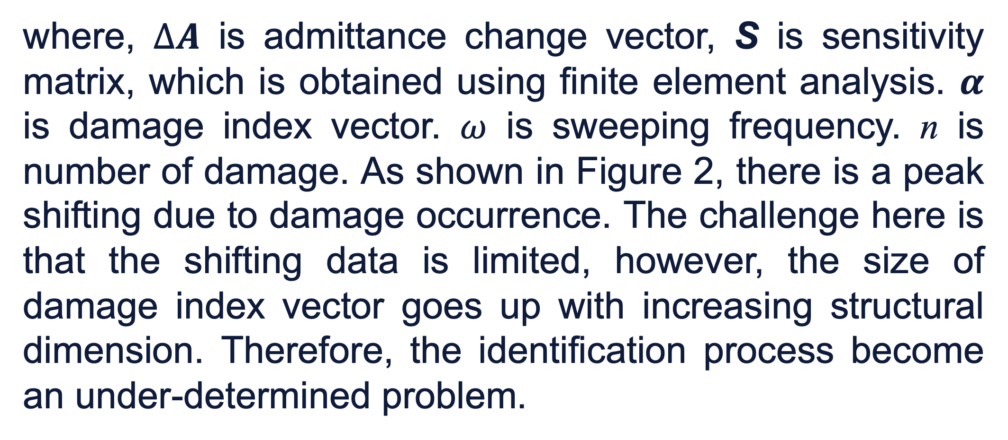

Fault Identification Using Global-Search Enhanced MOPSO Algorithm
Yang Zhang, Ph.D. student, Department of Mechanical Engineering, University of Connecticut Advisor: Prof Jiong Tang
Problem Descriptions
The goal of this research is to utilize piezoelectric actuator to detect damage in railway track. Here we develop an enhanced optimization algorithm that can handle large-scale variables in damage identification problem and identification mechanism is demonstrated.
As shown in Figure 1, the piezoelectric (PZT) transducer is bonded to a metal plate. It can be served as actuator and sensor simultaneously when harmonic voltage is applied to acquire the admittance data, in which the damage information is included.
Then the m points can be sampled from that limited shifting area.
selected based on the maximum Q-table value.
Figure 3 Diagram of EMOPSO algorithm.
Figure 2 Admittance variation with respect to sweeping frequency.
Results and Discussion
The testbed structure is divided into 120 segments for the purpose of fault identification. Two damage (stiffness reduction) cases are studied. One case with damage severity of 8% at segment 10 using simulation. One case with damage severity of 11% at segment 75 using experimental measurements. The identified results are shown in Figure 4. The algorithm identifies the damage location and severity with high accuracy for both of cases.
Inverse Problem Definition
The sampled data points are limited, or it means that m is far less than n, which indicate S is a rank-deficient matrix. Then matrix inversion is avoided here when solving unknowns. Therefore, the inverse process is converted into an optimization problem defined as:
Figure 1 Geometry of Plate with PZT patch and experimental setup.
This inverse fault identification process can be converted to an optimization problem, which is solved by enhanced multi-objective particle swarm optimization algorithm (EMOPSO) with global searching ability.
Admittance Data
Expression of admittance change is defined as:
$$∆A=\left[\begin{matrix}∆A(ω_{n}) \\ ⋯ \\ ∆A(ω_{m})\end{matrix}\right]=S_{m×n}α_{n×1}$$
Here first objective function is comparison between admittance changes from finite element analysis and experimental measurements. Because the damage only affects a small area, then second objective is defined to determine the sparsity of the damage index vector.
where, $∆A$ is admittance change vector, S is sensitivity matrix, which is obtained using finite element analysis. $α$ is damage index vector. $ω$ is sweeping frequency. n is number of damage. As shown in Figure 2, there is a peak shifting due to damage occurrence. The challenge here is that the shifting data is limited, however, the size of damage index vector goes up with increasing structural dimension. Therefore, the identification process become an under-determined problem.
The complexity of fault identification problem increase since the size of damage index vector goes up due to increasing structural dimension, thus resulting in a multi-modal optimization problem. To help the algorithm find the global minima, here we develop several local search strategies to guide the particle in MOPSO algorithm to jump out of the possible local minima. The flowchart is shown in Figure 3. To guide the particle to select specific local search strategy, here Q-learning algorithm is used. Each local search method will be
Figure 4 Identified damage location and severity.
These results demonstrate accuracy and robustness of EMOPSO for piezo admittance-based damage identification in large-scale problem. This method can be directly applied to railway track.
* This research is supported by the Transportation Infrastructure Durability Center at the University of Maine under grant 69A3551847101 from the U.S. Department of Transportation’s University Transportation Centers Program

