Slide 1
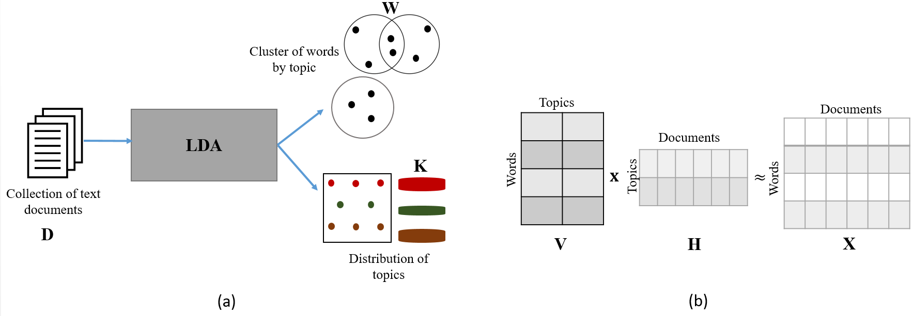
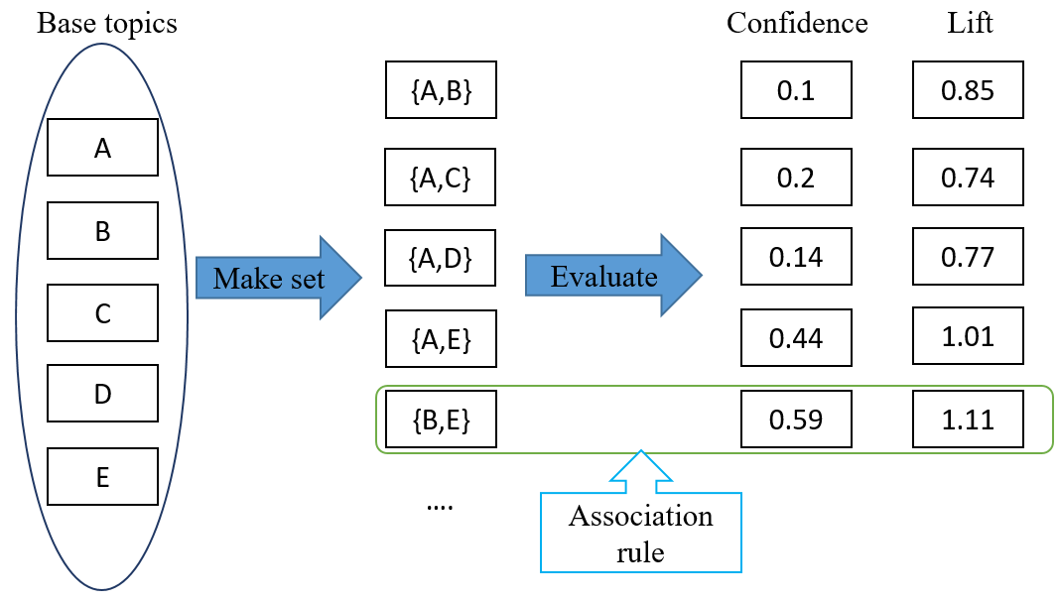
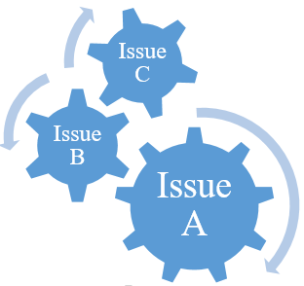
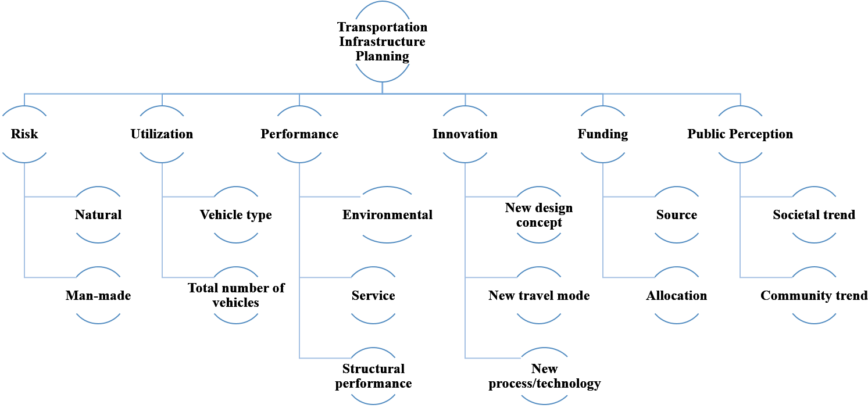
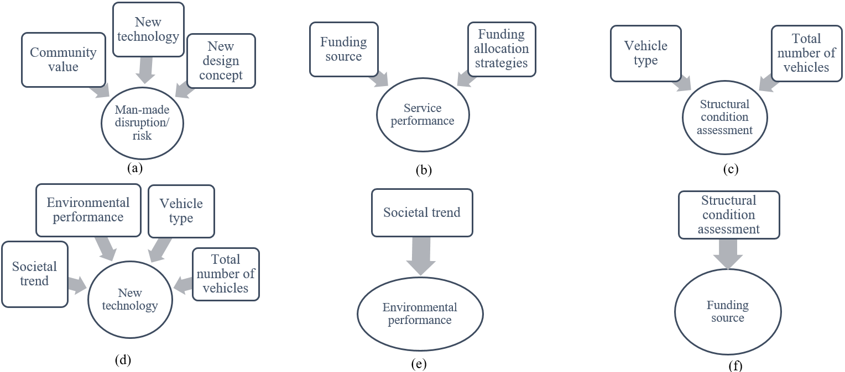
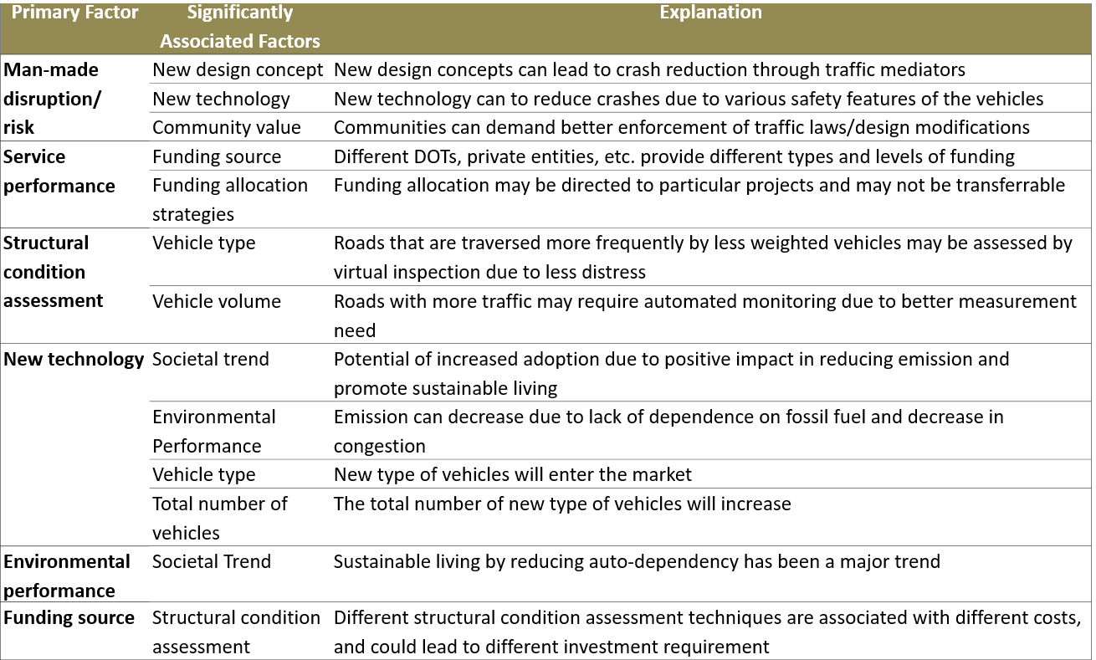
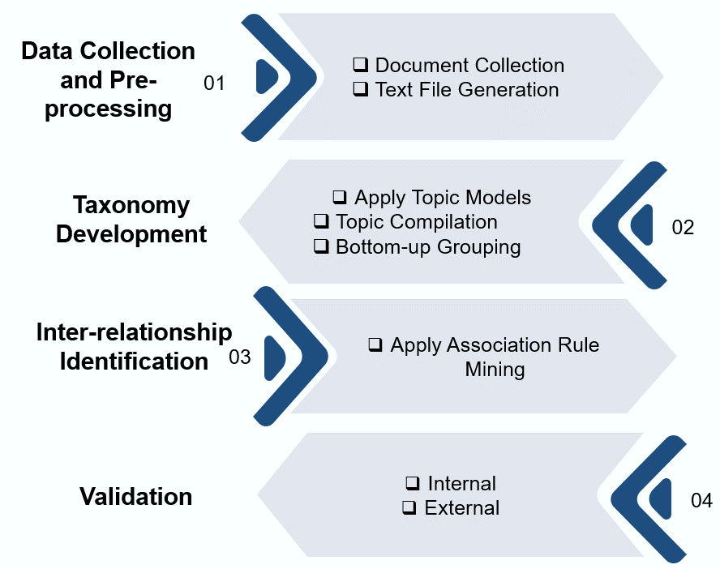
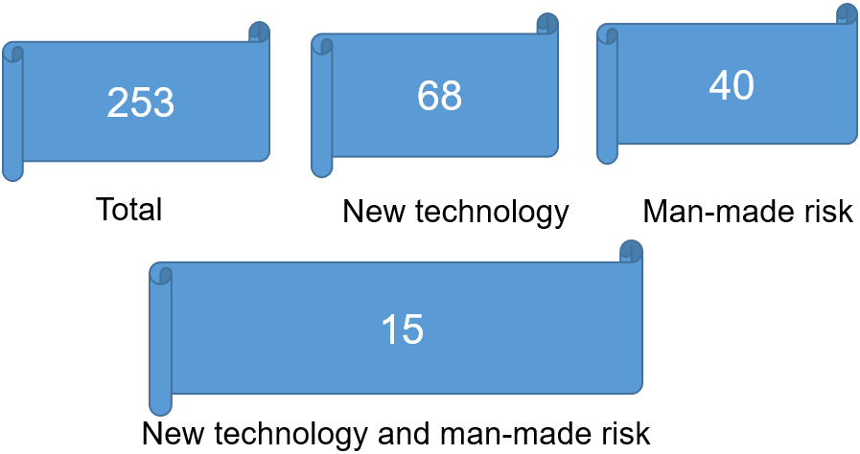
The Usage of Association Rule Mining towards Future-proofed Transportation Infrastructure Planning
Sudipta Chowdhury, Department of Civil and Environmental Engineering, University of Connecticut
Advisor: Jin Zhu, Ph.D., Department of Civil and Environmental Engineering, University of Connecticut
Background
Topic Modelling & Association Rule Mining
Transportation infrastructure planning is a complex process
Multitude of factors affect transportation infrastructures
There can be significant inter-relationships among these factors
$Support(X)$ : the proportion of observations in the database which contains item X
Measures of Interestingness:
High Confidence
High Lift
$$Confidence\left(X→Y\right)=\frac{Support(X→ Y)}{Support(X)}$$
$Support\left(X→Y\right)$: the proportion of observations in the database which contains both items $X$ and $Y$
$$Lift\left(X→Y\right)=\frac{Support(X→ Y)}{Support\left(X\right)∗Support\left(Y\right)}$$
Planning
B
C
W
A
Figure 5. High Association
Figure 3. Topic Modelling
Figure 4. Association Rule Mining
Results
Figure 1. Complexity in Transportation Infrastructure Planning
Research Objectives
Developing methodology for identifying the inter-relationships among different transportation infrastructure planning factors based on text-mining techniques
Research Methodology
Figure 8. 13 Significant Associations
The research methodology of this study primarily included four steps
Figure 6. Proposed Taxonomy
$$Confidence$$
$$\text{(}\text{New} \text{technology}→\text{man}\text{−}\text{made} \text{risk}\text{)}$$
$$=\frac{\frac{15}{253}}{\frac{68}{253}}=22.06\%$$
$$Lift$$
$$\text{(}\text{New} \text{technology}→\text{man}\text{−}\text{made} \text{risk}\text{)}$$
$$=\frac{\frac{15}{253}}{\frac{68}{253}∗\frac{40}{253}}=1.395$$
Table 1. Ranges of Confidence and Lift values
Range | Confidence | Lift
Low Medium High | [0.8%, 6.89%] [6.90%, 14.28%] [≥14.28%] | [0.05, 0.59] [0.60, 0.98] [≥0.99%]
Figure 2. Proposed Research Methodology
Figure 7. Sample Confidence and Lift Calculation
Figure 9. Sample Explanations of the Significant Associations
References
[1] Skorobogatova, O., & Kuzmina-Merlino, I. (2017). Transport infrastructure development performance. Procedia Engineering, 178, 319-329.
[2] Khanzadeh, M., et al. (2018). Porosity Prediction: Supervised-learning of Thermal History for Direct Laser Deposition. Journal of manufacturing systems, 47, 69-82.
Contributions
A formalized structure to collect, organize, analyse, and utilize information from different sources using text mining techniques
Help create holistic budget proposals, development plans, knowledge base, as well as manage risks and cultivate opportunities
Acknowledgement
This work was supported by U.S. DOT under its Transportation Infrastructure Durability Center
June 2019 – www.tidc-utc.org
Figure 5. Research Steps

