Slide 1
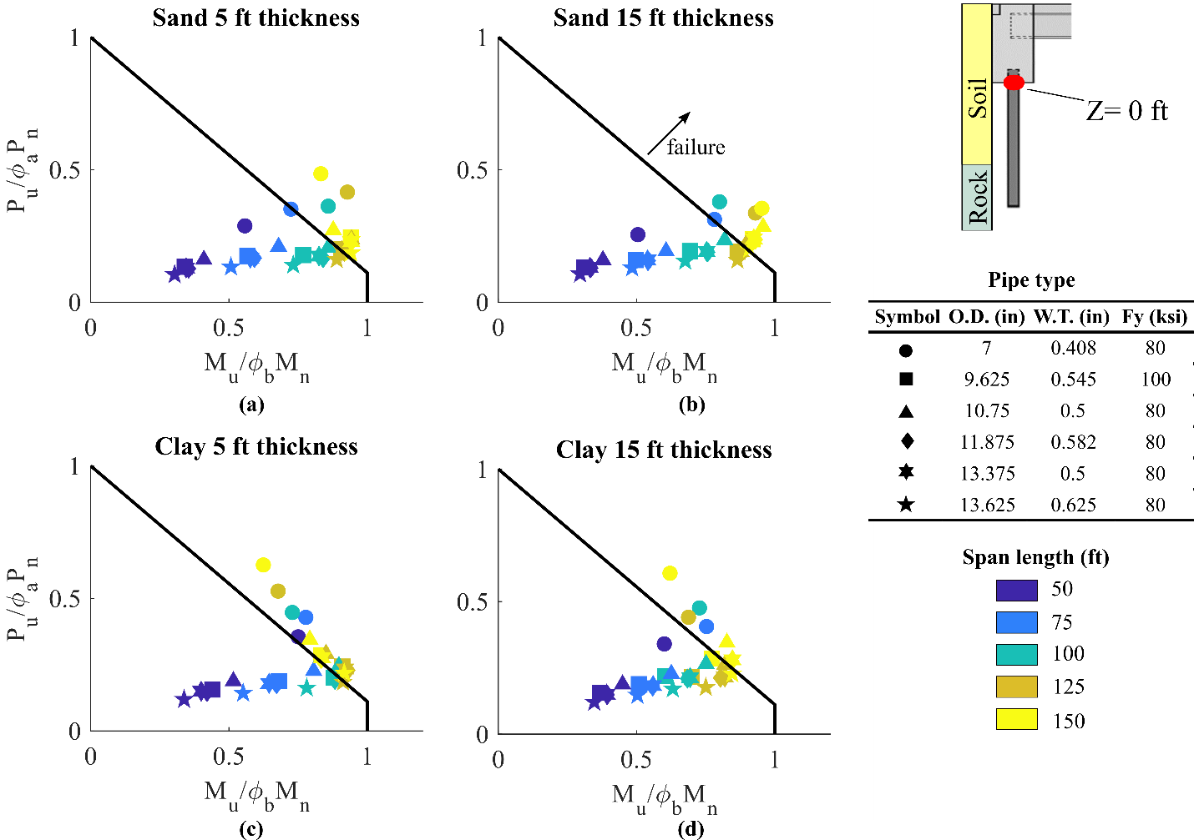
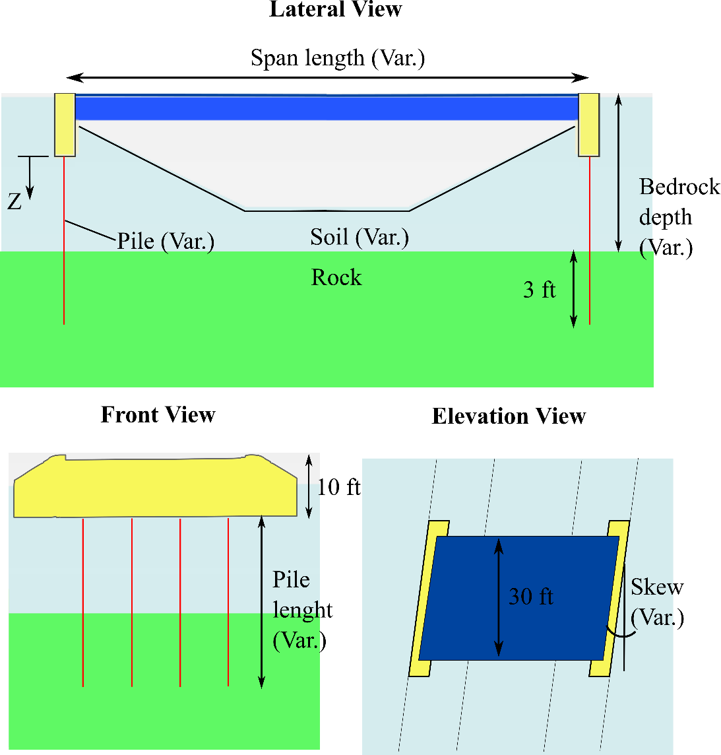
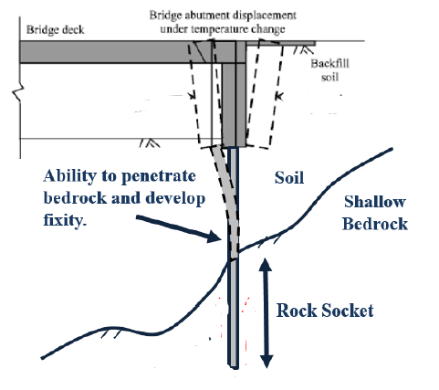
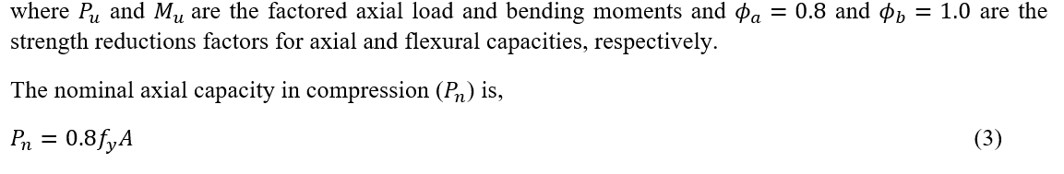
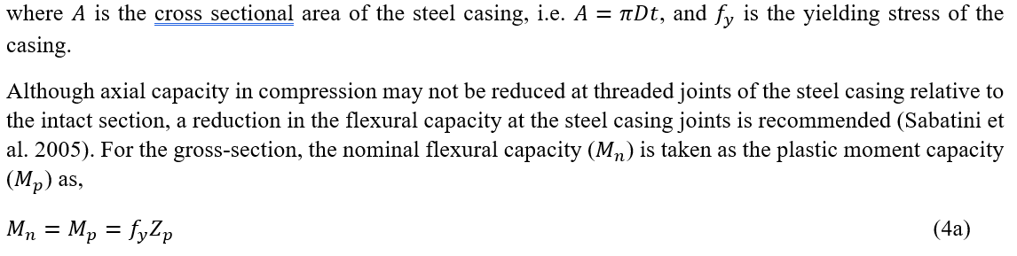

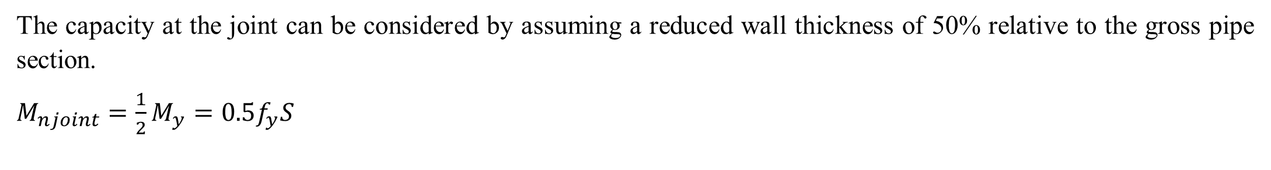
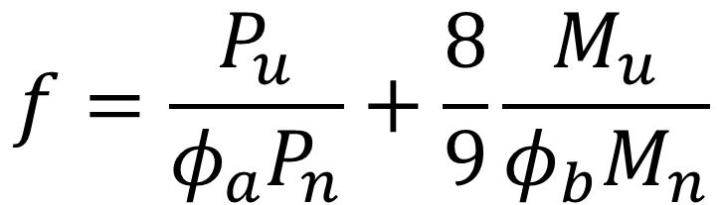
Assessment of Micropile Supported IABs
Sebastian Montoya-Vargas, Civil and Environmental Engineering, University of Maine, Advisors: Aaron Gallant and Bill Davids
INTRODUCTION
Integral abutment bridges (IABs) are the preferred bridge type utilized by the Maine Department of Transportation (MaineDOT) and other transportation agencies throughout the United States due to their durability and reduced upfront and life-cycle costs. Micropiles are small diameter drilled foundation elements that can penetrate through shallow bedrock and challenging subsurface conditions to facilitate IAB construction.
METHODS
To investigate applicable span lengths for several commercially available micropiles types commonly used in the United States, 3D finite elements analyses (FEAs) were performed using the commercial finite element code Plaxis 3D (v2020).
RESULTS
The applicable span lengths was examined through interaction diagrams for intact section (Figure 3) and f value contours for the joint (Figure 4).
Figure 3. Interaction equation (black line) for the “intact” gross-section at Z = 0.
Figure 2. Model geometry and terminology adopted for the parametric study of micropile-supported IABs.
Figure 4. Summary of depth limits where 𝒇_{𝒋oint} values exceed 1.
This parametric study focuses on the demand and capacity of both the intact (gross) and jointed sections of the micropile pipe casing for a broad range of conditions.
Figure 1. Schematic representation of micro-piles supported IAB
(Modified from FHWA, 2011)
$$f=\frac{P_{u}}{φ_{a}P_{n}}+\frac{8}{9}\frac{M_{u}}{φ_{b}M_{n}}$$
Section 6.5.4.2 from AASHTO
(AASHTO, 2017)
GOALS
To assess the structural capacity and applicable span lengths for micropile supporting IABs, considering the influence of bridge geometry and subsurface conditions
CONCLUSIONS
Plastic hinges were expected to develop at the base of the abutment for most micropiles considered once bridge span lengths exceeded 100 to 125 ft.
For shallow bedrock depths (5 ft. below bottom of abutment in this study) a joint is more likely to be overloaded before a plastic hinge develops at the base of the abutment for intermediate and longer spans (75-150 ft)
The capacity at the joint can be considered by assuming a reduced wall thickness of 50% relative to the gross pipe section.
$M_{njoint}={\frac{1}{2}M}_{y}=0.5f_{y}S$
FHWA reference manual (Sabatini et al. 2005)
$$f≥1 Exceeds combined capacity,$$

