Slide 1
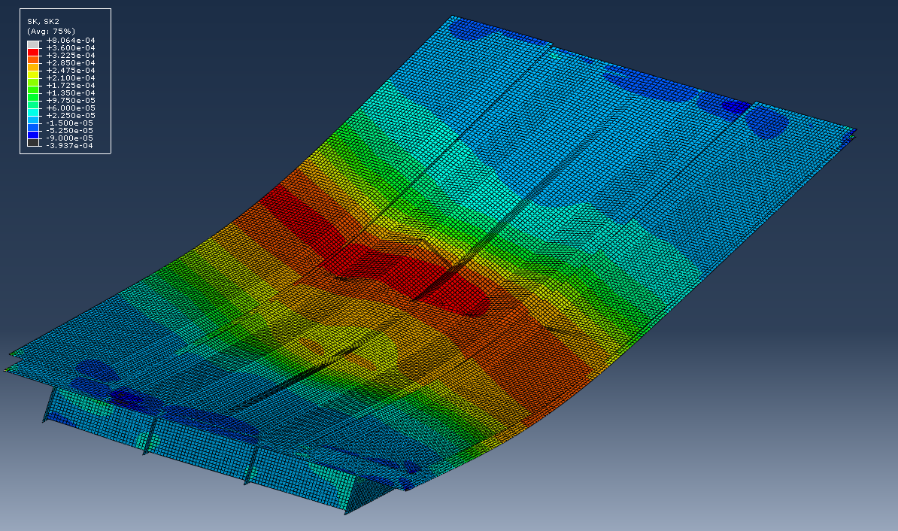
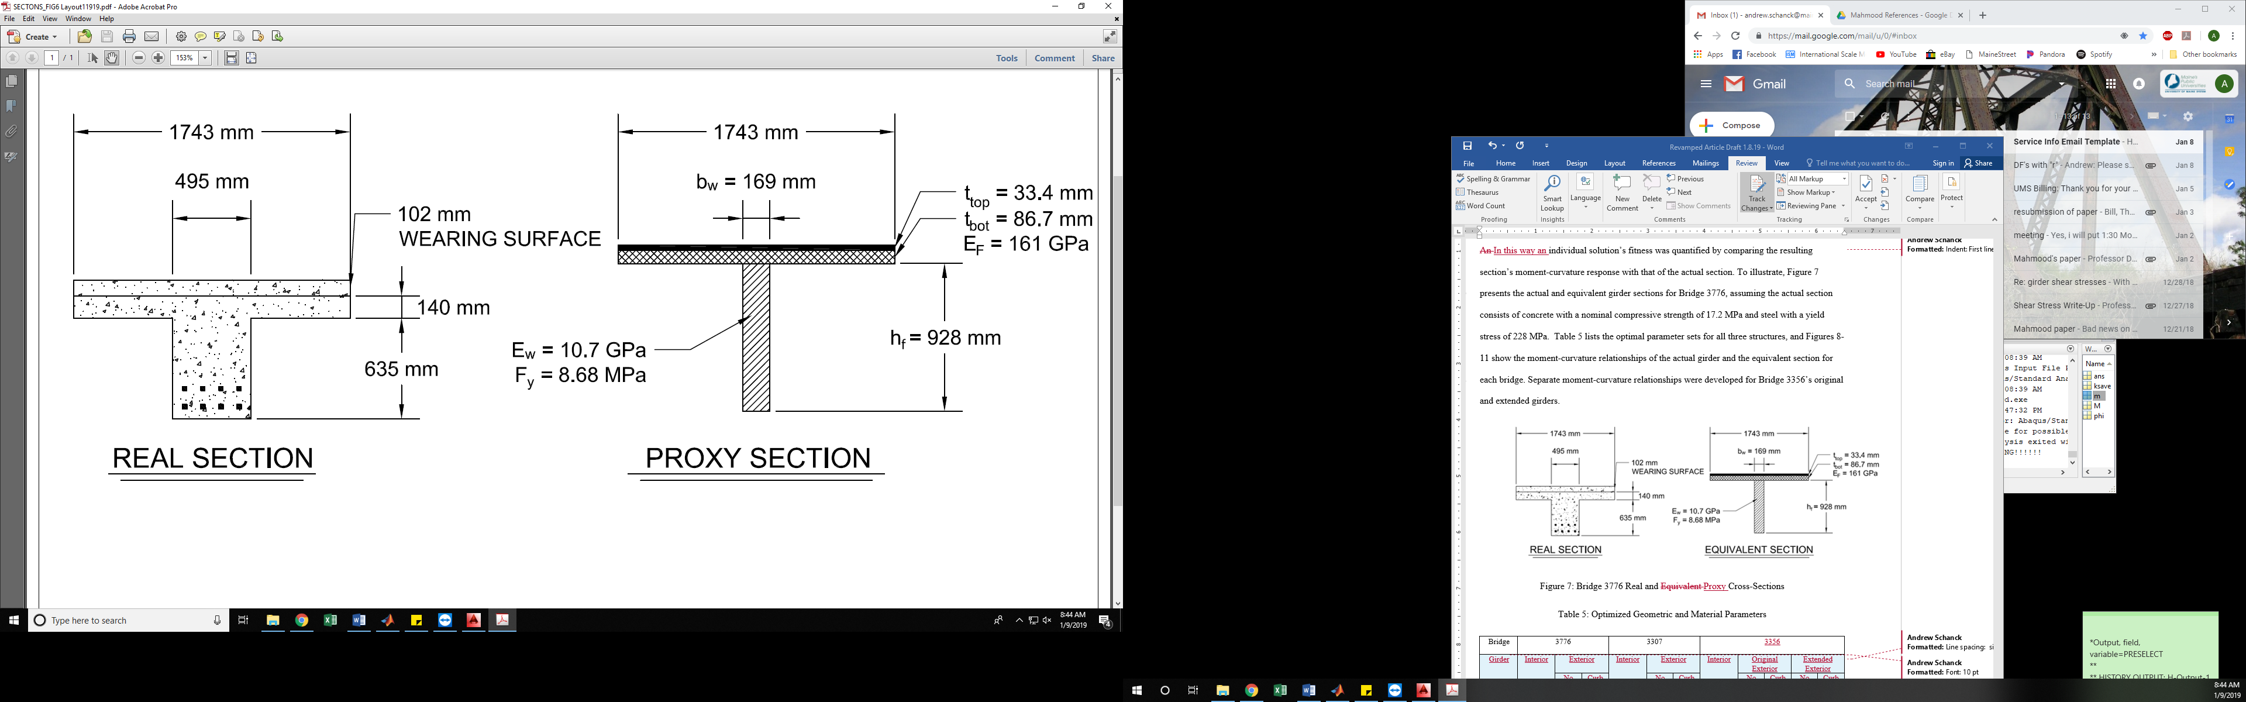

Improved Bridge Capacity Assessment by Nonlinear Proxy Finite-Element Analysis
Andrew Schanck, M.Sc., E.I., Civil and Environmental Engineering, The University of Maine Advisor: William Davids, Ph.D, P.E.
Motivation
Many bridges built in the first half of the 20th century are still in service today, carrying modern service-level loads without undergoing obvious damage. Despite this, conventional engineering analysis often predicts that these structures lack the strength to carry modern traffic, leading to costly load restrictions, repairs and replacement. While field live-load testing can be used to assess bridge response to heavy truck loads, these assessments are extrapolations of linear, service-level behavior, ignoring structures’ post-linear behavior. Here, a novel and computationally efficient numerical modeling technique – Nonlinear Proxy Finite Element Analysis (PFEA) – is developed to overcome limitations of physical testing and provide realistic capacity estimates by accounting for load redistribution and ductility.
3. Use PFEA Used to Determine Ultimate Capacity
3. PFEA led to significant increase in controlling rating factors
Table 1: Initial and Updated Rating Factors
Bridge | 2130 | 3307 | 3356 | 3776 | 5432 | 2390 | 2879 | 3848 | 5109 | 5489
Initial RF | 0.92 | 0.92 | 0.28 | 0.69 | 0.75 | 0.76 | 1.09 | 0.89 | 0.69 | 0.78
Field Test | 1.28 | 1.61 | 0.30 | 1.20 | 1.10 | 0.84 | 1.35 | 1.15 | 0.94 | 1.10
PFEA | 1.87 | 1.30 | 1.83 | 1.43 | 1.96 | 1.56 | 2.23 | 1.72 | 2.35 | 1.91
Extensions to and Uses of PFEA
Effects of deck skewness explicitly incorporated
Results of analyses used to rate bridges for shear capacity
Effects of prestressing incorporated into the moment-curvature relationship extraction process – validated against results of a full-scale destructive bridge test available in the literature
Results of PFEA analysis used to justify loosening of load restrictions on MaineDOT Bridge 5109
Figure 3: Deformed Shape of PFEA Model at Ultimate Capacity
Overview of Technique
1. Extract Moment-Curvature Behavior, Create a Proxy Section using Nonlinear Optimization, Verify in ABAQUS
Results
1. Constitutive models and moment-curvature extraction process verified against previous tests of reinforced concrete beams
Figure 1: Comparison of Geometric and Constitutive Properties of Real and Proxy Sections
Figure 4: Validation of PFEA Prediction against Lab Beam Tests
Figure 6: Prediction of Prestressed Bridge Load-Deflection Response to Failure
2. PFEA accurately predicted redistribution of load after individual girder softening
Conclusions
PFEA can accurately predict a bridge’s behavior at ultimate capacity including load redistribution, ductility, and nonlinear material behavior
PFEA can be a useful tool in bridge capacity rating that can prevent costly remedial action and avoid field load tests
With minimal, straightforward alteration of the moment-curvature extraction and modeling processes, PFEA’s utility can be expanded to cover bridges for which it was not initially designed
PFEA’s mechanics basis and built-in conservatism justify its use for bridge analysis, and has been successfully used to update the rating of a real bridge
Figure 2: Actual, Proxy, and Implemented Moment-Curvature Relationships
Figure 5: Demonstration of Load Redistribution at Higher Loads
October 2021 – www.tidc-utc.org

