Slide 1
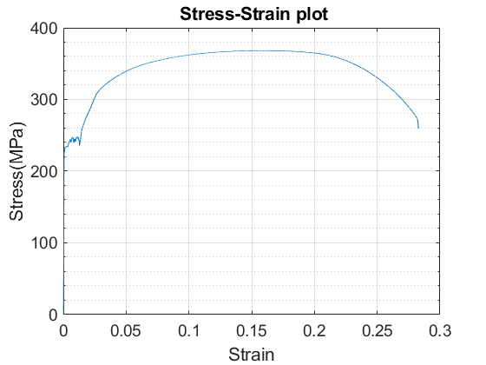
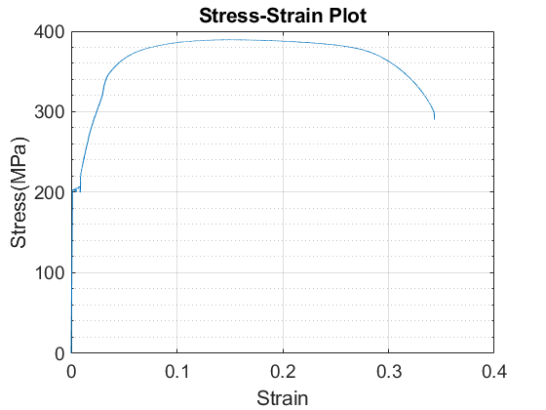
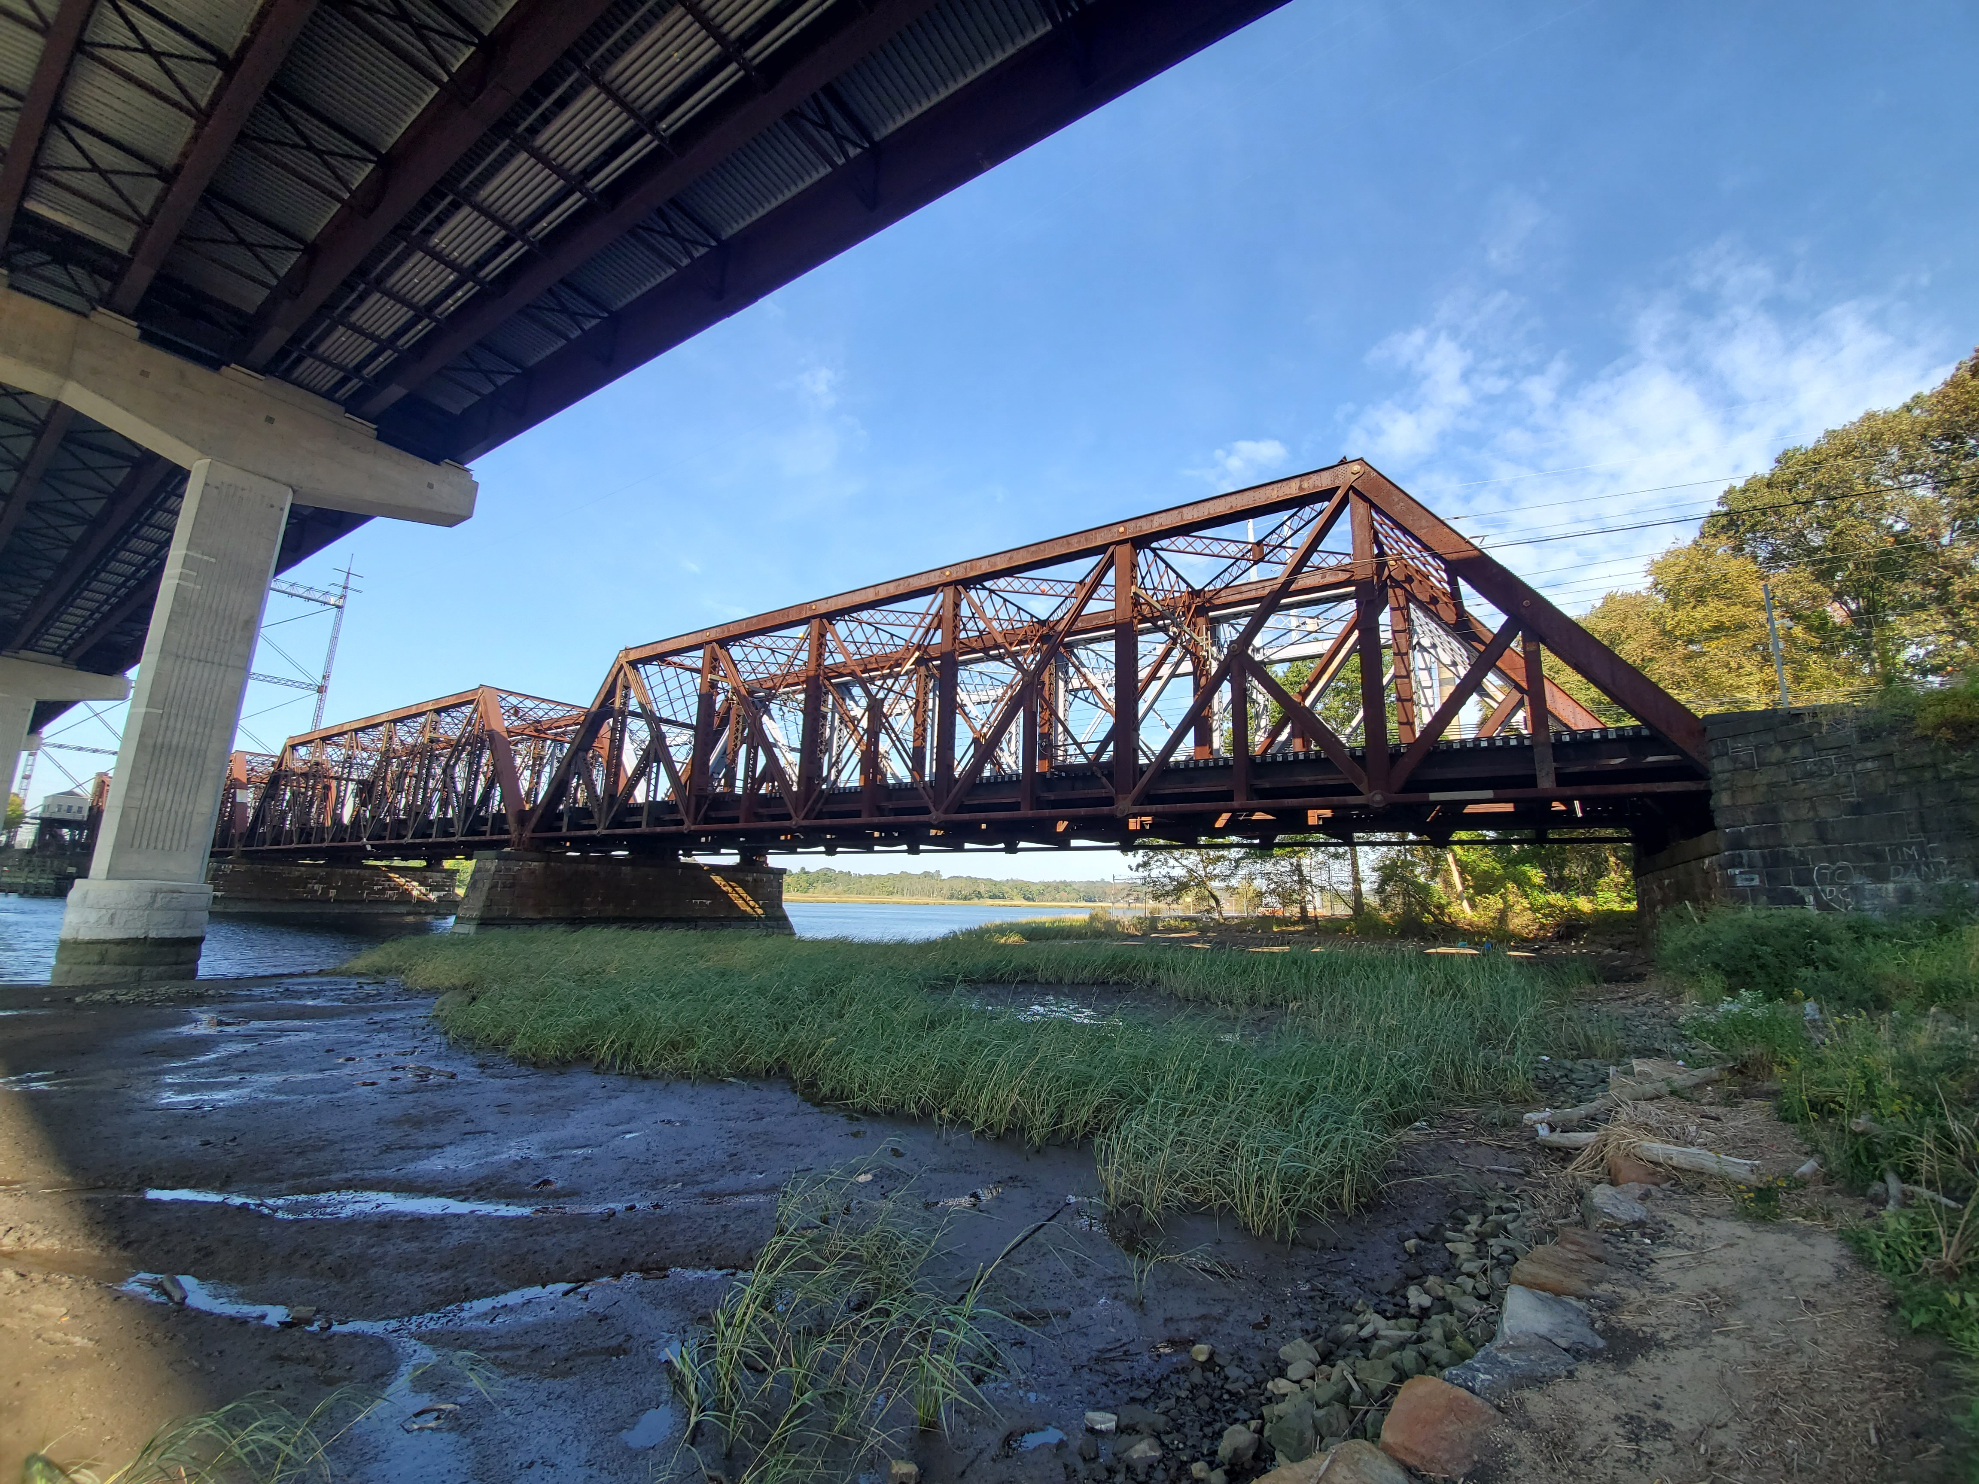
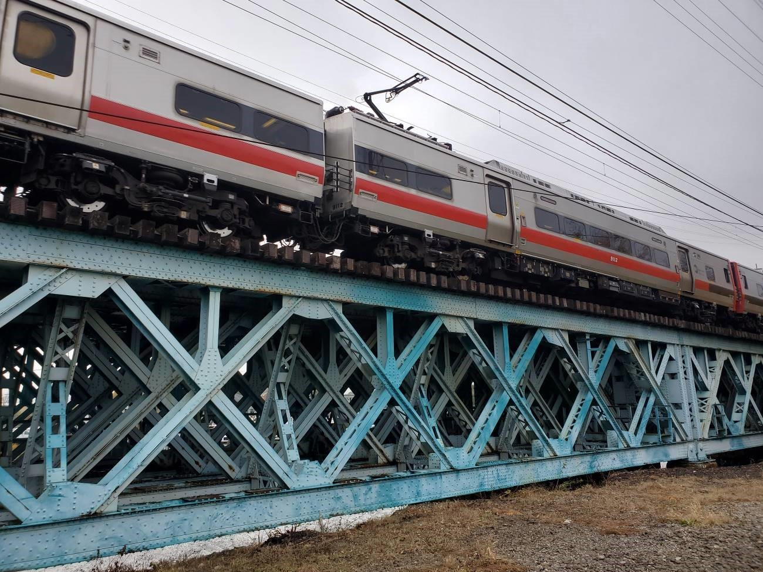
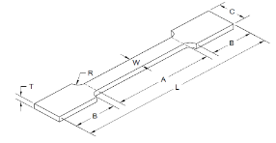
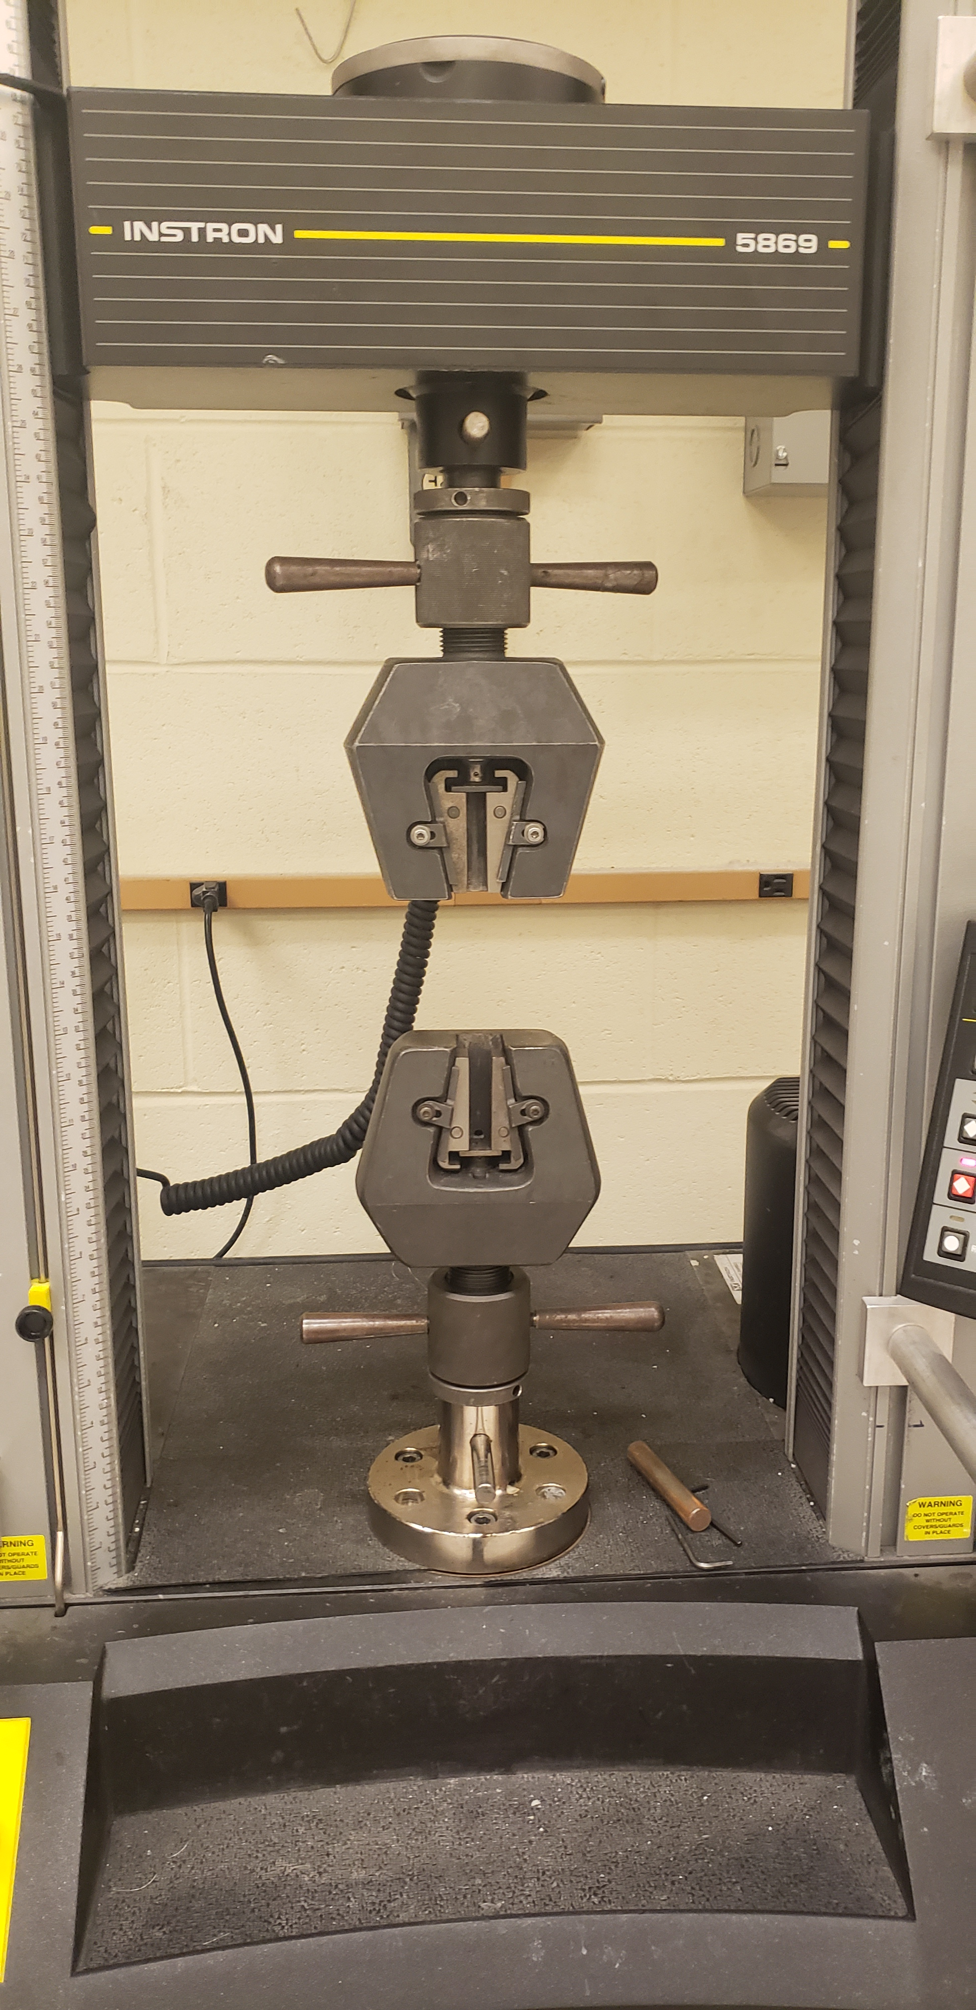
Tensile properties of Two Old Railroad Steel Bridges in Connecticut
Author: Santosh Dhakal (M.S. Student) Co-Author: Celso Cruz De Oliveira (Ph.D. Student) Advisor: Ramesh Malla, Ph.D., F. ASCE, F. EMI
University of Connecticut, Storrs
Introduction
Most of the railroad bridges in service in the New England area were built more than a century ago using ASTM A7 steel, which was later withdrawn and replaced by ASTM A36 in 1967. So, it is imperative to understand the mechanical behavior of such outdated material to avoid any possible catastrophic failure.
Methodology
Dog bone shape specimens with gage length, width and thickness 2”, 0.5” and 0.29” respectively were prepared according to ASTM E8 specification as shown in figure 2 Testing was performed using Instron 5869 as shown in figure 3. Elongation in the specimen was recorded using an extensometer from the Instron.
Figure 4: Cos cob bridge on the left, and Devon Bridge on the right
Thus obtained results are compared with the ASTM A7-1939 specifications and the results on the Fritz Laboratory report,. This comparison shows that the test results are very close to those defined in the specification and the report.
Figure 1: Devon Bridge on the left, and Cos Cob Bridge on the right.
Objectives
The objective is to present the tensile properties of the critical members from the Devon and the Cos Cob bridges obtained from the tensile test (monotonic loading to failure).
Figure 2: Instron 5869
Figure 3: Tensile Specimen
Conclusions
The material has maintained their elastic, yielding, plastic deformation, and strength hardening characteristics. More testing are to be performed at different loading condition to better understand these behavior of these materials.
Literature Review
Based on ASTM A7-1939 specifications, Yield Stress is defined as 33,000 psi (227.5 MPa), Ultimate Stress is defined as 66,000 psi (455 MPa) and Maximum Elongation 22%.
Based on Fritz Laboratory Report – 1963 (Rao,1963), Yield Strain is defined as 0.112%, Yield Point Elongation Strain is defined as 1.4%, and Young’s Modulus is defined as 29,600 ksi ( 204000 MPa )
Bridges
Devon Bridge, Located over the lower Housatonic river between Milford and Stratford. Built by American Bridge Company in 1906 and owned by ConnDOT, this bridge is a combination of deck girder, Warren trusses and Scherzer rolling Lift Bascule. The sample material from the stringer angle.
Acknowledgments
This work is partially supported by the Transportation Infrastructure Durability Center under grant 69A3551847101 from the U.S. Department of Transportation’s University Transportation Centers program. The research team would like to thank to Metro North Railroad and ConnDOT for their support throughout this research.
Results
Results from one of the specimen for each bridge are presented in the table 1. Corresponding stress-strain plots are shown in fig 4.
Table 1: Tensile test results: Cos Cob and Devon Bridge
References
ASTM A7-39. (1939). Standard Specifications for STEEL FOR BRIDGES AND BUILDINGS’.
Nagaraja, Rao, N. R., "Material properties of structural carbon and high strength steels, August 1963" (1963).Fritz Laboratory Report. Paper 1681.
http://preserve.lehigh.edu/engr-civil-environmental-fritz-lab-reports/1681
Cos Cob Bridge, Located over Mianus river in Greenwich, I Built by American Bridge Company in 1904 and owned by ConnDOT, this bridge is a combination of deck girder, deck trusses and rolling lift bascule. The Sample Material was collected from the bracing members of the adjacent pedestrian bridge.
September 2020 – www.tidc-utc.org

