Slide 1
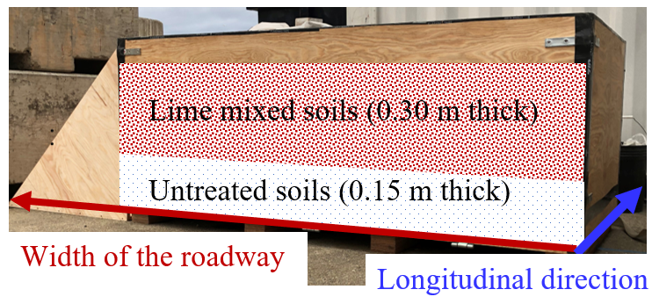
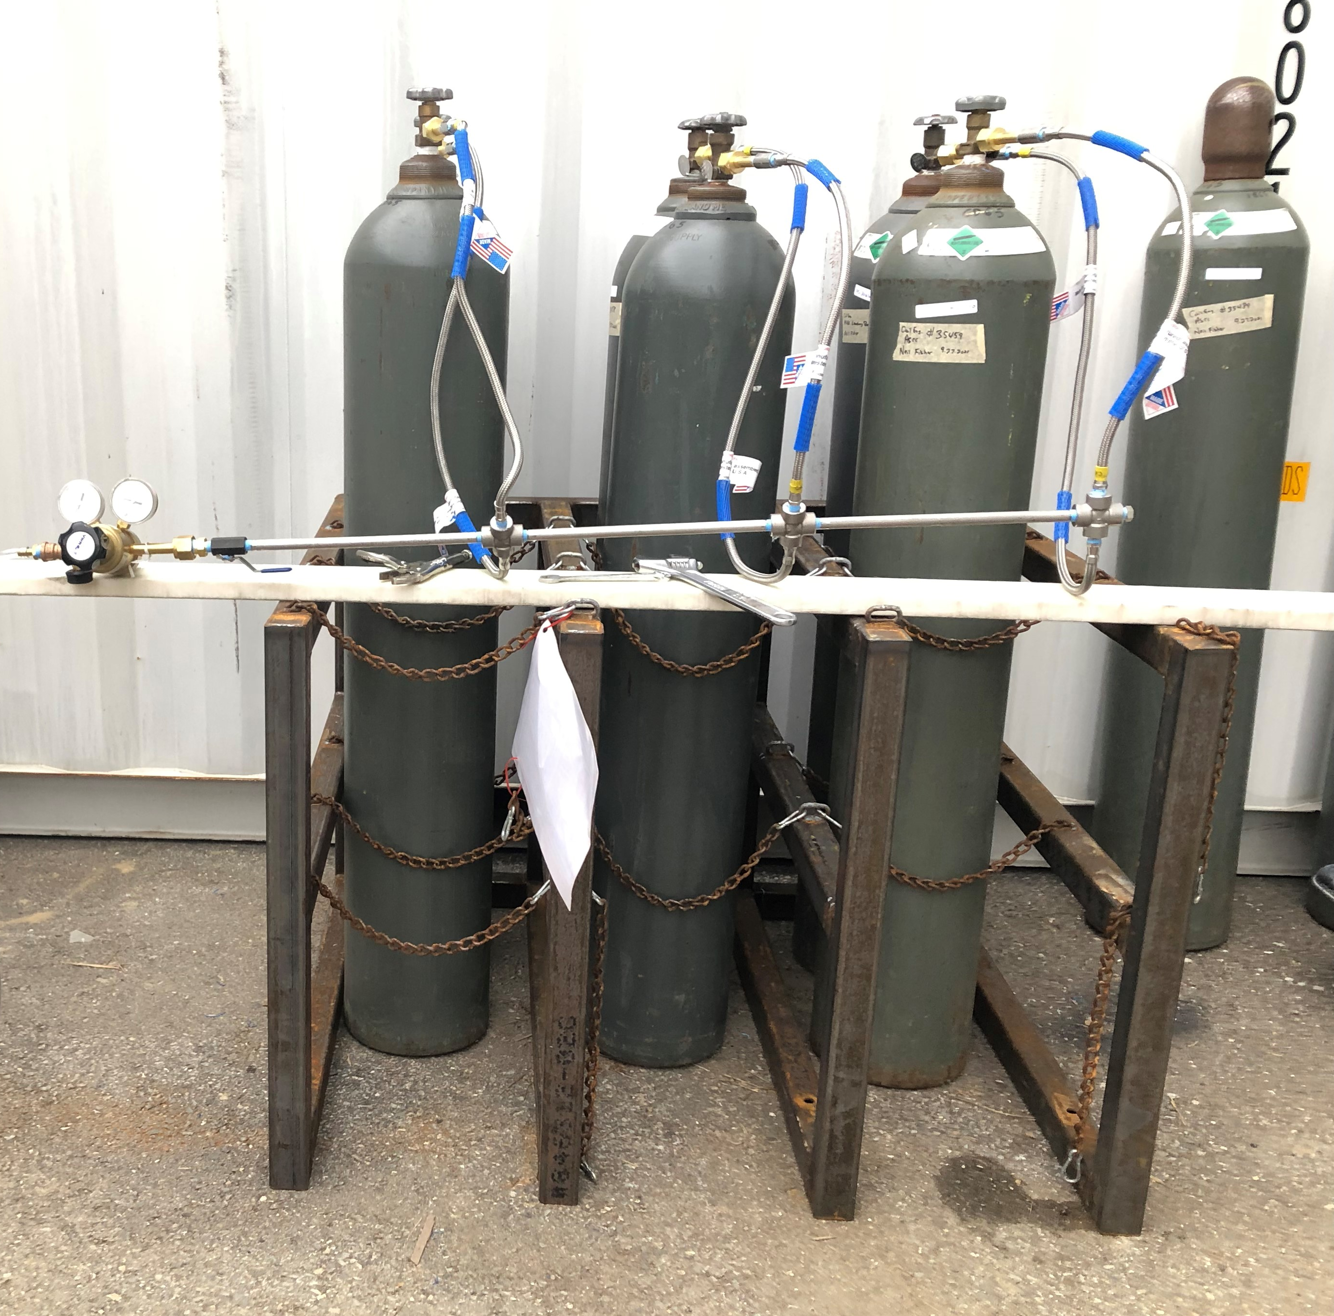
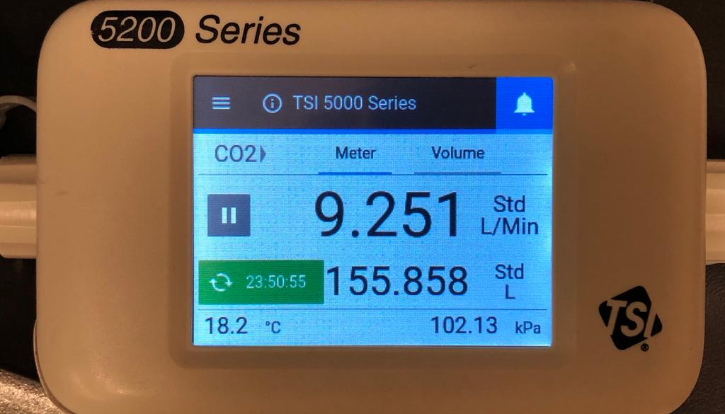
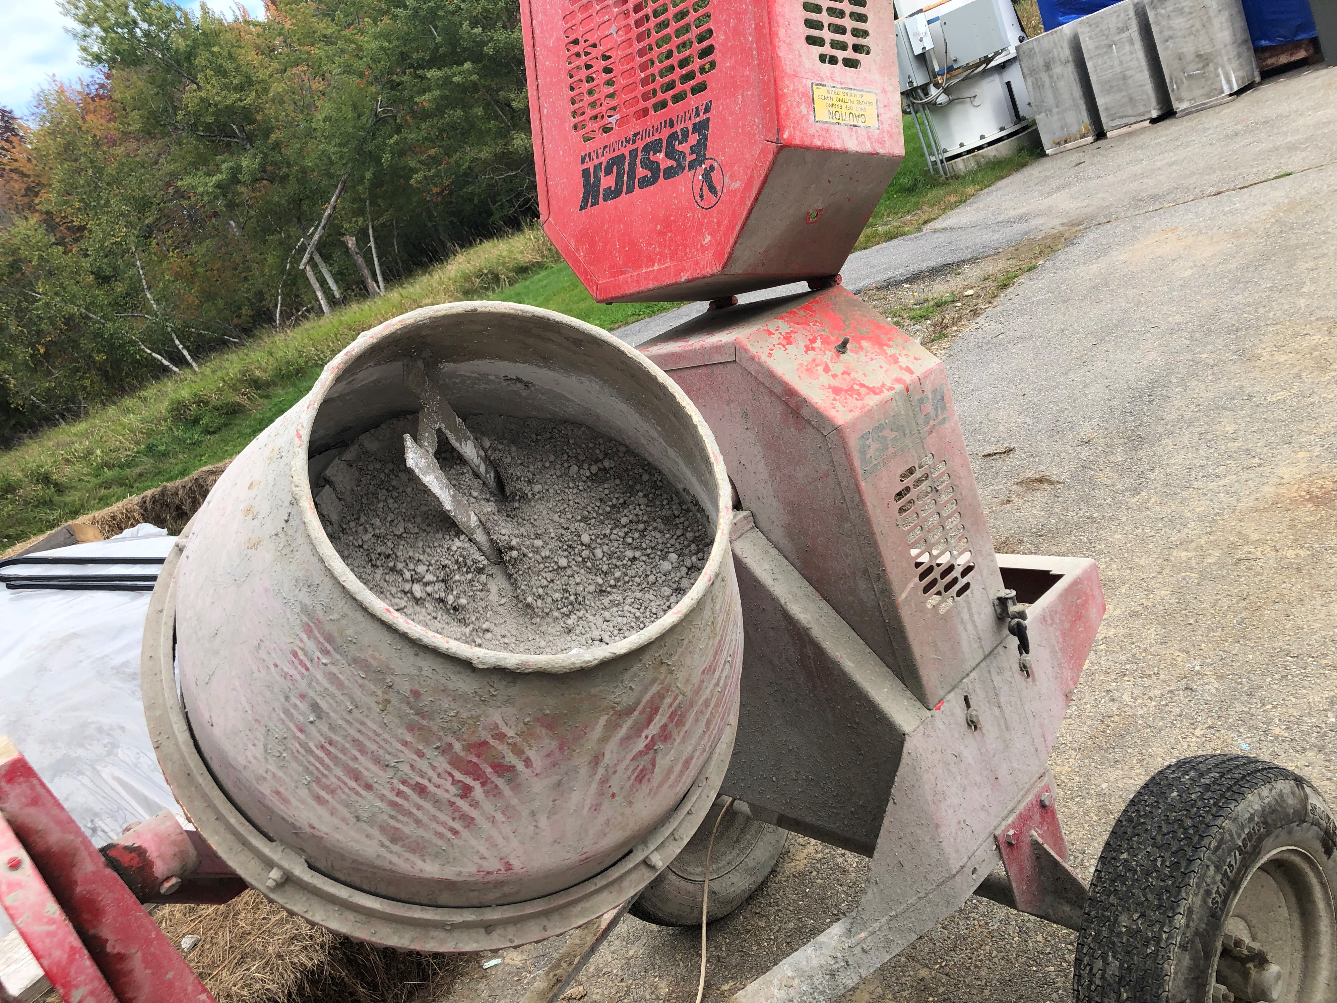
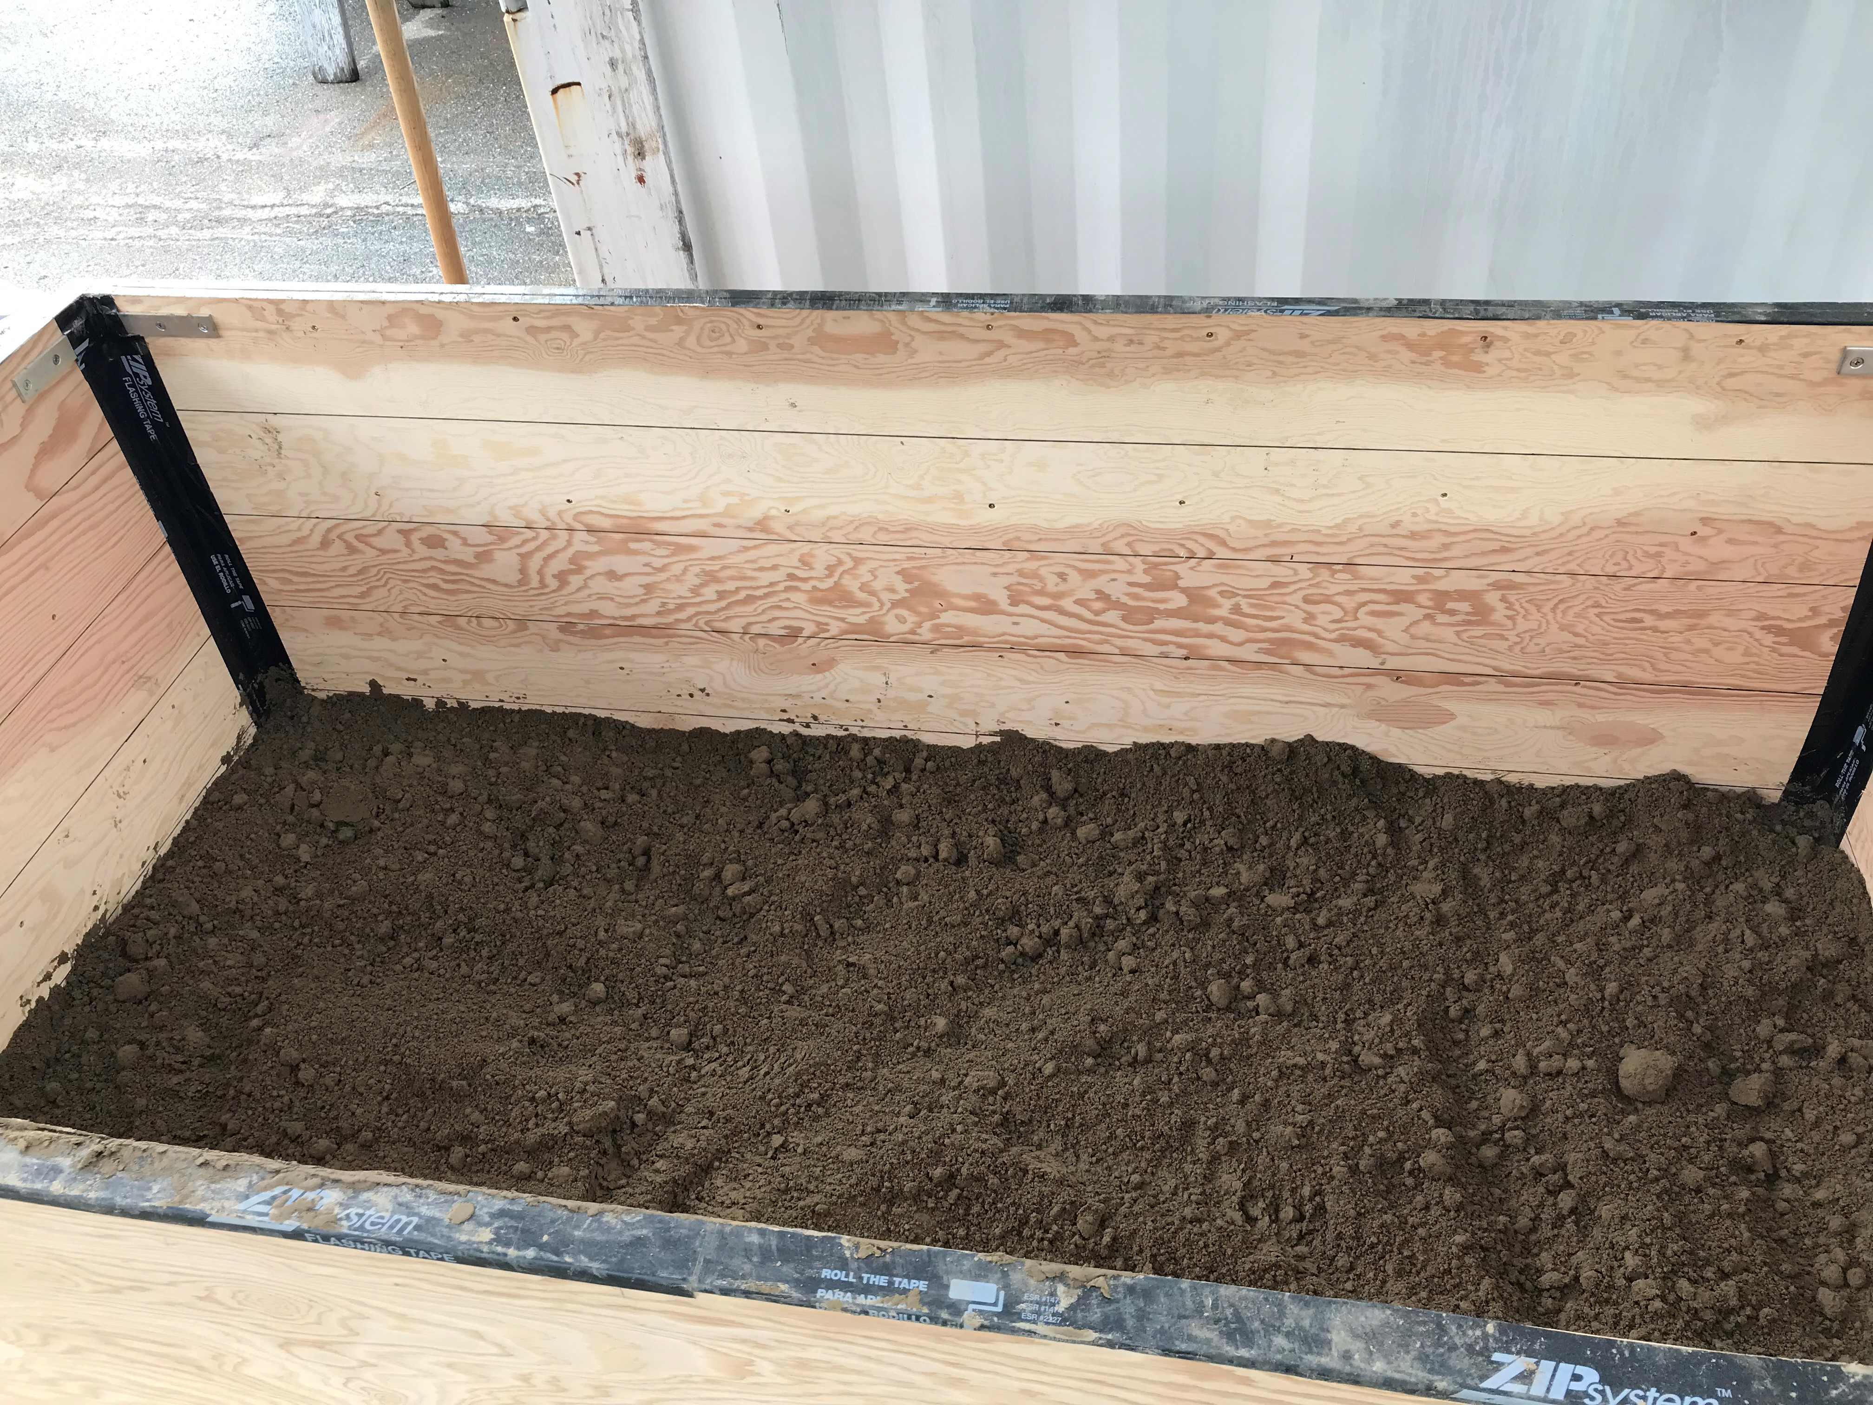
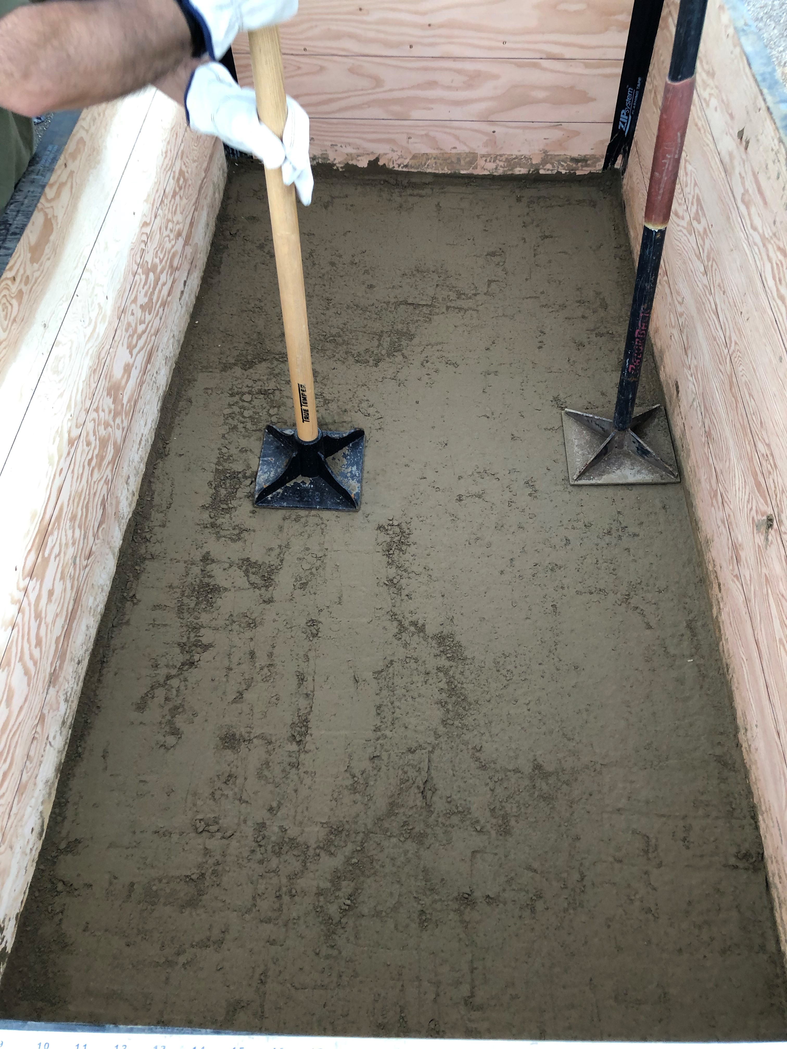
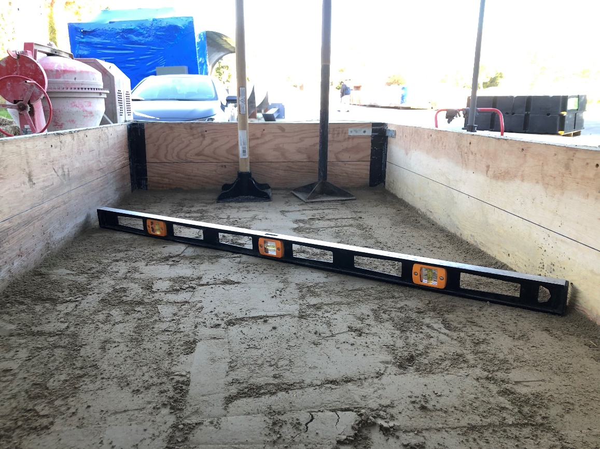
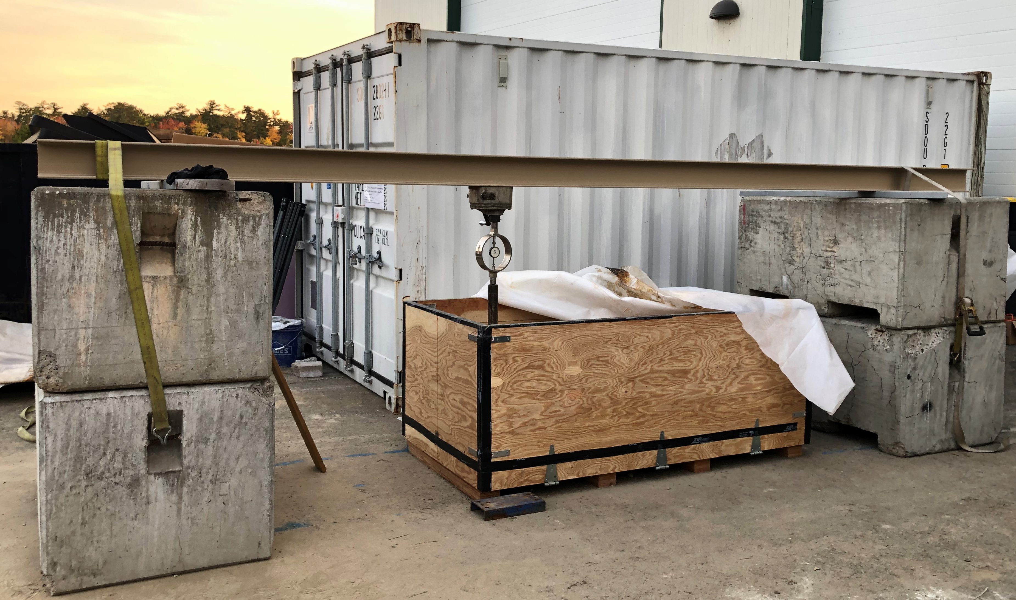
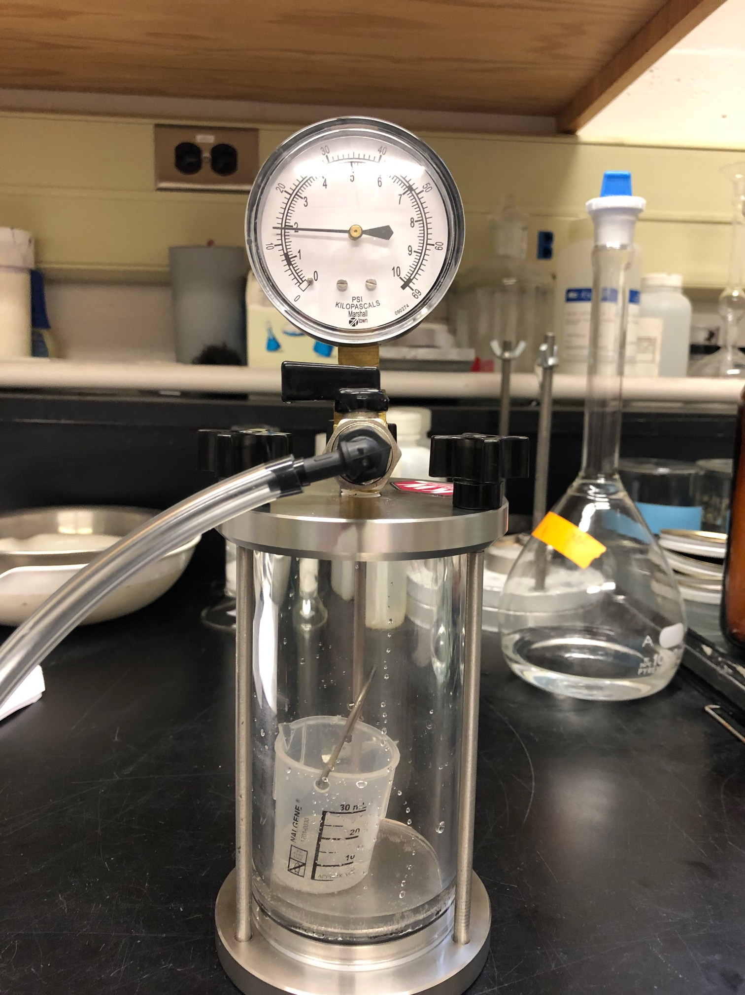
Implementation of Soil Carbonation for Subgrade Stabilization
2021 TIDC Annual Student Poster Competition
SK Belal Hossen, EI¹, Aaron P. Gallant, PhD, PE² and Warda Ashraf, PhD³
¹Graduate student, Civil and Environmental Engineering, University of Maine, Orono, Maine, USA. e-mail: sk.hossen@maine.edu; ²Assistant Professor, Civil and Environmental Engineering, University of Maine, Orono, Maine USA. e-mail: aaron.gallant@maine.edu;
³Assistant Professor, Department of Civil Engineering, Center for Advanced Construction Materials (CACM), University of Texas at Arlington, Texas, USA. e-mail: warda.ashraf@uta.edu
1. Motivation/Background
2. Field investigation- instrumentation and testing
Objective
Soil carbonation
Effective means to introduce the gaseous CO₂ into subgrade soils with optimum performance (in terms of maximum binder formation with minimal gas loss and strength improvement)
Ca(OH)₂ [s]+ H₂O [l] + CO₂[g] CaCO₃ [s] (↓) +2H₂O[l]
CO ₂ Gas
Step 1
Step 2
Ca²⁺ + CO₃²⁻ = CaCO₃
Untreated soils
Carbonation
Cementation in soils
Note: s=solid, l=liquid, g=gas, ↓=deposited
Gas mass flow meter
Fig 1.) Reaction mechanism for soil strength improvement
Potential benefits
Utilize and store CO₂ gas into subgrade soils→ more sustainable and environmentally friendly
Relatively faster strength improvement→ reducing construction time and/or construction costs
Soil box (2 m in length, 1 m in width and 0.75 m in height)
Manifold for CO₂ Gas cylinders
Fig 3.) Carbonation in the box
Mixing
Box preparation in layers
Performance of soil carbonation on the laboratory scale
Compaction
After completion
Fig 4.) Soil box preparation
Testing
b.) installation in the soil box
a.) Bender Element (BE)
Fig 5.) Shear wave measurement
Fig 6.) Field CBR testing setup
Fig 7.) Binder content measurement
Fig 2.) Relationship between UCS and binder content of carbonated sand mixed with 10% lime
Funding for this research is provided by the Transportation Infrastructure Durability Center at the University of Maine under grant 69A3551847101 from the U.S. Department of Transportation’s University Transportation Centers Program.
October 28, 2021

