Slide 1

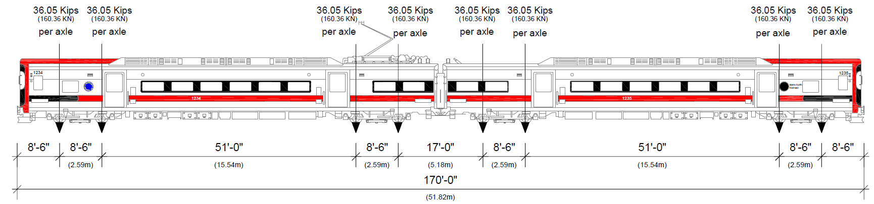
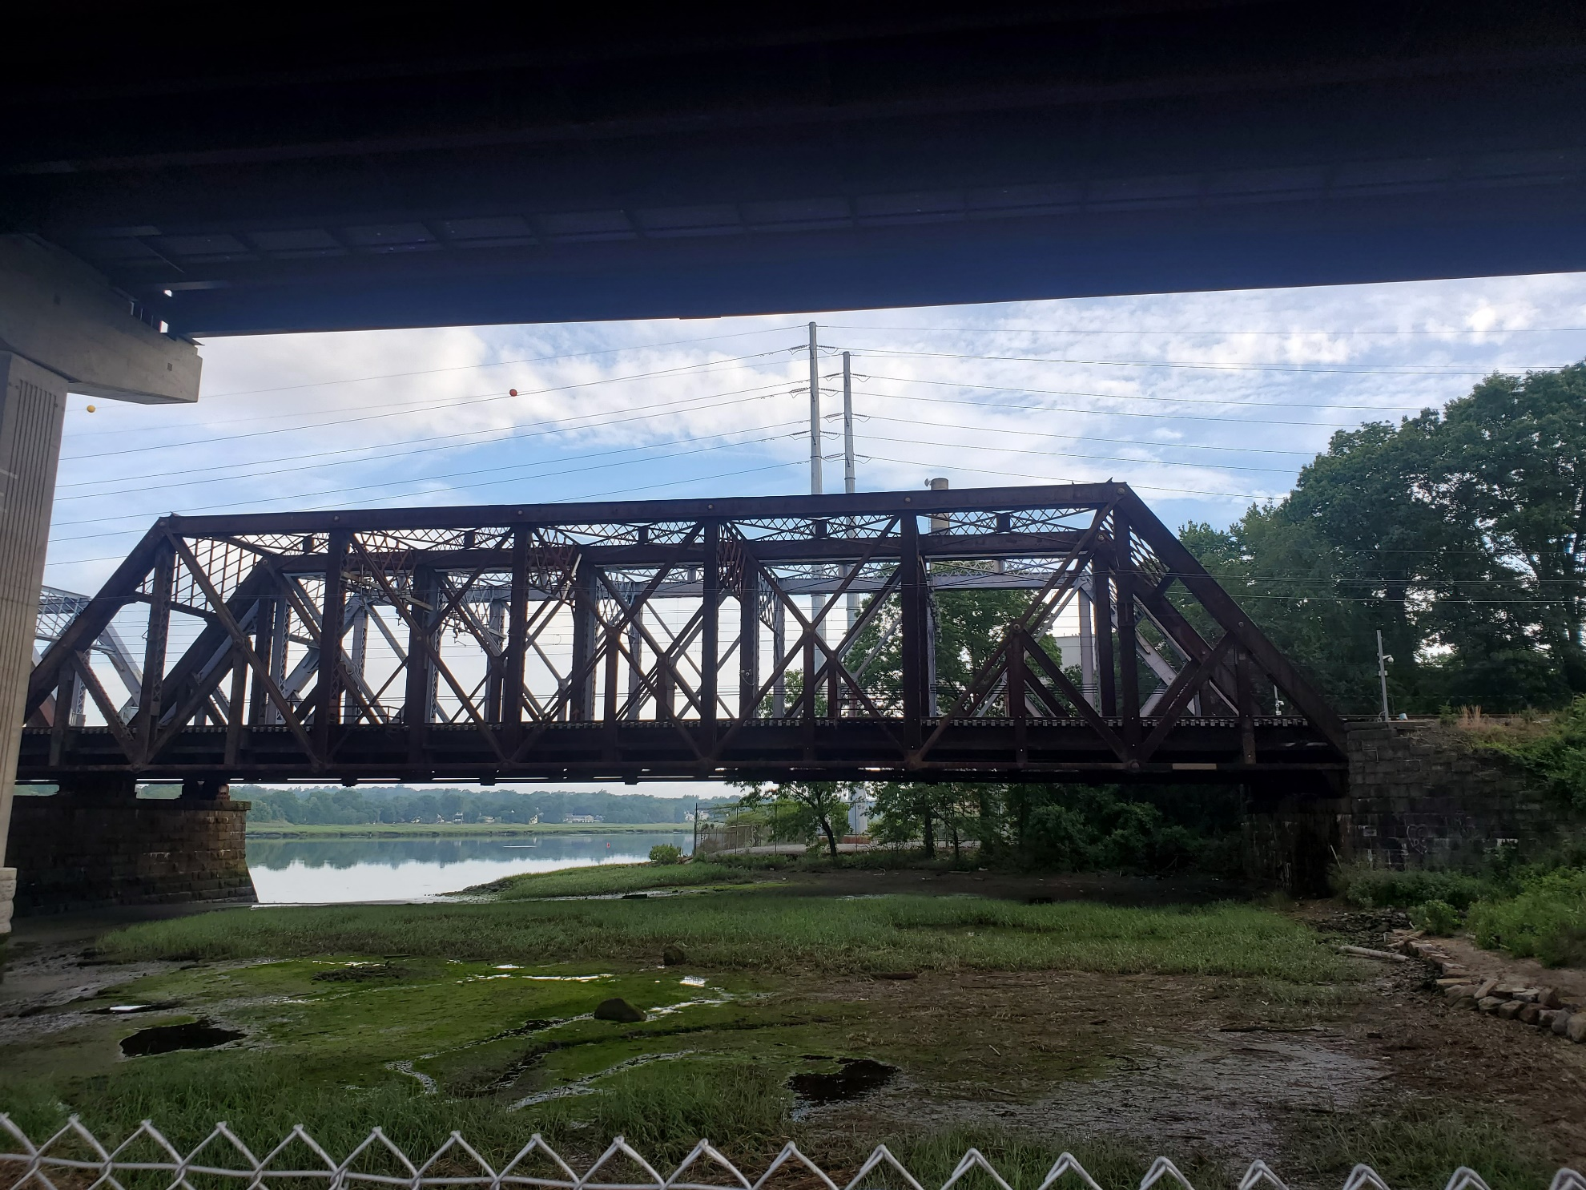
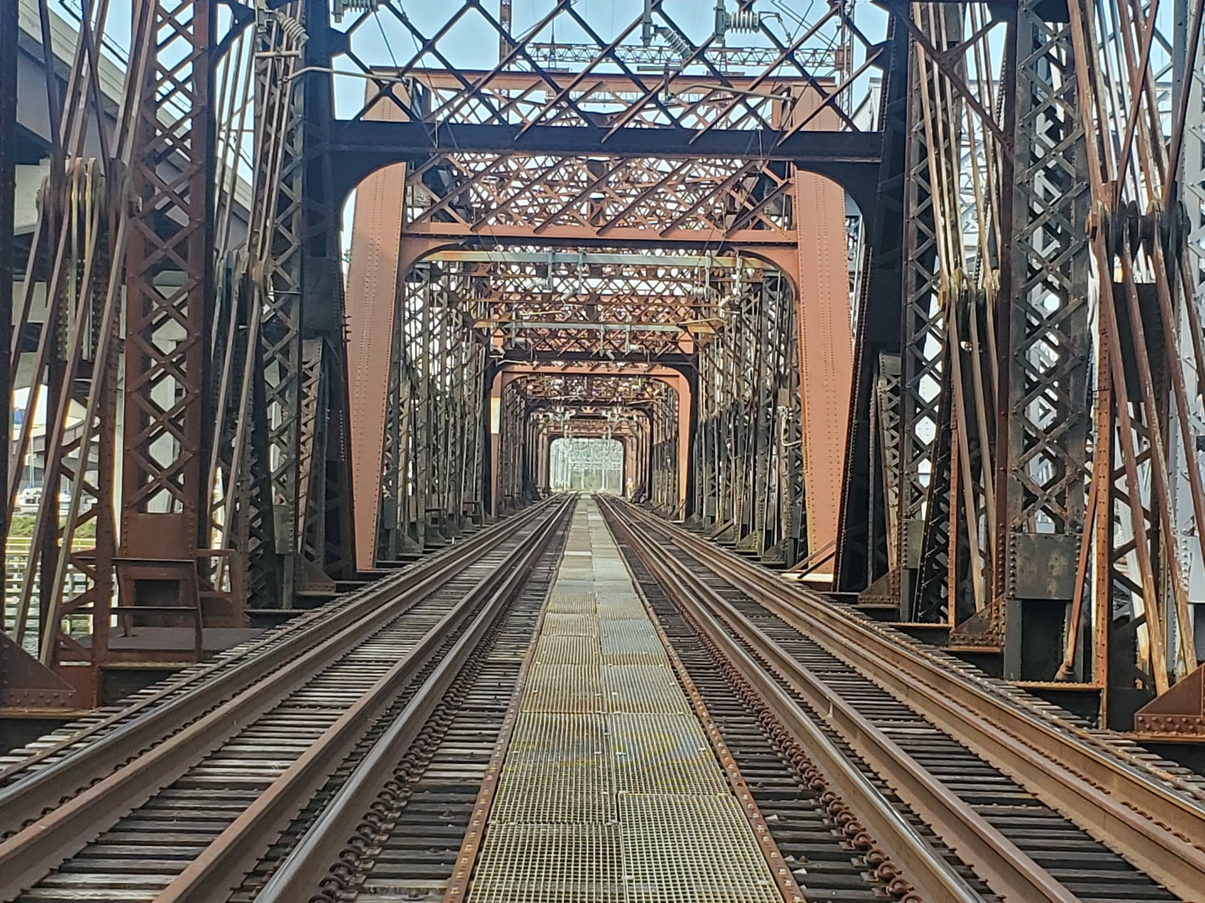
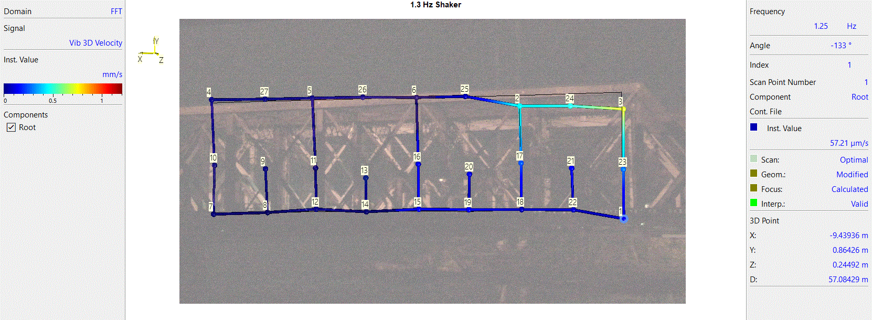
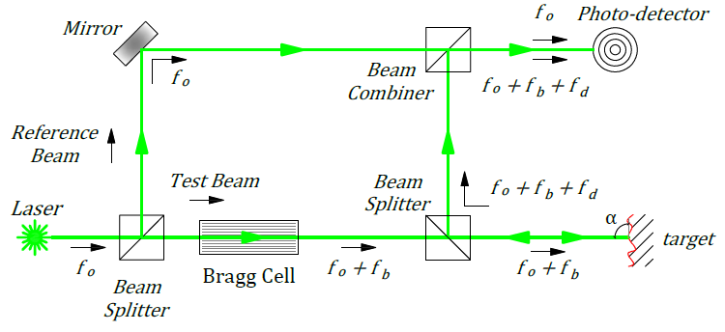
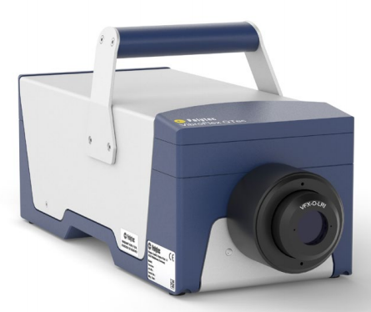
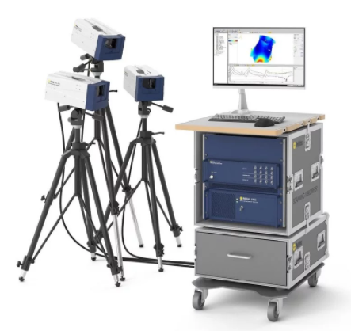
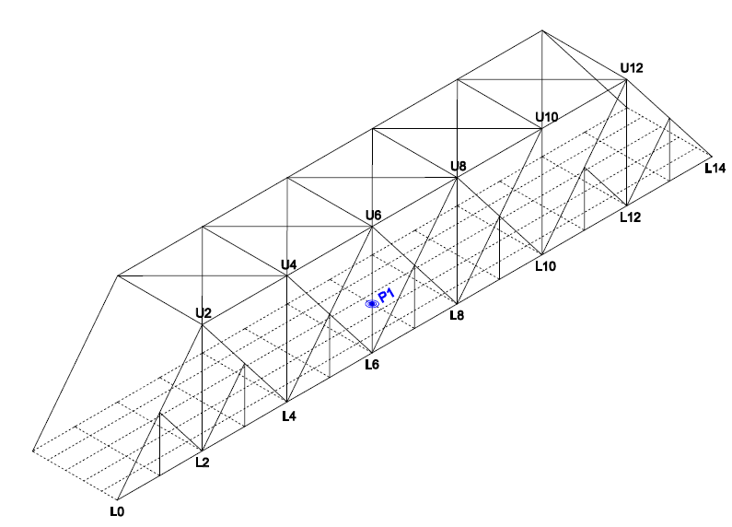
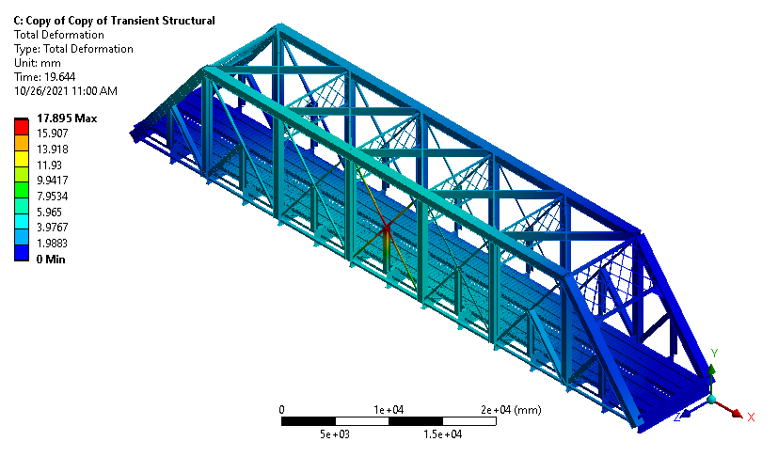
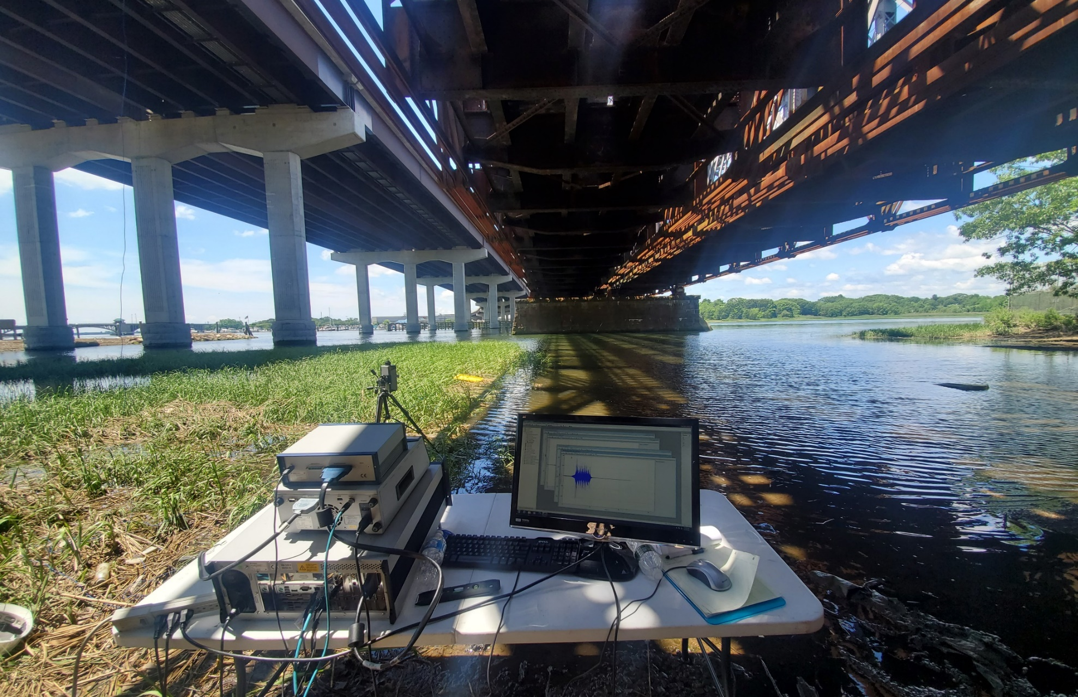
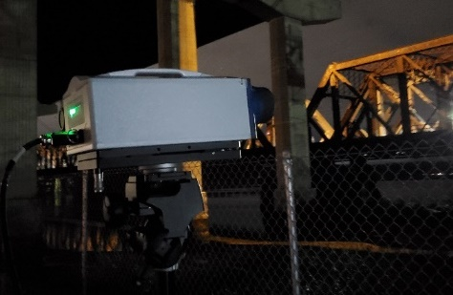



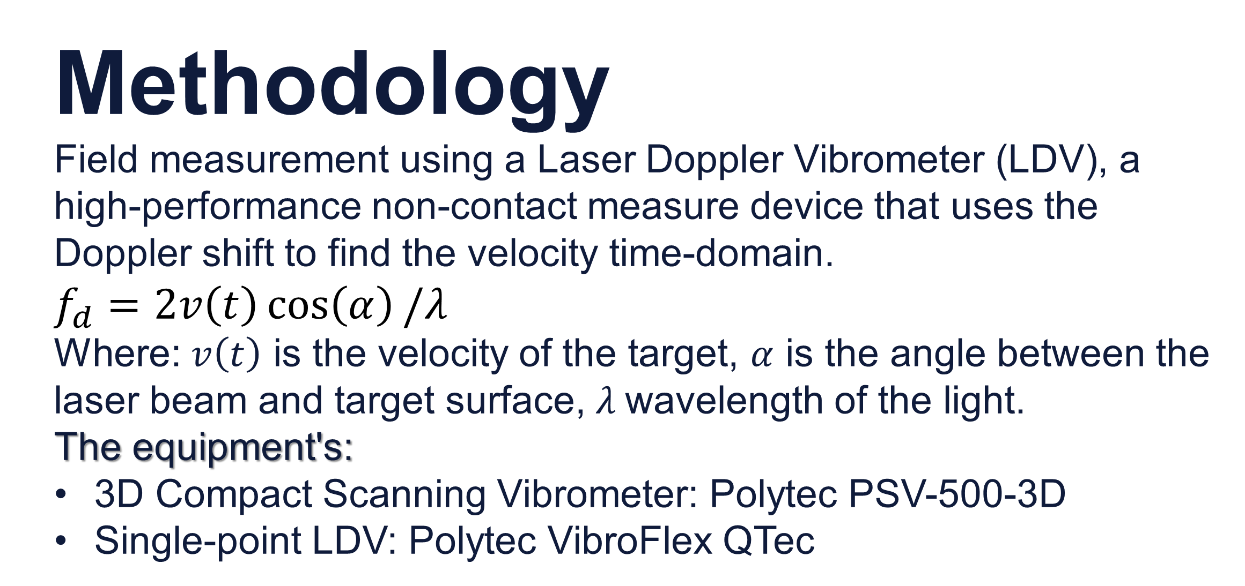
Dynamic Study of Devon Railroad Bridge Span 7th using a Laser Doppler Vibrometer
Author: Celso Cruz de Oliveira (Ph.D. Student) Co-Author: Santosh Dhakal (M.S. Student) Advisor: Ramesh B. Malla, Ph.D., F. ASCE, F. EMI
Department of Civil and Environmental Engineering, University of Connecticut, Storrs CT
Introduction
Most New England railway bridges were designed and built more than a century ago using outdated material and design codes. Therefore, it is imperative to monitoring and determine their current dynamic behavior due to the actual loading and vehicle type to ensure the bridge and users’ safety. This poster presents the typical vehicle-bridge interaction study of the span 7th of the Devon railroad bridge located in Connecticut.
Vehicle – MNR M8
The 8th generation of the Metro-North Railroad co. (MNR) dedicated passage train; an Electric Multiple Unity Railroad Car built by Kawasaki Rail car. With 85 feet in length and 10.5 feet wide, the MNR M8 can reach 80MPH of service speed.
Results and Discussion
Time Domain: The velocity-time variation recorded from selected points was processed and integrated into displacement time variation.
Figure 3: MNR M8 train specifications
Figure 6: P1 vertical displacement @ 17MPH, data processing (left), processed vertical displacement (right)
Methodology
Field measurement using a Laser Doppler Vibrometer (LDV), a high-performance non-contact measure device that uses the Doppler shift to find the velocity time-domain.
$$f_{d}=2v\left(t\right)\cos\left(α\right)/λ$$
Where: $v\left(t\right)$ is the velocity of the target, $α$ is the angle between the laser beam and target surface, $λ$wavelength of the light.
The equipment's:
3D Compact Scanning Vibrometer: Polytec PSV-500-3D
Single-point LDV: Polytec VibroFlex QTec
Frequency Domain: The time-domain velocity was transformed to frequency-domain using FFT. The three natural frequencies were identified, and the mode shapes were recreated.
Figure 1: Devon Bridge span 7th, elevation (left), and deck (right)
Objectives
With the approaching life expectance of most bridges in the United States, it is essential to establish a methodology to evaluate the existing bridges using cost-effective techniques. Therefore, the specific objectives of this presentation are to present and discuss the detailed method and procedure to record the field data of the typical service train using a Laser Doppler Vibrometer (LDV) and the process to extract the dynamic parameters from data.
Natural Frequency | Field Test |  | FEM
 | Harmonic | Forced Vib. | FEM
Mode 1 | 1.465 | 1.800 | 1.423
Mode 2 | 3.250 | 3.125 | 3.073
Mode 3 | 4.650 | 4.850 | 4.547
Figure 7: Nat. freq. comparison tab. (left), mode shape at 1.3Hz (right)
Conclusions
The dynamic bridge behavior recorded using an LDV has maintained a consistent result, and the data collection process has proven efficient. In addition, the bridge-vehicle interaction from the field test and the FEM has held consistency, the model update is under development. This project will enhance railroad bridge safety by understanding old bridges' dynamic behavior and the benefits of LDV in the bridge monitoring campaigns.
Devon Bridge – Span 7th
Located over the lower Housatonic River between Milford and Stratford, It was built in 1906 and owned by the Connecticut Department of Transportation. It’s a combination between deck girder, Baltimore trusses, and Scherzer Rolling Lift Bascule. Span 7th is a Baltimore steel truss with 66.32 meters (217’-7”) span length adjacent to the east abutment.
Figure 4: LDV principle (left), equipment used for field test (right)
The study recorded the bridge response under harmonic and forced vibration using a bridge shaker and MNT M8 train, respectively. The Finite Element Model (FEM) validates the field test results in the time and frequency domain.
Acknowledgments
This work is partially supported by the Transportation Infrastructure Durability Center under grant 69A3551847101 from the U.S. Department of Transportation’s University Transportation Centers program.
Figure 2: Devon Bridge span 7th, node code (left), and FEM render (right)
Figure 5: Field test setup, single-point LDV (left), 3D scanning Vibrometer (right)
October 2021 – www.tidc-utc.org

