Slide 1

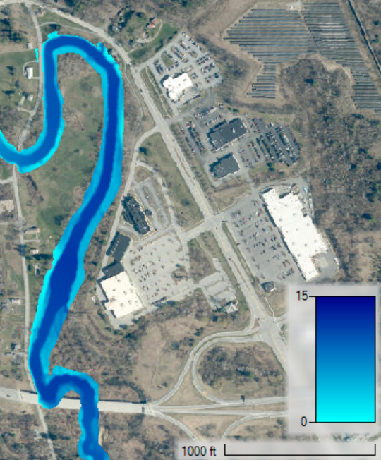
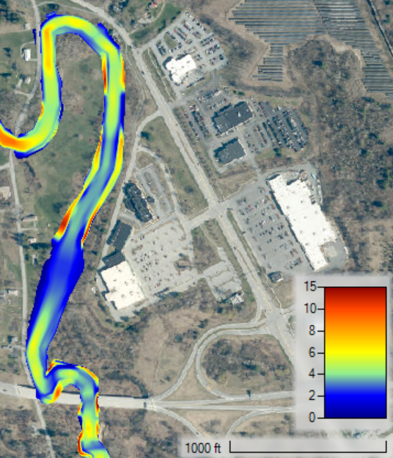
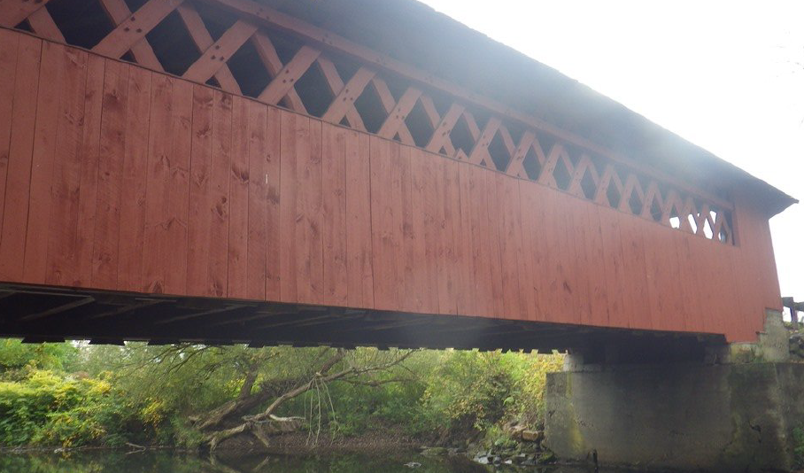
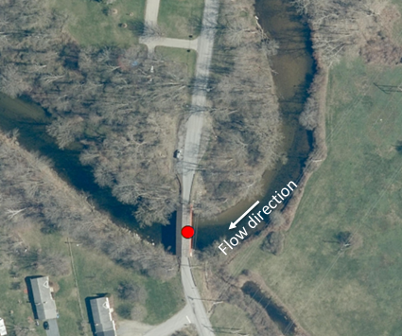
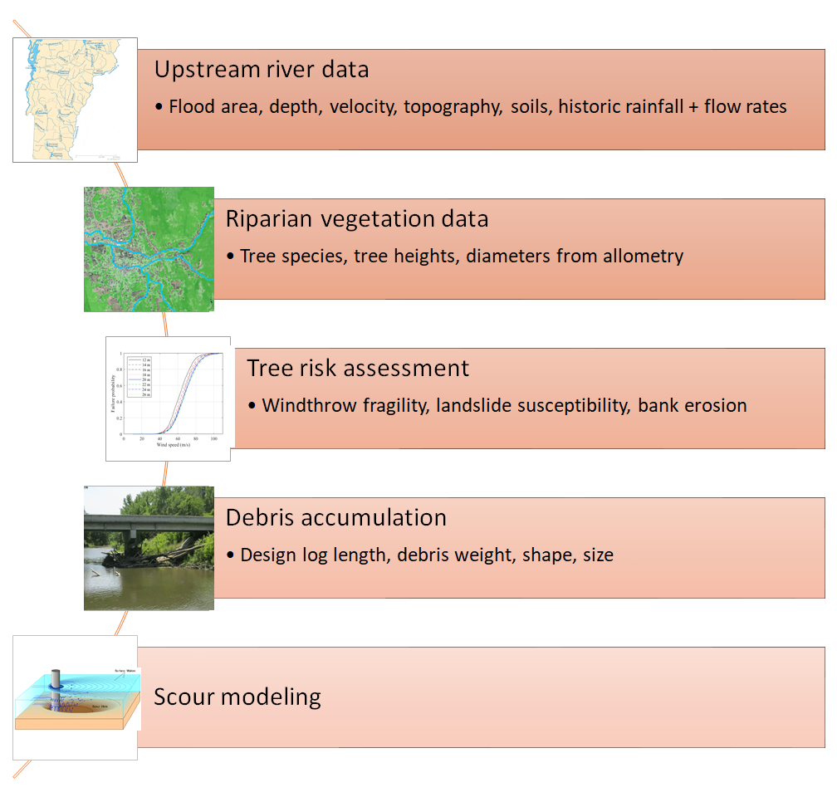
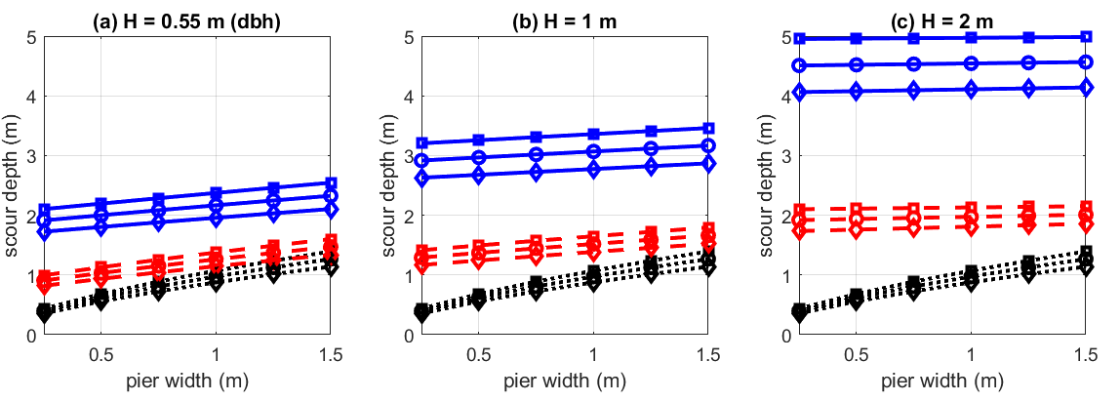
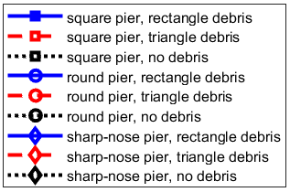
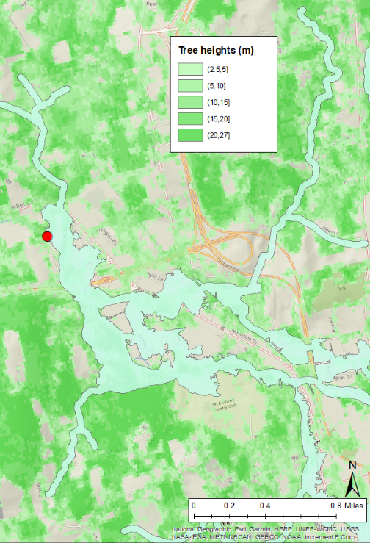
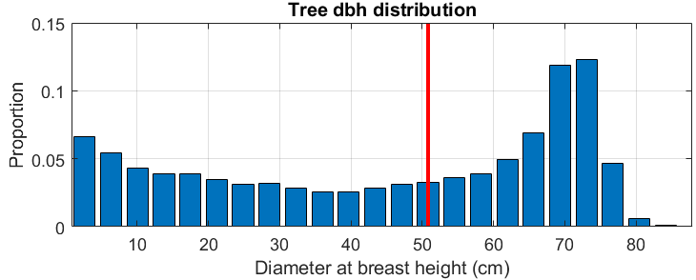

Modeling Bridge Debris Accumulation Dimensions and Scour
William Hughes¹ and Qin Lu², Dept. of Civil and Environmental Engineering, University of Connecticut, Advisors: Dr. Wei Zhang³; Dr. Ramesh Malla⁴
Abstract
Large woody debris accumulation near bridges exacerbates scour, which is responsible for one-third of bridge failures. Accurate methods of predicting debris generation, transport, entrapment, and dimensions are needed to improve public safety and bridge designs. Presently, a holistic, area-specific framework incorporating the risk from local vegetation, weather, soil, and river conditions to predict debris accumulation and scour is developed. Risk assessment of the riparian trees from bank instability and windthrow is conducted to obtain the debris generation probability. The design log length and scour are then computed for a case study of a bridge in Vermont under Hurricane Irene. Sensitivity analysis is performed considering various debris and pier configurations. The pier geometry is found a minor factor compared to the shape of the debris. Scour depths up to five meters are predicted, indicating the bridge could be at high risk.
Methodology
As outlined in flow-chart in Fig. 1., based on the surrounding tree species and heights, tree diameter and weight is estimated from allometric relations
Risk assessment of tree failing in river is conducted based on tree fragility
Resulting scour is predicted based on accumulated debris geometry and river and bridge properties
Results & Conclusions
River depth and velocity under Irene are presented (Fig. 6). In some areas, overtopping is observed.
Scour depths under various debris and pier geometries are calculated based on [4] (Fig. 7).
The debris geometry and size plays a critical role in scour, while the pier geometry is less impactful.
Scour depths up to 5 meters could be predicted under a debris accumulation with width of design log
Case Study
Case study conducted on bridge in Bennginton, VT (Fig. 2.) subjected to 4,400 cfs flow observed during Hurricane Irene
Data on tree height, species, soil, and hydraulics were gathered for the 10-mile upstream region (Fig. 3)
Tree risk is assessed from landslide [1] or windthrow fragility (Fig. 4) based on modeling of common tree species [2], e.g., red maple
Using allometric relationships [3], the typical log sizes are calculated (Fig. 5), and the design log length of 16 m is estimated [4] with diameter of 55 cm.
Introduction/Objective
Large woody debris (LWD) accumulations near bridges result in increased scour, the leading cause of bridge failures
Existing predictive models do not account for the local stream and vegetation characteristics
Objective: develop holistic, site-specific model for prediction of bridge debris accumulations and scour
Fig. 6. Depth (ft., left) and velocity (ft/s, right) under Hurricane Irene
Figure 2. Photo (left) and aerial view (right) of chosen bridge
Fig. 7. Effect of pier shape and debris thickness H and shape on scour
Acknowledgements
The work was funded by TIDC Project C19.2020.
Support and collaborations from TIDC and project technical champions (Mr. Benjamin Foster from Maine DOT and Mr. Jeffery DeGraff from VTrans) and collaborator (Mr. Andrew Mroczkowski from Connecticut DOT) are appreciated.
Figure 4. Fragility for landslide (left) and maple tree windthrow (right)
References
[1] Huang et al. 2019, “Landslide Potential Evaluation Using Fragility Curve Model”
[2] Lu and Zhang, 2021, “An Integrated Damage Modeling and Assessment Framework for Overhead Power Distribution Systems Considering Tree-Failure Risks,” (Under review)
[3] McPherson et al 2016., “Urban Tree Database and Allometric Equations”
[4] Arneson et al. , “Evaluating Scour at Bridges. HEC-18”
Fig. 1. Proposed model framework
¹Graduate student, william.hughes@uconn.edu
²Graduate student, qin.2.lu@uconn.edu
³Professor, wzhang@uconn.edu
⁴Professor, ramesh.malla@uconn.edu
Figure 3. Upstream area and surrounding vegetation
Fig. 5. Riparian tree diameter distribution and design log length (red line)
November 2021 – www.tidc-utc.org

