Slide 1
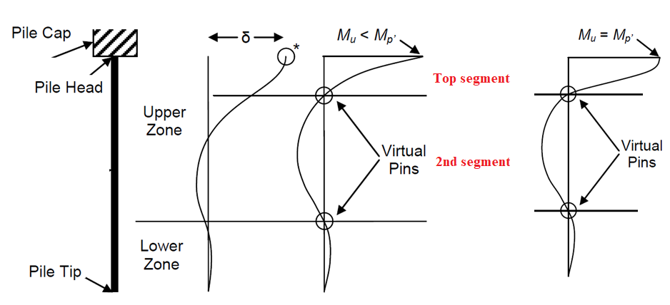



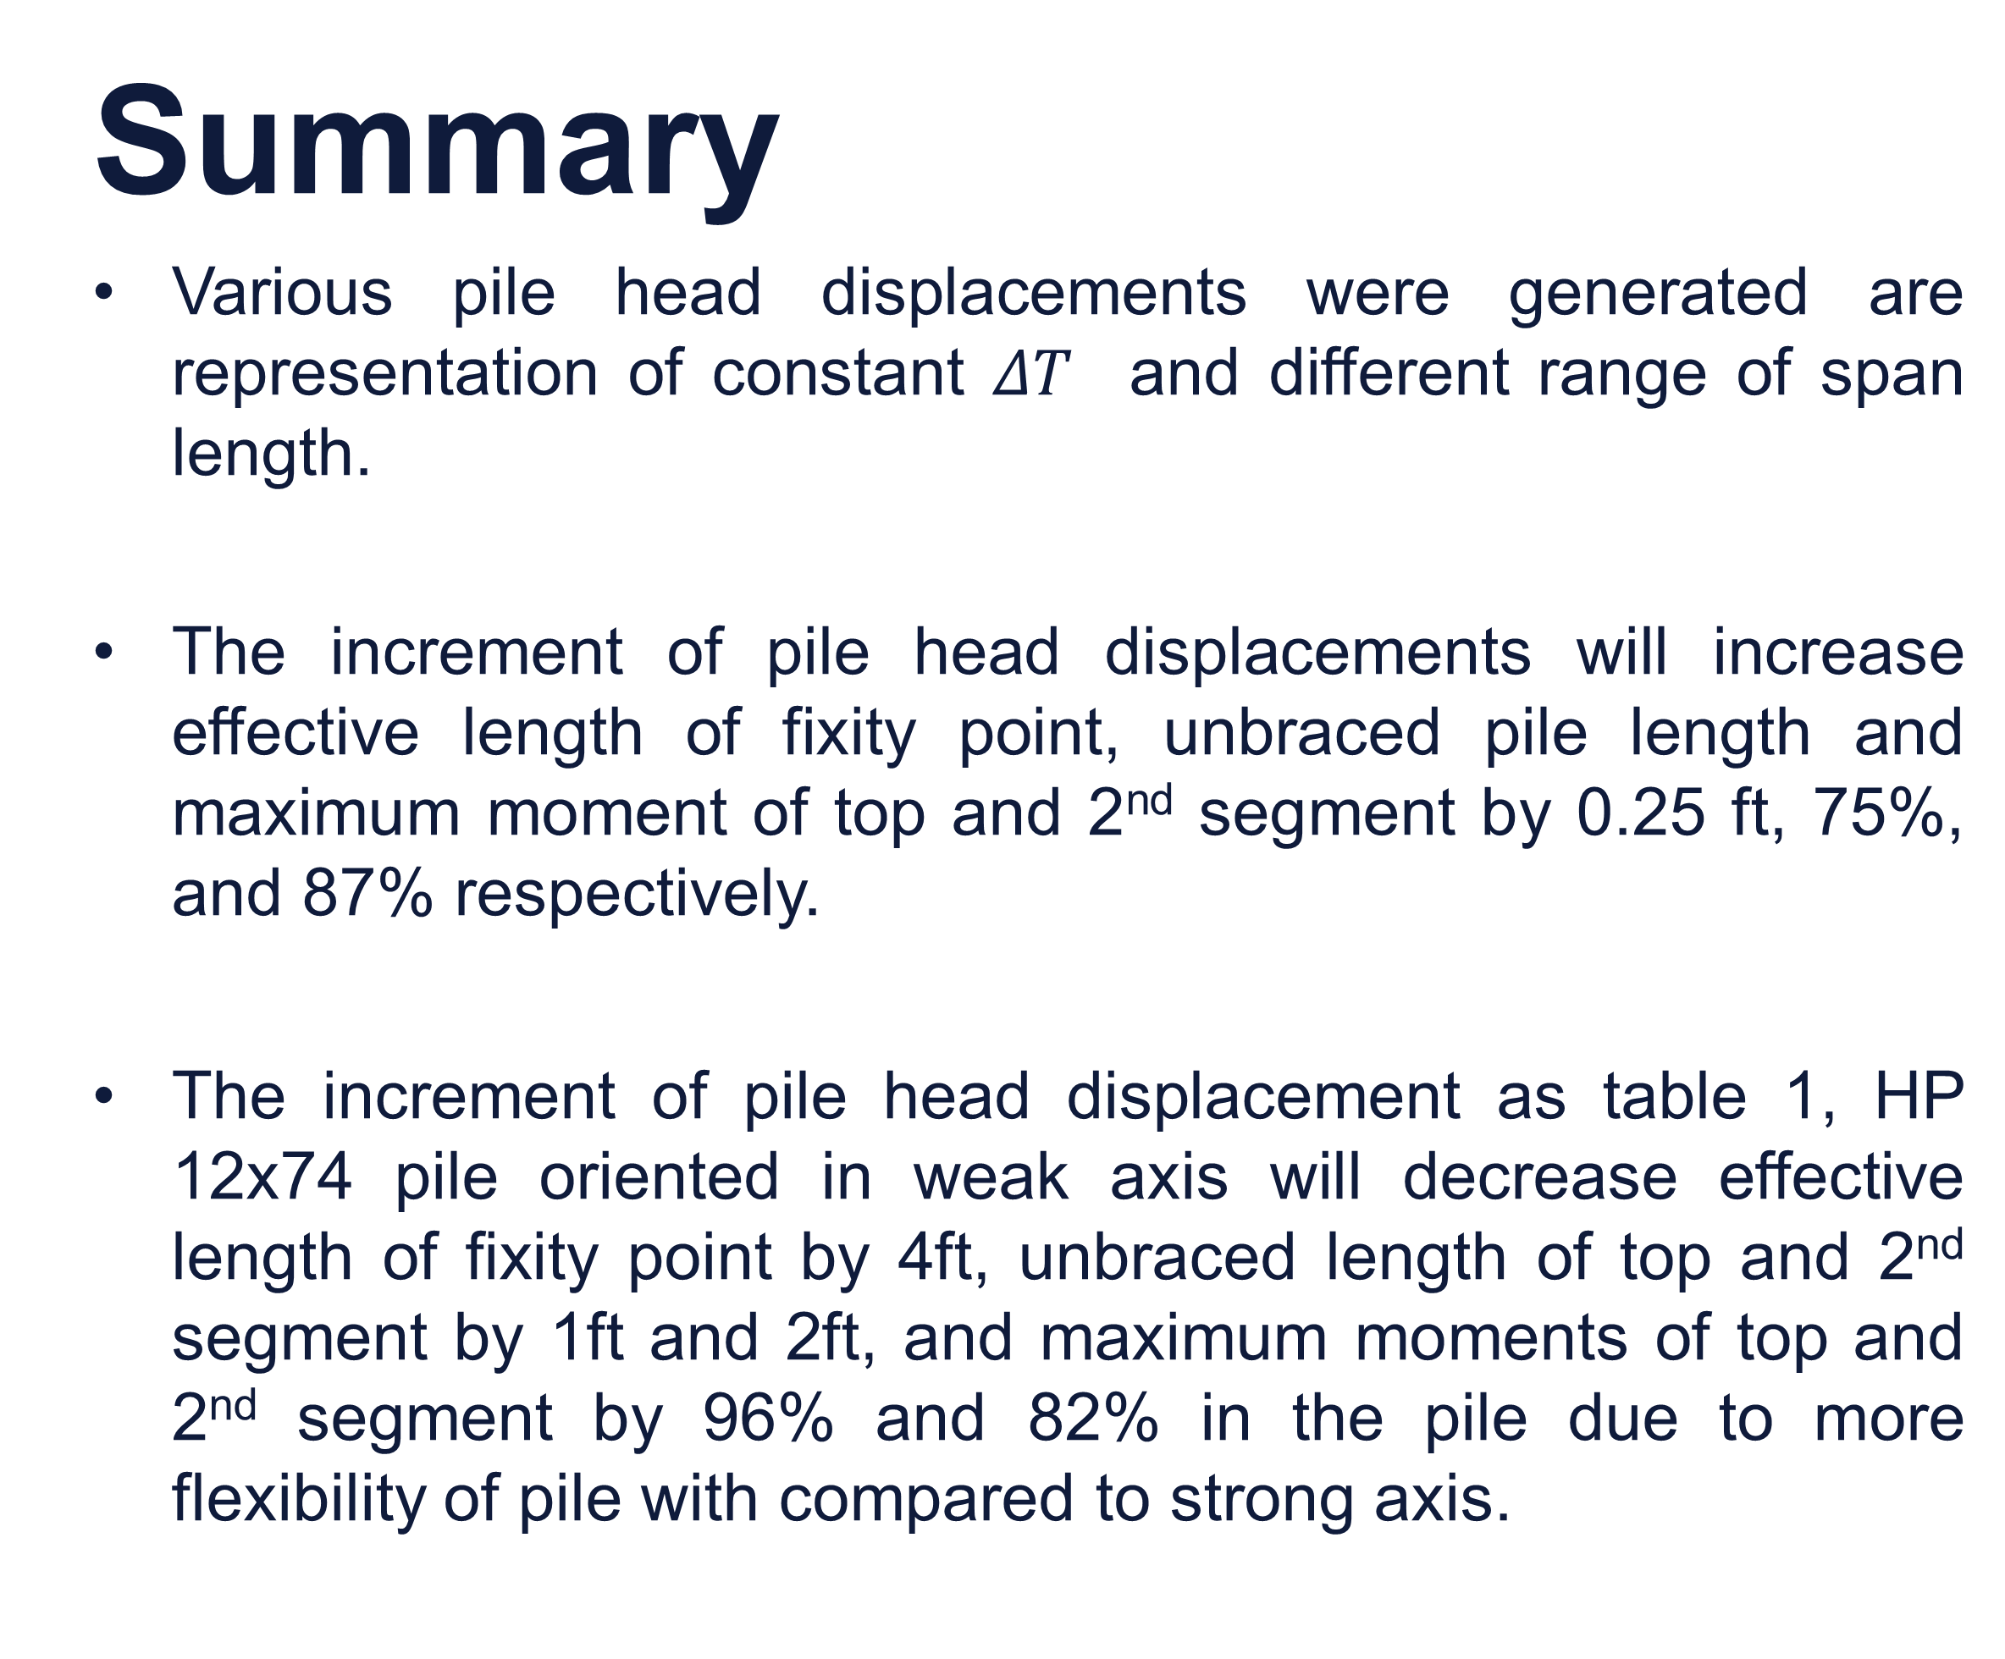
The Effect of Various Pile Head Displacement in Pile Design of IAB
Author: Harsh Gandhi
Department of Civil and Environmental Engineering, University of Massachusetts Lowell Advisor: Prof. Susan Faraji
Introduction
Integral Abutment Bridges (IABs) are single or multiple span continuous deck bridges. Instead of movable expansion joints between the spans and bearings at the abutments, IABs have continuous decks integral with abutment walls. In order to minimize the effect of the longitudinal forces in the abutments, the abutment foundation is made flexible by supporting abutment walls on flexible piles
Objective
The objective of this study is to analyze the effect of the range of span length on the design of HP piles in IABs under thermal expansion, that is, how the range of span length will impact the fixity point, the bending moment values, and
the length of
the segments
of the piles.
The study
was done by
using LPILE,
varying the displacement at the pile head from 0.05 to 0.5 inches, but keeping the thermal loading, soil profile and cross sectional properties of the pile constant. The study was conducted orienting an HP pile in both the weak and the strong direction.
Cases Analyzed
8 cases were studied of HP 12x74 by varying the pile head displacement to 0.05, 0.1, 0.2, 0.5 inches by keeping the soil profile and temperature difference same.
Pile Modeling Result
Displacement (in) | Pile Orientation | Fixity point (ft) | Top segment (ft) | 2nd Segment (ft) | Max. Moment (kips-ft)
0.05 | Weak | 18.00 | 3.75 | 10.25 | -15.0/4.6
 | Strong | 22.00 | 4.75 | 12.25 | -29.0/9.3
0.10 | Weak | 18.50 | 4.00 | 10.50 | -26.2/8.5
 | Strong | 22.50 | 5.00 | 12.50 | -52.3/18.1
0.20 | Weak | 19.00 | 4.25 | 10.75 | -46.4/16.0
 | Strong | 23.00 | 5.25 | 12.75 | -94.8/34.6
0.50 | Weak | 19.50 | 4.50 | 11.00 | -100/37.0
 | Strong | 23.50 | 5.50 | 13.00 | -210/80.1
Depth of fixity point
Soil – Table 1 – Pre-drilled
Axial load – 93 kips
Pile size – HP 12x74
Pile orientation- weak axis
Depth of fixity point
Depth of fixity point
Depth of fixity point
Fig.2 Pile deflection at different pile head displacement – weak axis
Table 1 Fixity point and unbraced length of pile at various displacement
Unbraced length – Top segment
Summary
Various pile head displacements were generated are representation of constant $ΔT$ and different range of span length.
The increment of pile head displacements will increase effective length of fixity point, unbraced pile length and maximum moment of top and 2nd segment by 0.25 ft, 75%, and 87% respectively.
The increment of pile head displacement as table 1, HP 12x74 pile oriented in weak axis will decrease effective length of fixity point by 4ft, unbraced length of top and 2nd segment by 1ft and 2ft, and maximum moments of top and 2nd segment by 96% and 82% in the pile due to more flexibility of pile with compared to strong axis.
Unbraced length – 2nd segment
Soil – Table 1 – Pre-drilled
Axial load – 93 kips
Pile size – HP 12x74
Pile orientation- weak axis
Unbraced length
Points of zero moments
Fig.1 Pile Design Model
Fig.3 Pile moment at different pile head displacement – weak axis
Soil – Table 1 – Pre-drilled
Axial load – 93 kips
Pile size – HP 12x74
orientation- Strong axis
Soil – Table 1 – Pre-drilled
Axial load – 93 kips
Pile size – HP 12x74
orientation- Strong axis
Contact: Prof. Susan Faraji
(susan_faraji@uml.edu)
Fig.4 Pile deflection and moment at different pile head displacement
– strong axis
October 2021 – www.tidc-utc.org​
Project 3.7 – Development of general guidelines related to the effect of factors such as the bridge span range, range of pile length, roadway profile grade, and skew angle range on integral abutment bridges (IABs)

