Slide 1
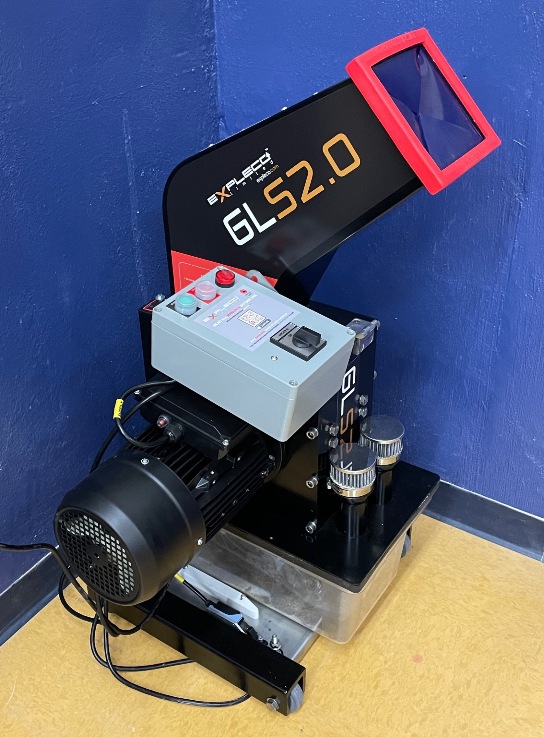
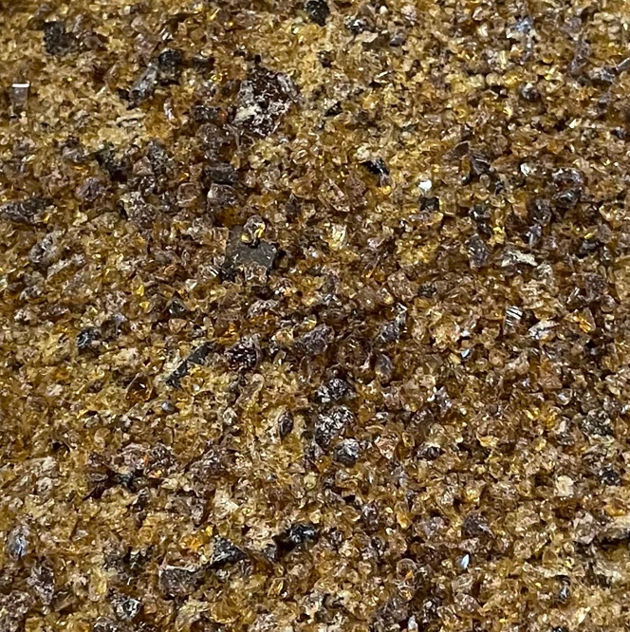
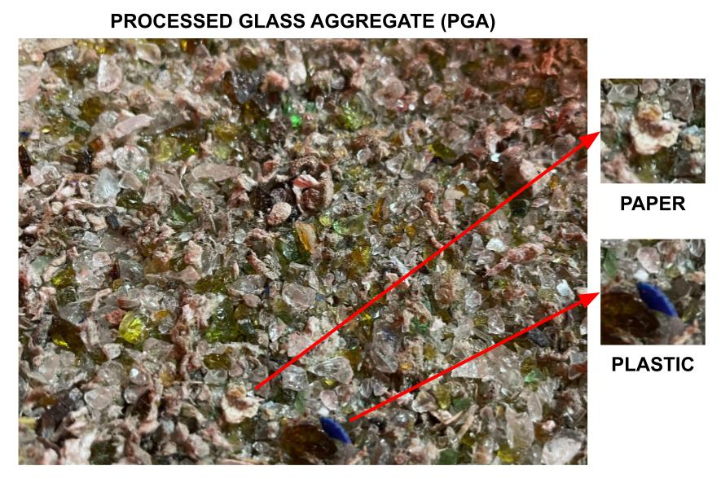





Development of Protocols for Determining Deleterious Material Content in Processed Glass Aggregate
Fiona Nutbeam, Civil & Environmental Engineering, University of Vermont Advisors: Drs. Matthew Scarborough & Mandar Dewoolkar
Introduction
Processed glass aggregate (PGA, Figure 1) studied in this project is a fine crushed recycled glass with a high potential to replace sand borrow and other free-draining fill materials. The major benefits of using PGA are that it reduces demands for limited high-quality sand borrow, which is increasingly scarce and expensive; and it keeps glass out of landfills. In practice however, PGA is not widely used in our region because of a lack of clear guidance on deleterious material content determination.
Primary objectives are to research, develop, and perform a variety of processes to determine deleterious material content in PGA; evaluate the effectiveness of individual processes using lab-manufactured PGA (LM-PGA) samples; and recommend a reliable protocol for determining deleterious material content for operational purposes.
Figure 3. Glass crusher (left) and clean crushed glass (right)
Results & Conclusions
The acquired PGA samples are within VTrans gradation requirements for sand borrow and PGA which references AASHTO M 318. Figure 2 shows that the gradation of the manufactured PGA matches that of the PGA sample obtained from CSWD. The internal friction angle of dry PGA ranged from 38 – 42º. Thus far, we have explored float, furnace, and magnet testing.
Additional PGA and sand borrow samples will be acquired and tested alongside LM-PGA with known deleterious content and type. Currently, the focus will remain on the deleterious material testing, with engineering properties determination of recycling facility PGA, LM-PGA, and sand borrow samples and economic analysis in the following year of the project.
Funding for this research is provided by the Transportation Infrastructure Durability Center at the University of Maine under grant 69A3551847101 from the U.S. Department of Transportation’s University Transportation Centers Program. Additional financial support from CSWD and VTrans is gratefully acknowledged.
Figure 2. Comparison of gradations for sand borrow Sample, recycling facility PGA, sample, & lab-manufactured PGA.
Methodology
At present a number of laboratory tests were conducted on recycling facility PGA (RF-PGA) (from CSWD – Chittenden Solid Waste District) and sand borrow (from VTrans) samples including specific gravity, grain size, compaction, hydraulic conductivity and direct shear testing. A number of tests for determining deleterious material types and contents are being explored including float test, furnace, solvents, magnets and acids.
A laboratory-scale glass crusher was acquired to manufacture clean crushed glass to which known amounts of deleterious materials will be added (e.g. paper, plastic, metal) for verifying the developed laboratory processes for determining deleterious material content.
Figure 1. PGA containing containing deleterious materials
June 2019 – www.tidc-utc.org

