Slide 1
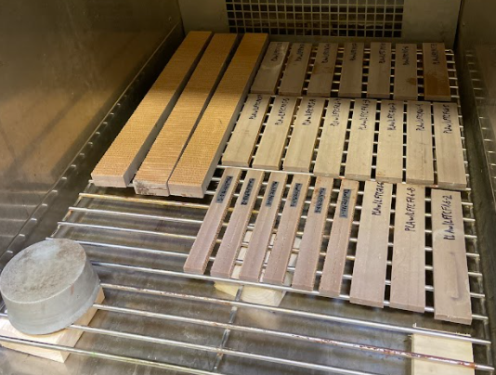
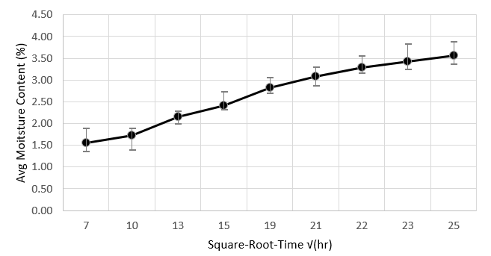
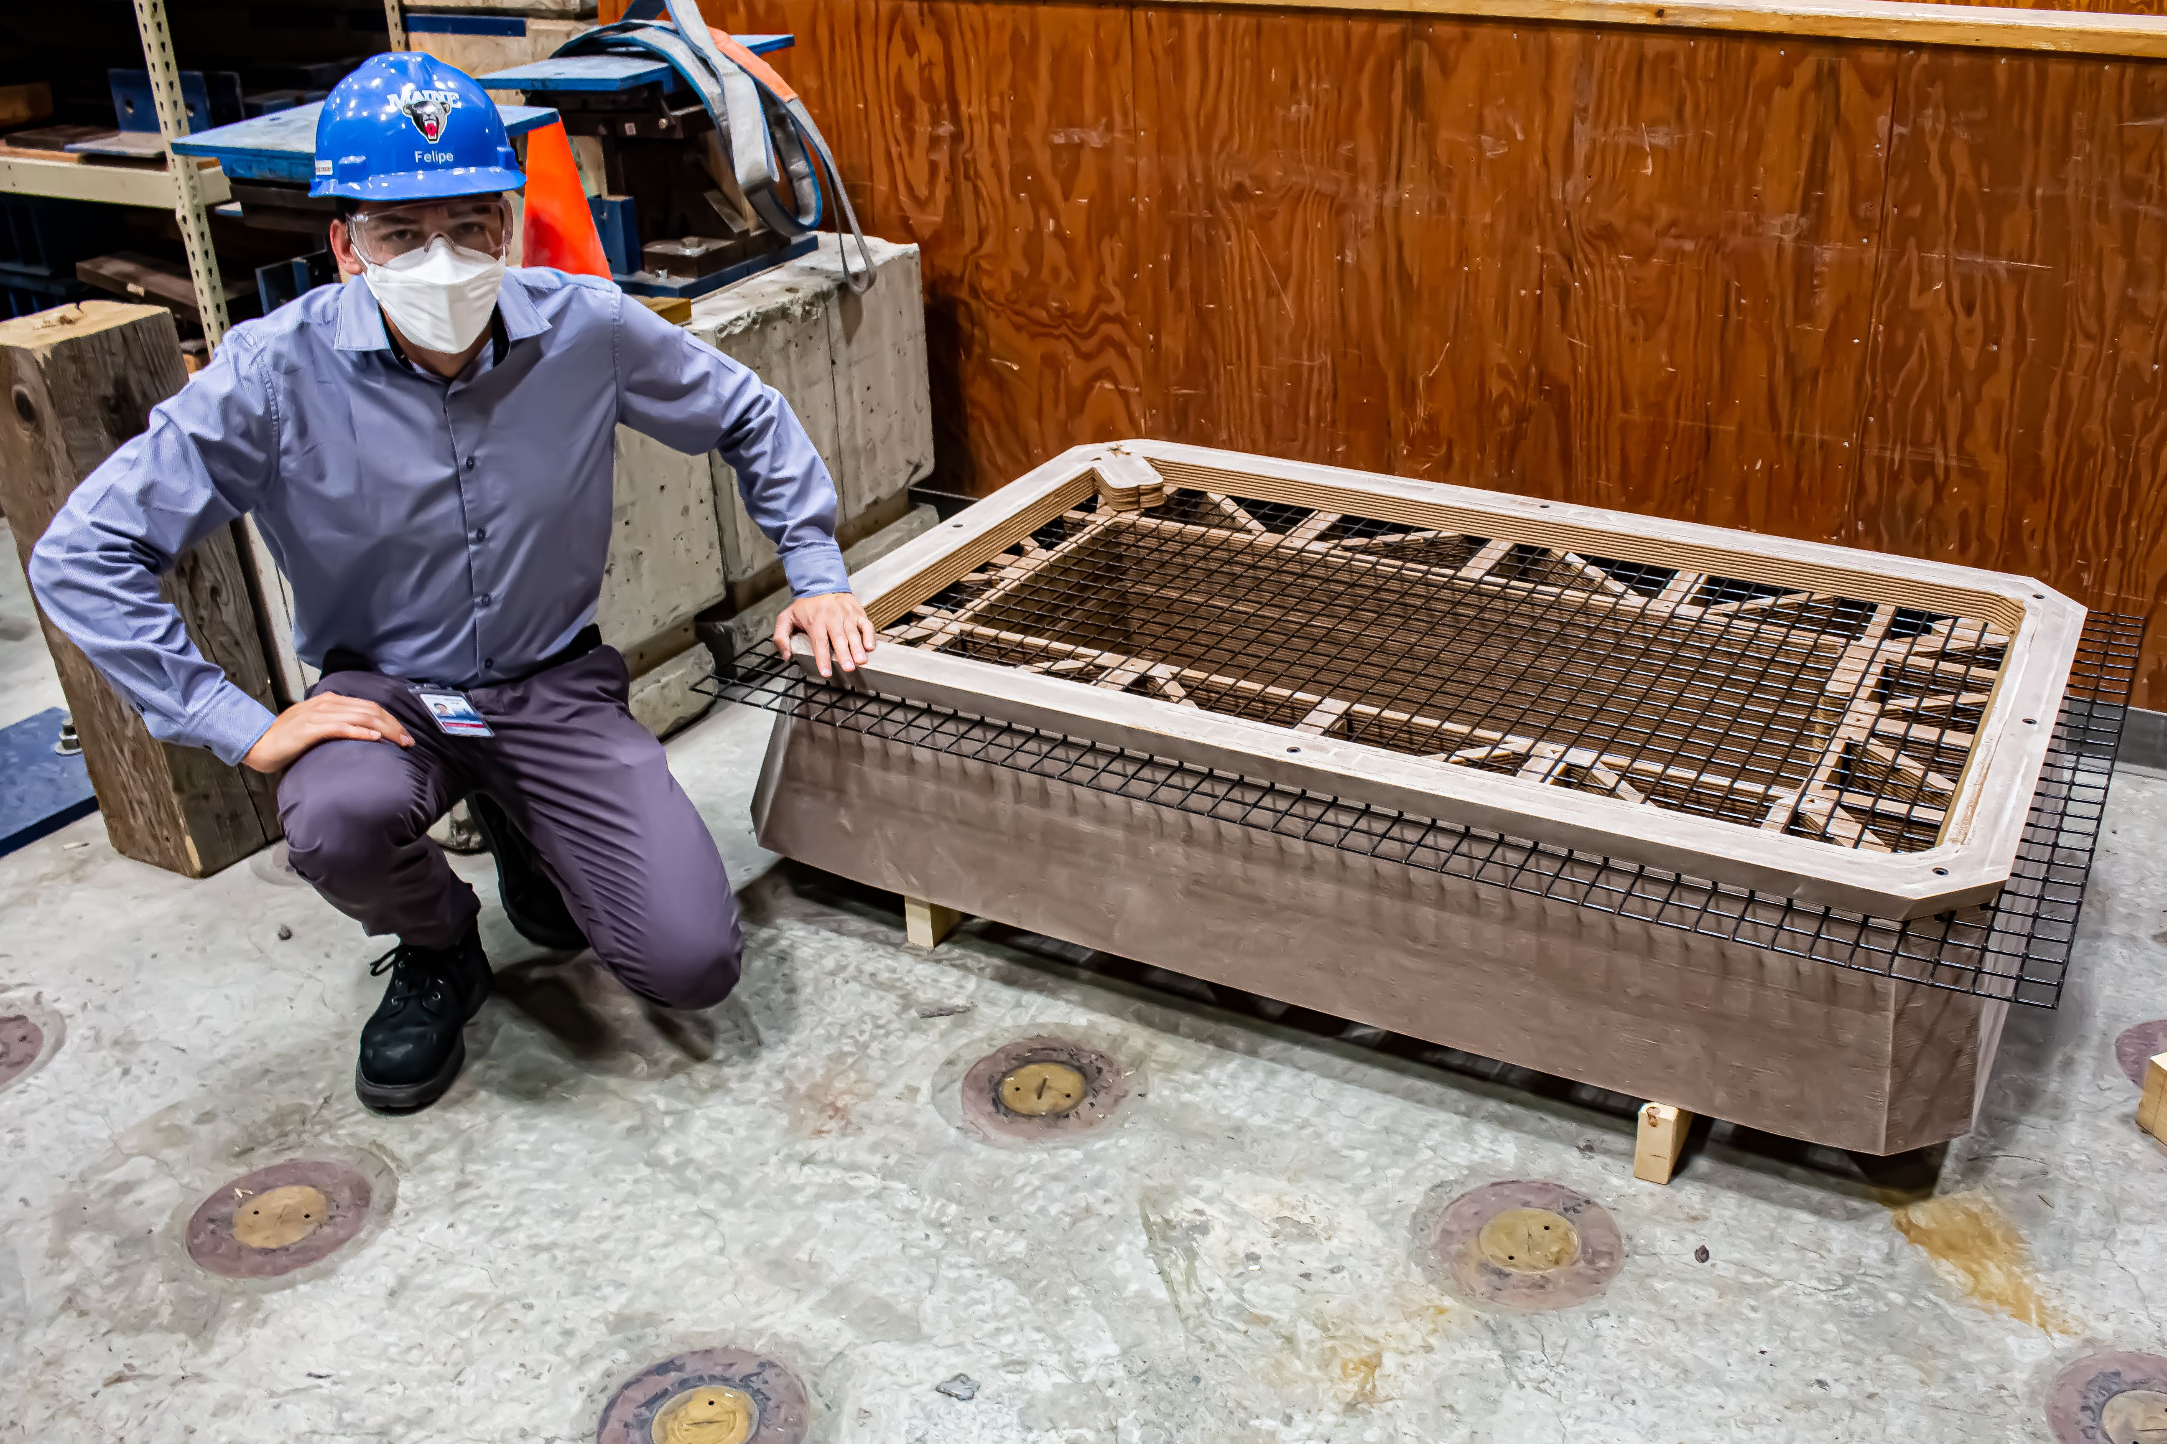
Durability of Large-Scale 3D Printed Materials for Transportation Infrastructure
Felipe Saavedra, Department of Civil Engineering, University of Maine, Advisor: Dr. Roberto Lopez Anido
Introduction
Large-format extrusion-based additive manufacturing (AM) or 3D printing was implemented for transportation infrastructure applications including culvert outlet diffusers and precast concrete formwork.
Assess the durability and dimensional stability of thermoplastic composite material systems under different exposure conditions of moisture and freeze-thaw.
Investigate the use of bio-based renewable polymer composites for transportation applications.
Correlate accelerated lab durability tests with site specific environmental durability for selected transportation applications.
Compare the performance of bio-based composite materials (Wood Fiber/PLA) with a conventional composite material (Carbon Fiber/ABS)
Fig.2 : Freeze-thaw conditioning for WF/PLA specimens
Fig. 3: Sorption Curve for WF/PLA specimens – Average values
Methods
The durability of the material will be evaluated based on the change in flexural strength and modulus of the exposed specimens.
Select and adapt standard test methods for mechanical performance and durability assessment of large-format extrusion-based 3D printed materials
Evaluate the durability of both semicrystalline and amorphous PLA polymer systems.
Environmental conditions selected: Moisture exposure and freeze-thaw cycling.
Digital Image Correlation/Pontos: Measure strains a displacements.
Durability assessment: Comparison between mechanical properties and dimensional stability of conditioned and baseline specimens.
Results and Future Work
Moisture conditioning: ASTM D5229 standard test method.
Moisture Equilibrium Content (MEC): computed based on the sorption curve in accordance with ASTM D5229
WF/PLA material specimens are being conditioned.
Freeze-Thaw Cycling: ASTM D7031 standard test method for Wood-Plastic Composites (WPC). Apply three cycles, each with moisture exposure, freezing and thawing.
ASTM D7264 standard test method: four-point bending configuration to determine elastic modulus and strength.
Future work: Specimen preparation for all 3D printed materials, conditioning, flexural tests and data analysis.
Fig. 1 : 3D Printed Formwork for Precast Concrete using WF/PLA material
October 2021– www.tidc-utc.org

