Slide 1
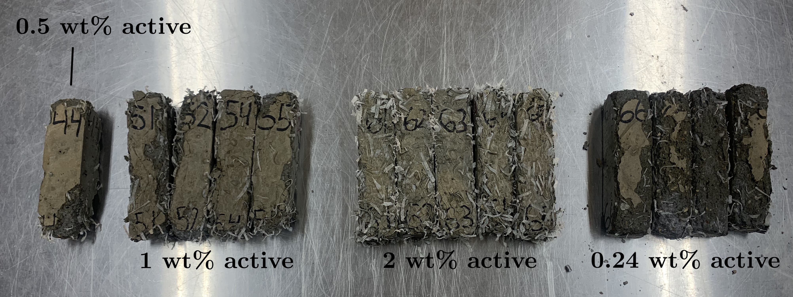

Chitosan-Based Shrinking Fibers for Post-Cure Stressing to Increase Durability of Concrete
Diarmuid Gregory, Mechanical Engineering, University of Vermont
Advisor: Dryver Huston
Introduction
Concrete durability frames the motivation for this research. We use shrinking fibers to combine the reinforcing effects of FRC and prestressed concrete which is typically achieved with cables. Shrinking fibers theoretically create a more isotropic prestressing and inhibit crack growth closer to the source compared to cables because of their small size and uniform distribution.
Freeze-thaw damage and chloride penetration are two detrimental attacks on concrete durability. Freeze-thaw cycling creates and progressively expands cracks particularly in porous materials like concrete. Chloride ions from salts degrade the passivating layer of rebar and corrode the steel subsequently damaging the concrete. Active (shrinking) chitosan fibers were compared to passive (non-shrinking) chitosan fibers and 0 wt% control (non-reinforced) concrete in their ability to resist these forms of degradation.
Average resistance of specimens following the second partial immersion in saltwater (wet cycle) with SEM error bars
Results/Conclusions
From the freeze-thaw test, shrinking (active) fiber reinforced concrete had up to a 219% increase in durability factor over non-shrinking (passive) fiber reinforced concrete at a weight ratio of 2 wt% and a 540.5% increase over non-reinforced concrete at a weight ratio of 2 wt%.
Results from a chloride penetration test suggest that active fiber reinforced concrete had lower rates of chloride ion penetration than passive fiber concrete. Higher resistance values signify less chloride ion penetration because the ions aid in a specimen’s conductivity. Following the second partial immersion in saltwater, active fiber prisms had up to a 157.5% greater resistance than passive ones at the weight ratio of 0.24 wt%.
Percent higher durability factor of active fiber concrete than passive fiber with SEM error bars
Methods
Freeze-thaw testing was conducted by cycling various 40x40x160mm prisms (which cured for 14 days) wrapped in wet towels between -20 and 20ºC. The cycles lasted 3 hours and 14 cycles were conducted in between tests which included weighing, measuring length, and impact resonance testing.
The chloride penetration testing consisted of partial immersion in a 3.5% NaCl solution for 2 days at a time and air drying for 5 days after of the same 40x40x160cm prisms (cured for 7 days) with 1.5” 6-32 bolts halfway embedded in the concrete. The specimen’s resistances were measured with a four-point Wenner probe and weighed at 0, 2, 7, and 9 days following demolding, the first wet cycle, the dry cycle, and the second wet cycle, respectively.
Photo of specimens following 300 freeze-thaw cycles
Acknowledgements
Thanks to TIDC and USDOT for providing the funding for this research and Jim Wild of VTrans for being the technical champion of this Project 2.7
June 2019 – www.tidc-utc.org

