Slide 1
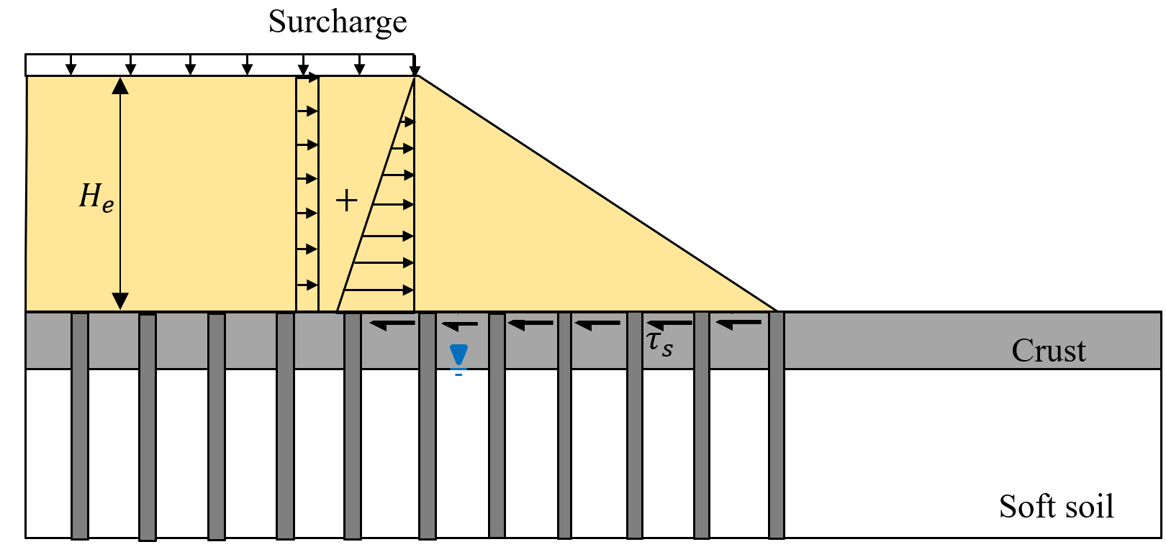
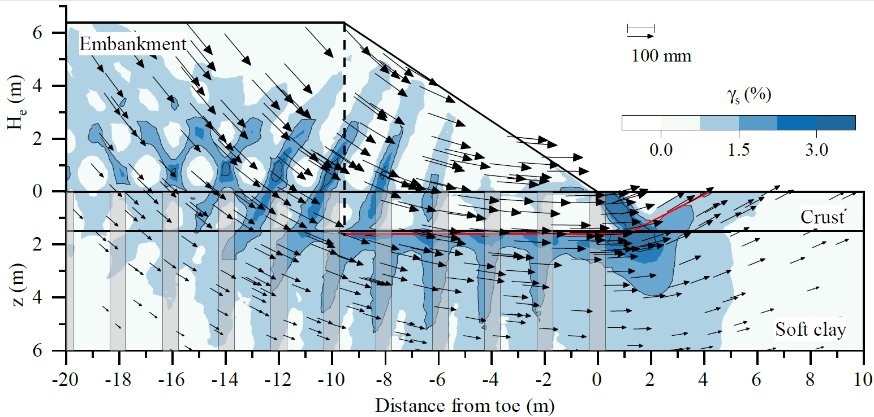
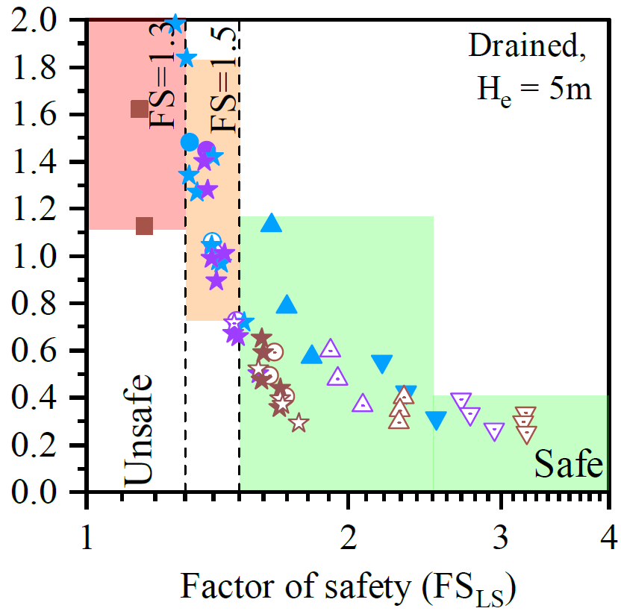
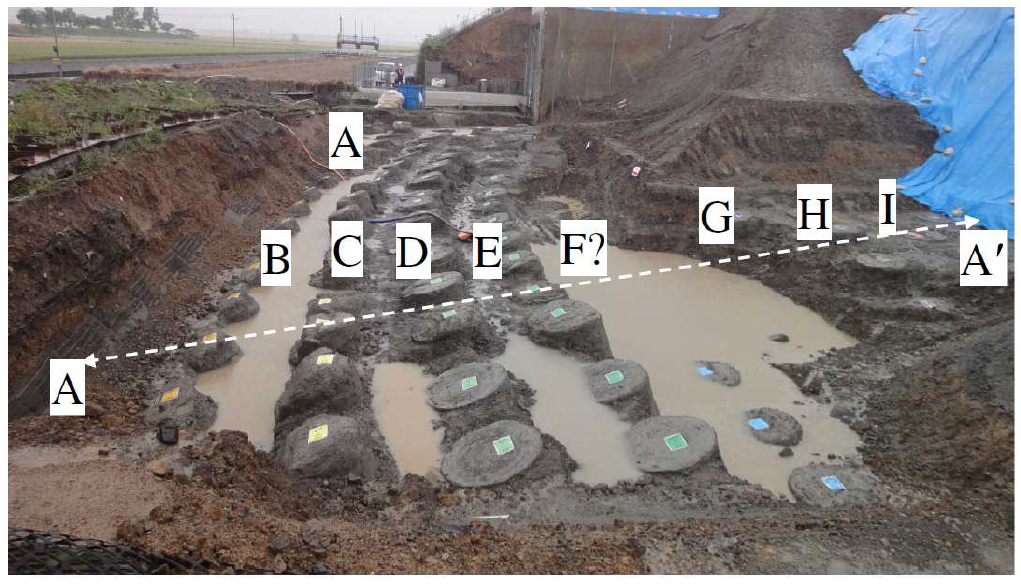
Lateral spreading and basal stability of column supported embankments
Danilo Botero Lopez, Civil and environmental Engineering, University of Maine Advisor: Ph.D. Aaron Gallant
Motivation:
Column-support is used to accelerate construction of embankments and MSE walls over soft ground. These columns are unreinforced high-modulus elements. It has been recommended by some that column fracturing should be avoided altogether due to the perception that column fracturing is either a major culprit, or indication of, lateral instability in the foundation materials. The goal is to determine if these elements can tolerate some degree of cracking and safely support embankments or MSE walls (Fig 1).
(a)
Results
Based on examination of field performance data (not shown) and the numerical results, the following observations were made:
Lateral spreading analyses --- recommended by FHWA ---- are akin to sliding check (Fig. 2.a) at the base of fill, which neglect the restraint and influence of crust thickness at the toe and potential strain discontinuities and slip surfaces that develop at depth in weaker soil (Fig. 2.a).
If subsurface conditions provided adequate confinement, justified based on a factor of safety for basal instability, some degree of column fracturing can be tolerated (Fig. 4). This understanding can be used to optimize area of replacement and/or justify elimination of steel reinforcement in perimeter columns to increase construction efficiencies.
(b)
Fig. 2. (a) Simplified limit equilibrium method to address lateral spreading (AASHTO); (b) Shear strains and displacements vectors obtained via FEM.
Methodology
A 3D parametric Finite Element (FEM), which incorporated a method to account for the cessation of bending resistance when column cracking was predicted, was performed. The influence of area replacement, soft clay type, and crust thickness were examined to address the factor of safety and predicted lateral spreading, which was compared with field performance data.
Acknowledgments:.
Fig 1. Failure case scenario in Japan (Chai, 2019)
.
Fig. 3. Summary of computed factors of safety of lateral spreading and the corresponding normalized lateral displacement.
October 2021 – www.tidc-utc.org

