Slide 1
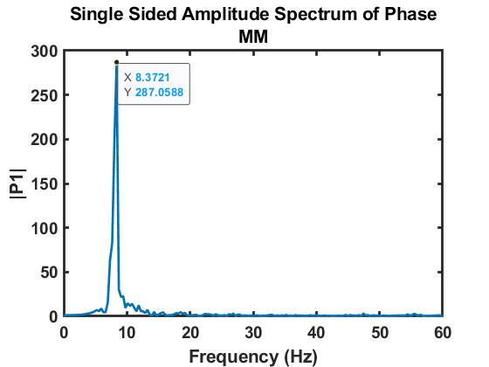
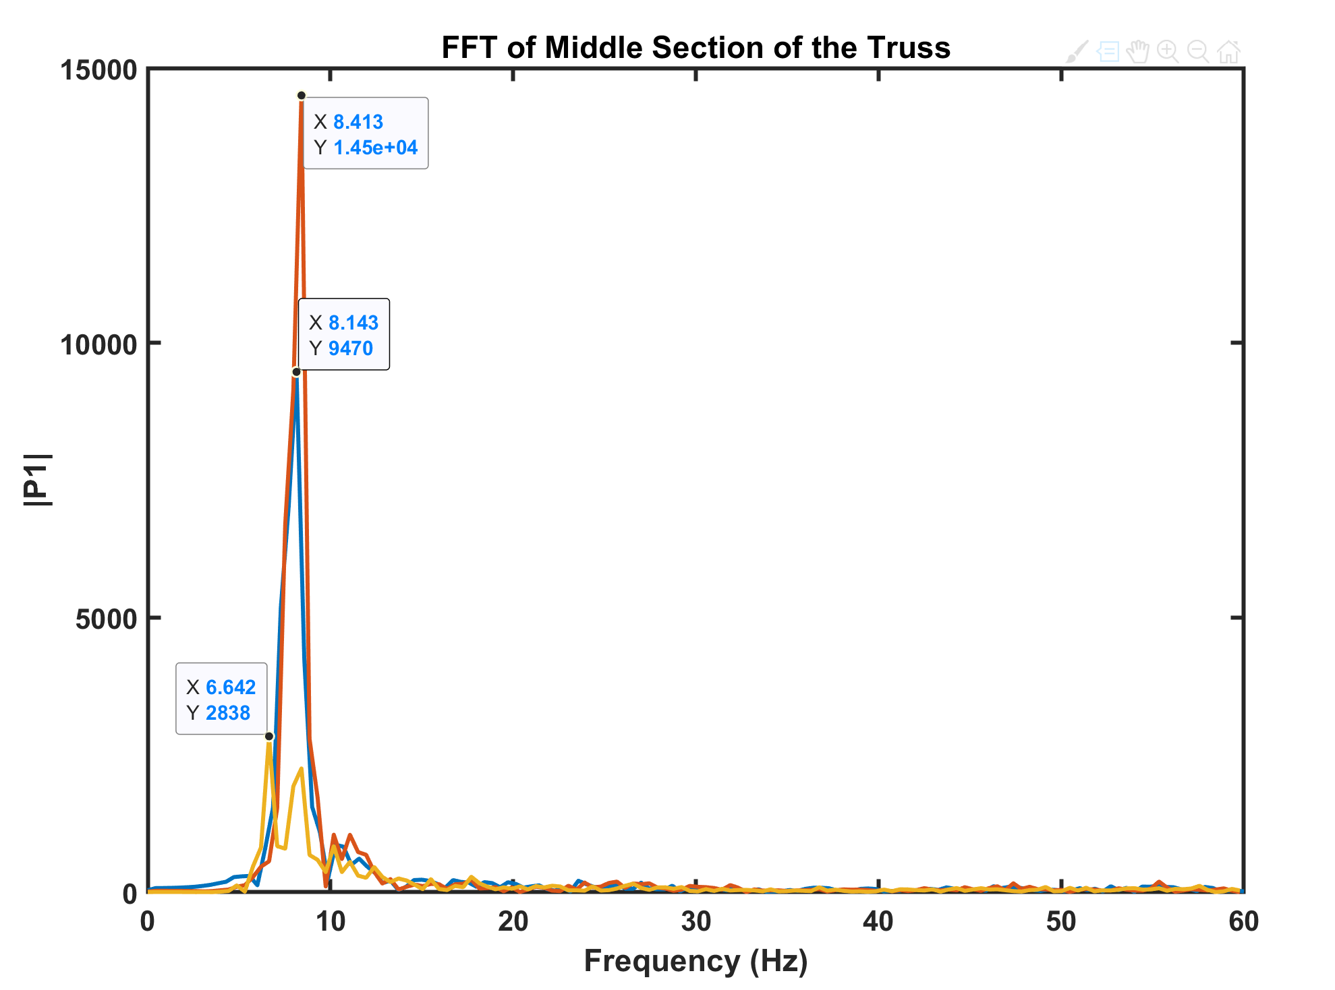
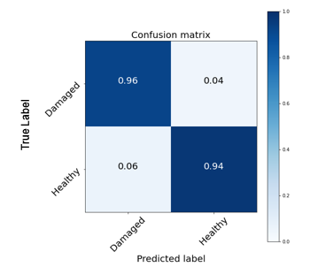
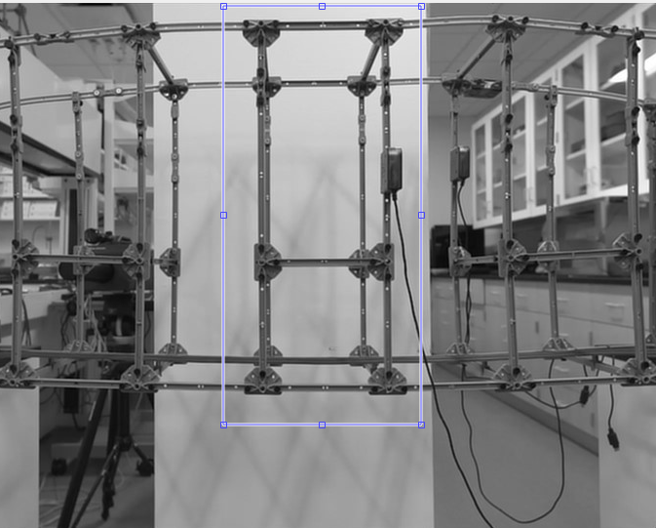
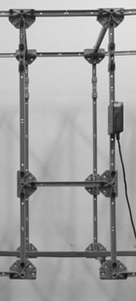
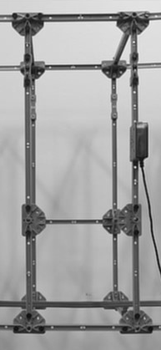
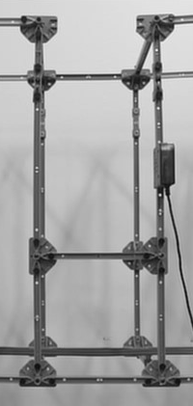
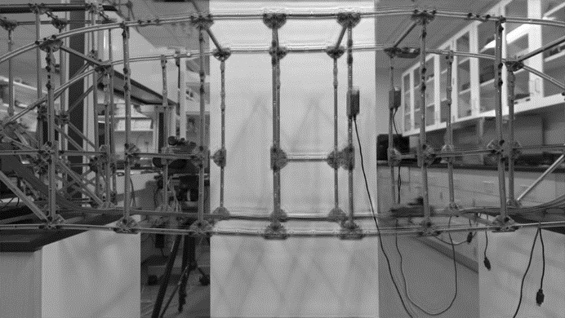
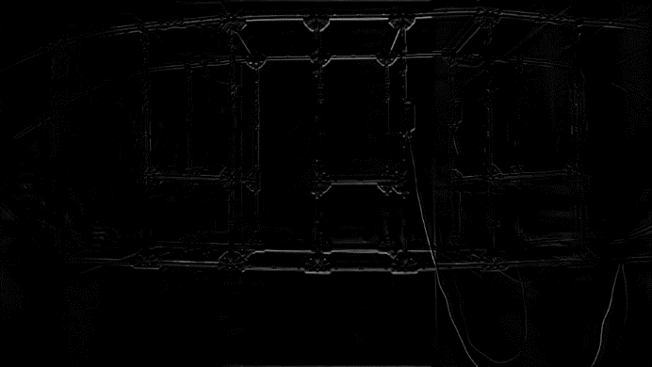
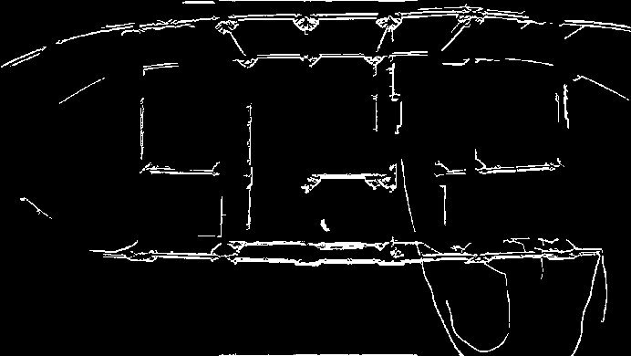
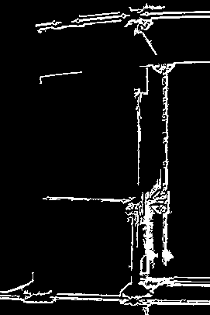
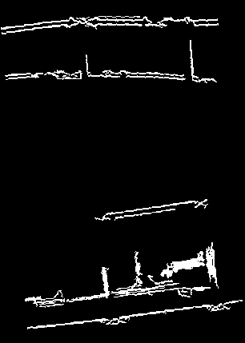
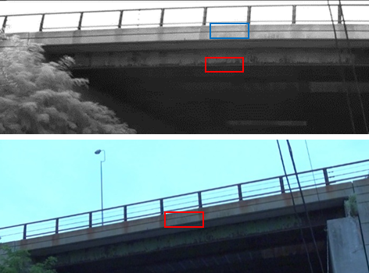
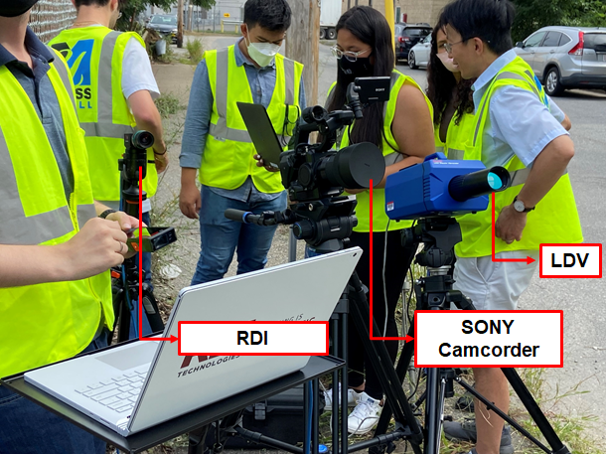
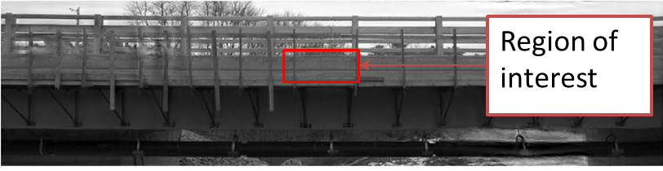
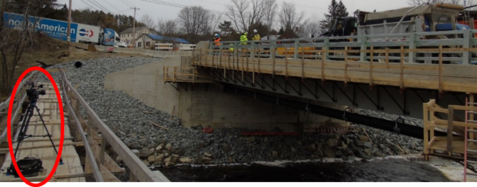
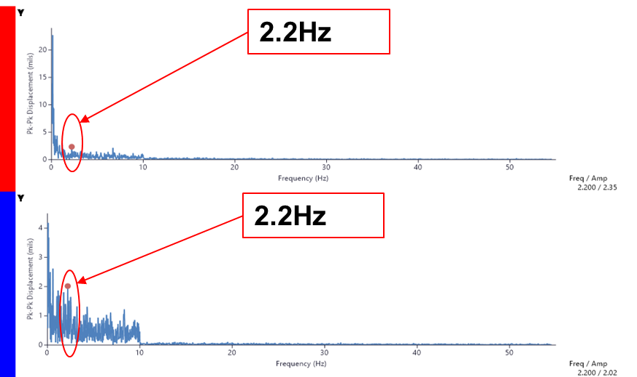
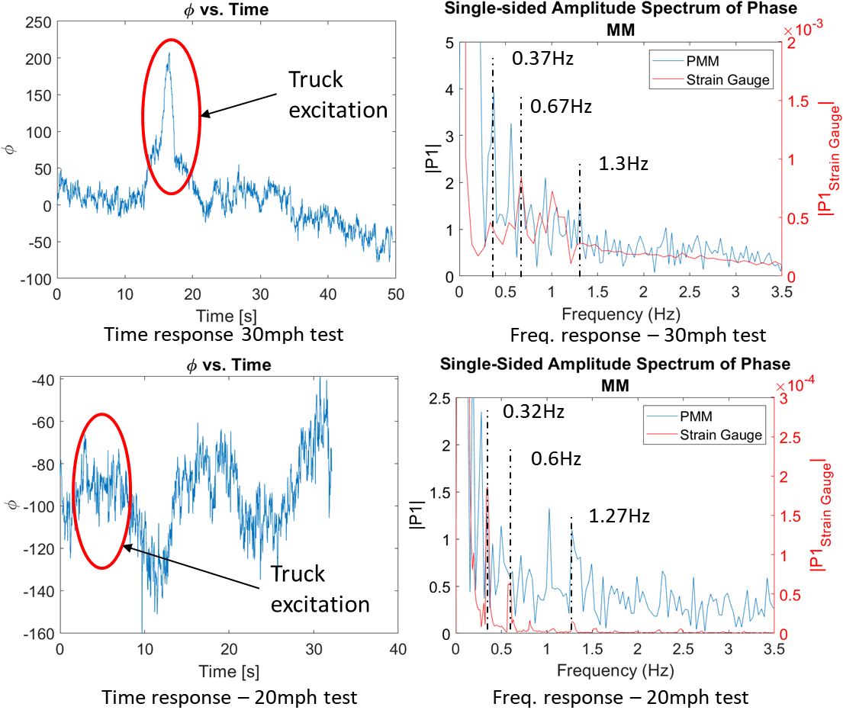
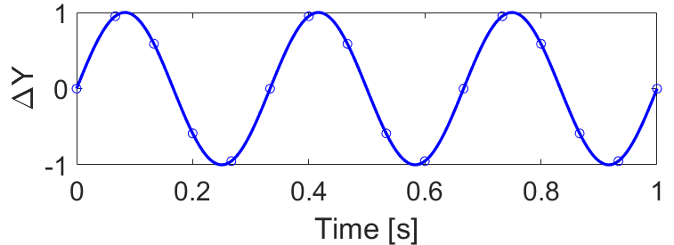
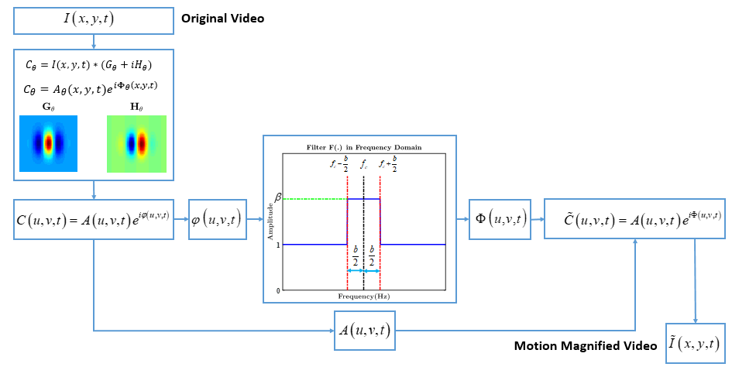
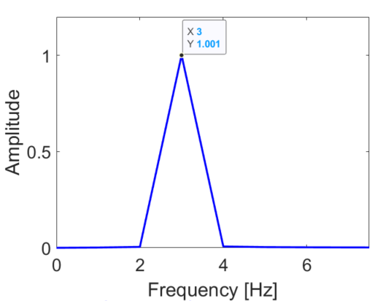
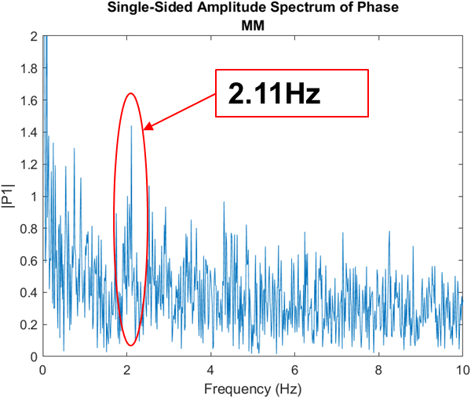
Noncontact Bridge Assessment via Computer Vision and Artificial Intelligence
Celso T. do Cabo, Department of Mechanical Engineering, UMass Lowell; Advisor: Dr. Zhu Mao
Motivation
Portable, low-cost, and nondestructive solution if compared with traditional sensing techniques
Allows setup and data extraction without interruption of traffic
Full-field data acquisition capability
Video Motion Extraction
Experimental Implementation
Lab-scale bridge test was done as preliminary data for the data-driven algorithm
Validation of Phase-based Motion Magnification (PMM) was done with commercial hardware and traditional sensing techniques available in real bridge tests
Data-Driven Damage Identification
Convolutional Neural Networks (CNN) with Long-Short Term Memory (LSTM) networks used to extract a pattern of the full-field mode shape under different conditions
CNN algorithm extract the features from the frame
LSTM algorithm relates the frames in time to find a pattern
Severe Damage – Member Removed
Healthy
Bottom
Middle
Top
Results for the healthy and damaged scenarios for the laboratory test
Frame with motion magnified
Extraction of the movement
Regions selected for data augmentation
Data augmentation samples
Lowell Connector Bridge Test
Grist Mill Bridge Test
CNN-LSTM algorithm scheme and pre-processing of frames for pattern recognition and damage detection
Comparison on portability of cameras with traditional sensing techniques
Summary
Non-contact sensing with video cameras is adopted for the development of a portable and fast bridge evaluation technology
PME proved to have a good accuracy if compared with other camera-based and traditional sensing techniques
PMM allows the amplification of the mode shapes of the structure, and full-field dynamic identification. Increasing the feasibility to identify changes in the dynamic behavior
Deep learning and artificial intelligence demonstrate extraordinary capability for damage detection when processing the camera-based data
Phase-Based Motion Extraction
Fourier Transform
$$F\left(f\right)=\int_{−∞}^{∞}{f(t)e^{−j2πft}dt}$$
Phase-Based Motion Magnification
Flowchart of phase-based motion extraction and magnification
Website of TIDC at UMass Lowell: https://www.uml.edu/research/tidc/
Author e-mail: ctdocabo@wpi.edu
Comparison between camera sensing techniques (Lowell Connector Bridge, MA) and traditional sensing techniques (Grist Mill Bridge, ME)

