Slide 1
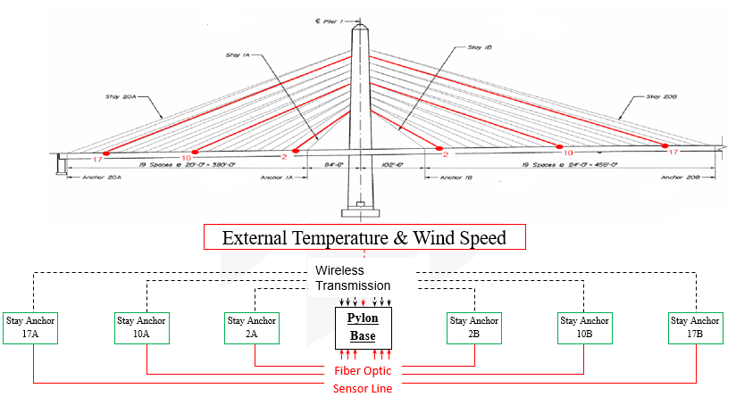
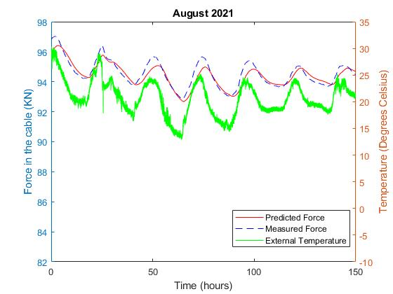
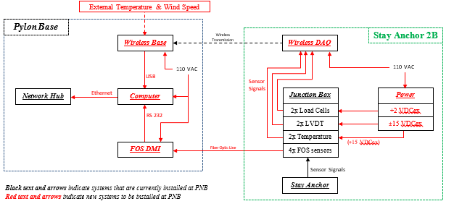
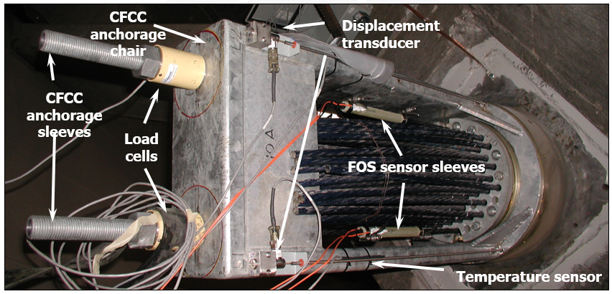
TIDC 2.10 Implementation of a Structural Health Monitoring System for Carbon Fiber Composite Strands (CFCS) in the Penobscot Narrows Bridge
Braedon Kohler, Mechanical Engineering, University of Maine PIs: K. Berube, R. Lopez-Anido, and A. Goupee
Introduction:
This project will enhance the transportation infrastructure durability as follows: a) MaineDOT will be able to monitor continuously the long-term durability of Carbon Fiber Composite Cables (CFCC) in the Penobscot Narrows Bridge, and b) Non-corrosive Carbon Fiber Reinforced Polymer (CFRP) strands will increase the longevity of highway bridges.
The Penobscot Narrows Bridge is being used as a “living laboratory” to test this material
CFCC demonstrates similar properties to steel but with much higher corrosion resistance, but the longevity of the material still needs to be determined.
Figure 2: Layout of CFCCs in PNB and Proposed data acquisition system layout
Objectives:
Upgrade the acquisition system for sensors currently at the bridge (see Figure 1.)
Implement external environment sensors
Process the data with an analytical model
Make a durability assessment of CFCC
Figure 4: Recent data from the wireless DAQ system
Results and Future Work:
In Figure 4 we can see the following:
No major deviation between measured and modeled forces
Load fluctuations in the cables mirror the change in the temperature at the bridge, which can be attributed to the difference in thermal expansion between the steel and CFCCs.
Given that the system had only been taking week long data measurements in various batches from 2008-2019 it is crucial to observe the long term trends of the CFCS performance at the bridge going forward. By using the continuous data collection system the research team will be able to determine if any major long term trends are being captured.
The DAQ system also has the potential to add additional sensing units to better capture the bridge conditions, such as wind speed and barometric pressur`e
Figure 3: Details of Stay Cable System and Pylon Base
Methods and Materials:
Current structural health system at the bridge
load cells, fiber optic strain sensors, displacement transducers, and internal temperature sensors.
Using wireless sensing units and a fiber optic conditioner (shown in Figure 2) we will be able to continuously collect data at the site remotely.
Collected data will be processed in conjunction with a thermoelastic model to determine major deviations from the predictive model
Figure 1: Structural health monitoring sensors for each pair of CFC cables inside the PNB
Acknowledgements: We thank the Maine DOT for facilitating access to the bridge.
September 2020 – www.tidc-utc.org

