Slide 1
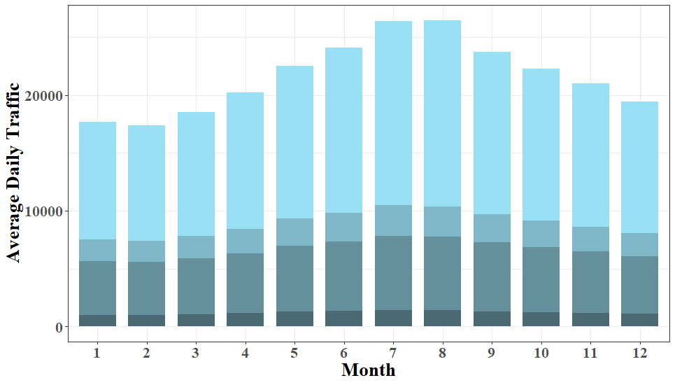
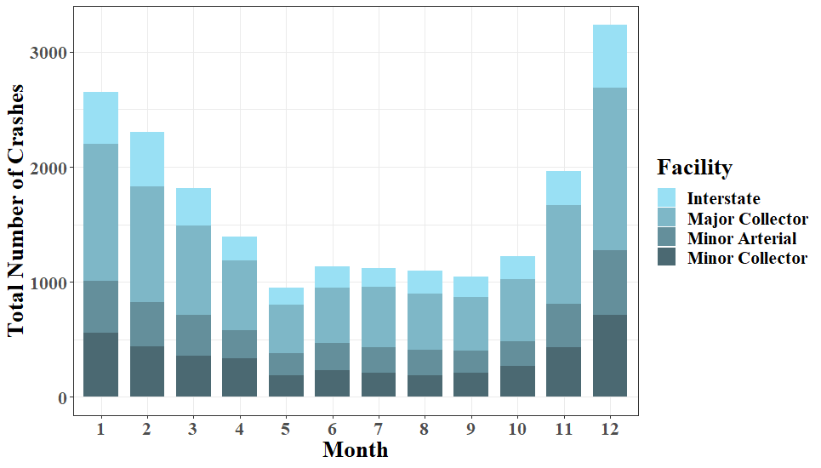
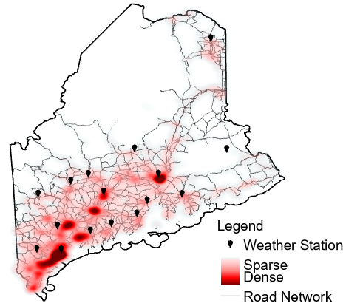
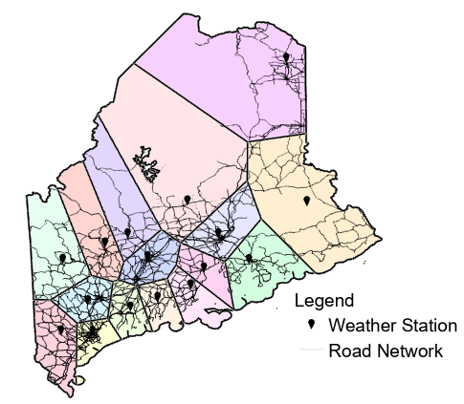
Impact of Weather Factors on Maine Lane Departure Crashes
Author: Alainie Sawtelle E.I., Department of Civil and Environmental Engineering, University of Maine
Advisor: Ali Shirazi, Ph.D. Assistant Professor, Department of Civil and Environmental Engineering, University of Maine
Introduction
Lane departure crashes account for 30% of crashes and 70% of Maine fatalities.
Most lane departure crashes occur on rural roadways (over 80%), and during the winter period (from October-April).
This study explored the impact of various monthly weather variables, and to what extent seasonal variations between winter and non-winter periods had on monthly lane-departure crashes from 2015-2019 on four separate rural facilities.
This analysis provides a better understanding of how factors influence crashes leading to improved maintenance strategies, safety and awareness.
Analysis
Negative binomial model was used with Generalized Estimating Equation (GEE) approach to fit the models using a total of 60 months of panel (longitudinal) data for each individual segment. A total of 8 individual NB models were estimated.
Marginal effects show by how much the mean number of monthly crashes would be expected to change if the variable is changed by 1% compared to the mean value.
Sample of Marginal Effects Analysis Results
.
Variables | Winter Period |  |  |  | Non-Winter Period
 | Interstate | Minor Arterial | Major Collector | Minor Collector | Interstate | Minor Arterial | Major Collector | Minor Collector
MADT | 2.812% | 0.413% | 0.403% | 0.296% | 1.253% | 0.254% | 0.181% | 0.115%
Speed Limit | 0.254% | 0.030% | 0.018% | 0.013% | 0.176% | 0.012% | 0.008% | 0.004%
Curve Present | -0.894% | 0.102% | 0.088% | 0.053% | -0.336% | 0.097% | 0.066% | 0.067%
Max. Temperature | NA | NA | NA | NA | - | - | -0.001% | -0.002%
Max. Precipitation | - | - | 0.064% | 0.065% | 0.172% | - | - | -
Precipitation Days | 0.092% | 0.020% | 0.007% | 0.014% | 0.053% | - | - | -
Snowfall Days | 0.495% | 0.048% | 0.037% | 0.026% | NA | NA | NA | NA
Key Results
All precipitation variables are positively correlated with crashes for all facilities and seasonal periods.
MADT, posted speed limit and curve presence effect crash frequency more during the winter period.
The snowfall days (number of days in a month with > 1 inch) is positively correlated with crash frequency for all facilities.
During non-winter period as temperature increases crashes decrease for major and minor collectors.
Monthly Average Daily Traffic (MADT) and Monthly Crash Counts for each Facility Type.
Weather Data Collection
Weather data was collected using the National Oceanic and Atmospheric Administration (NOAA) online resource.
Weather stations were selected based on proximity to dense crash locations and that had complete monthly weather data for the study period.
A total of 16 weather stations were selected to be used in the analysis.
Thiessen Polygons were created around each station.
Segments were matched with respective weather stations.
Conclusion
As the number of days with more than 1 inch of snowfall increases by 1% from the mean, crash frequency is expected to increase by 0.5%, 0.05%, 0.04% and 0.03% on interstates, minor arterials, major collectors and minor collectors respectively.
As the number of days with more than 1 inch of rainfall increases by 1% from the mean, crash frequency is expected to increase by 0.09%, 0.02%, 0.007% and 0.01% on interstates, minor arterials, major collectors, and minor collectors respectively.
Selecting Weather Stations by Crash Locations.
.
Acknowledgments
Recommendations for Future Work
Road Weather Information Systems (RWIS) would include more accurate and reliable weather data for segments and should be considered for future work.
More weather variables should be investigated including visibility and wind, accurate data was unavailable for this project.
Contacts: alainie.sawtelle@maine.edu, shirazi@maine.edu
Thiessen Polygons Determined by Weather Station Locations.
.
October 2021 – www.tidc-utc.org

