Slide 1
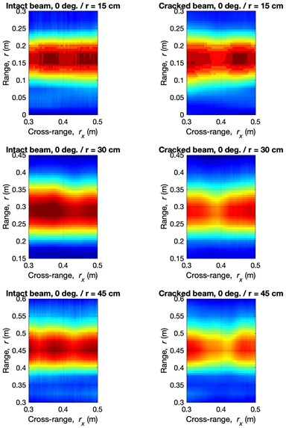
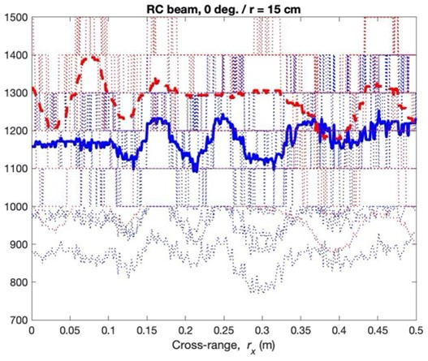
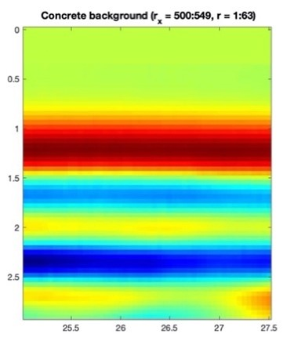
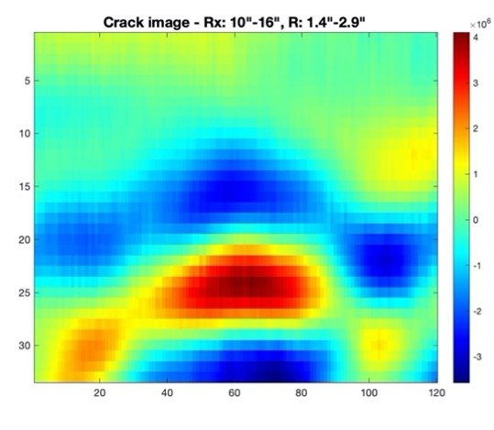
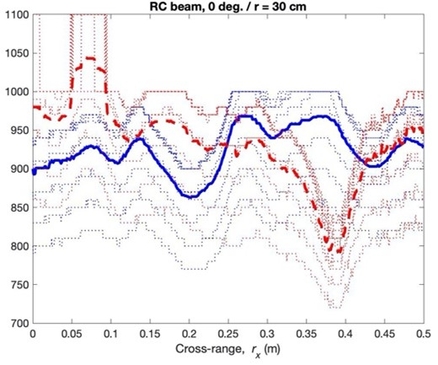
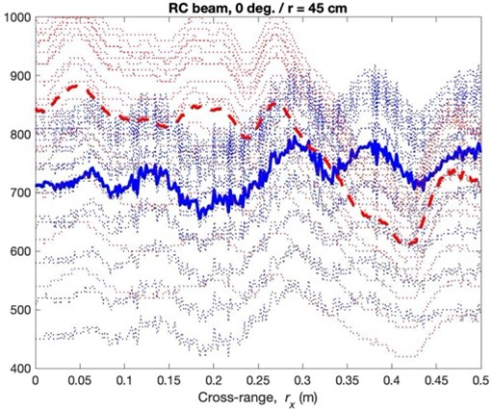
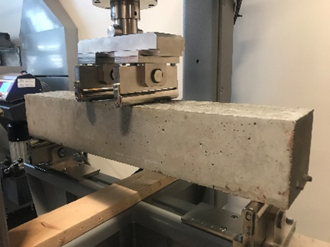
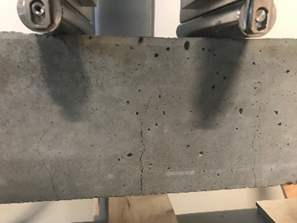
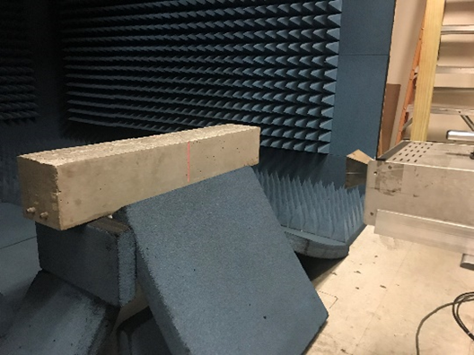
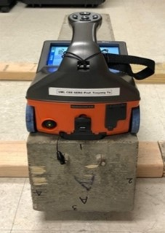
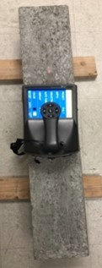
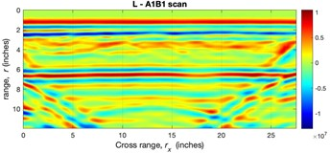
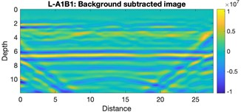
Crack Detection of Reinforced Concrete (RC) Beam Specimen using SAR and GPR
2021 TIDC Annual Student Poster Competition
Author: Aiyad Alshimaysawee / Advisor: Professor Tzuyang Yu
Department of Civil and Environmental Engineering, University of Massachusetts Lowell
Introduction
Reinforced concrete cracking is a commonly problem specially in concrete bridges. This problem is most important because the integrity of concrete cover indicates not only mechanical strength of the cross section but also the level of protection for steel corrosion. Concrete cracking and steel corrosion can occur to any component in concrete bridges. On this poster, detection the surface crack in reinforced concrete (RC) beam specimen using remote synthetic aperture radar (SAR) and contact ground penetrating radar (GPR) is presented.
Experimentation
1. Specimen preparation
Reinforced concrete beam specimen of dimensions 36 x6x6 in3 was cast and four-point bending test as shown in Fig.1 was carried out to flexural cracks as shown in Fig. 2
Fig.9 Background reflection signal
Fig.10 scattering signal representing a crack
Summary
Noncontact SAR and contact GPR can be used for:
Detect a surface crack in reinforced concrete structures.
Location a surface of crack in reinforced concrete structures.
Since SAR and GPR use different imaging algorithms, their images appear differently when inspecting same concrete structures. Fundamentally, the scattering signal due to the presence of a subsurface crack in concrete structures is the information civil engineers can use to estimate the characteristics of a subsurface crack for condition assessment.
Fig.5 SAR images of Intact and cracked beam at three different ranges
Fig.6 Maximum SAR amplitudes at different ranges
Crack detection
A major electromagnetic reflection (specular returns) from the surface and subsurface of the RC beam is imaged by SAR algorithm into spatial distribution of SAR amplitudes shown in Fig.5. The presence of a subsurface crack in RC will lead to a reduced SAR scattering response centering in vicinity of 40cm (0.4m) for all ranges. The SAR amplitude of cracked RC beam (red dashed curves) in average is greater than the one of intact RC beam (blue solid curves), it becomes smaller than the one of intact RC beam in the vicinity of the crack location as shown in Fig.6. This difference can be categorized into the two aspects: cross-range location and amplitude change. When GPR B-scan images the RC beam as shown in Fig.7, it is too strong to prevent the crack location. After background removal processing, the GPR B-scan image as shown in Fig.8. This background removal processing was achieved by using a clean background signal as shown in Fig.9, The scattering signal representing the presence of a crack at the midspan is shown in Fig.10
Acknowledgement
The financial support from TIDC Project 1.4 “Electromagnetic Detection and Identification of Concrete Cracking in Highway Bridges” is appreciated. We also thank graduate student Tek Dhant, undergraduate students Sophe Ying, Yaneliz Garcia Ruiz, and Tiana Robinson for their assistance in laboratory experimentation. CEE Laboratory Director Gary Howe’s help is always indispensable.
Fig.1 4- point bending
Fig.2 Flexural cracks generated
2. Data Collection
Reinforced concrete beam was scanned using SAR imaging sensor inside an anechoic chamber at UMass Lowell, before and after cracking. Experimental setup and the SAR images collected at the different ranges (15cm, 30cm, and 45cm) as shown in Fig.3. Also, GPR sensor was used to collect range-cross range domain of reinforced concrete beam as shown in Fig.4
References
Alzeyadi, A. and Yu, T. (2021) “Remote characterization of chloride content in oven-dried concrete specimens by using synthetic aperture radar image models,” Construction and Building Materials, 302. doi:10.1016/j.conbuildmat.2021.124317.
Alzeyadi, A., T. Yu (2020), Subsurface characterization of moisture content and water-to-cement ratio of concrete specimens using remote synthetic aperture radar imaging, Journal of Applied Remote Sensing, 14 (2); 024520-1-17, doi: 10.1117/1.JRS.14.024520.
Yu, T., S. Vinayaka (2020), Quantification of surface crack depth in concrete panels using 1.6 GHz GPR images, In: Proc SPIE Smart Structures/NDE, vol. 11380, April 27~May 8, doi: 10.1117/12.2558952.
Fig.3 Laboratory SAR imaging facility
Fig.4 GPR B-scan
Contact: Prof. Tzuyang Yu at UML (tzuyang_yu@uml.edu)
Fig.7 GPR image of RC beam specimen
Fig.8 Background removed GPR B-scan image
October 2021 – www.tidc-utc.org

