Slide 1
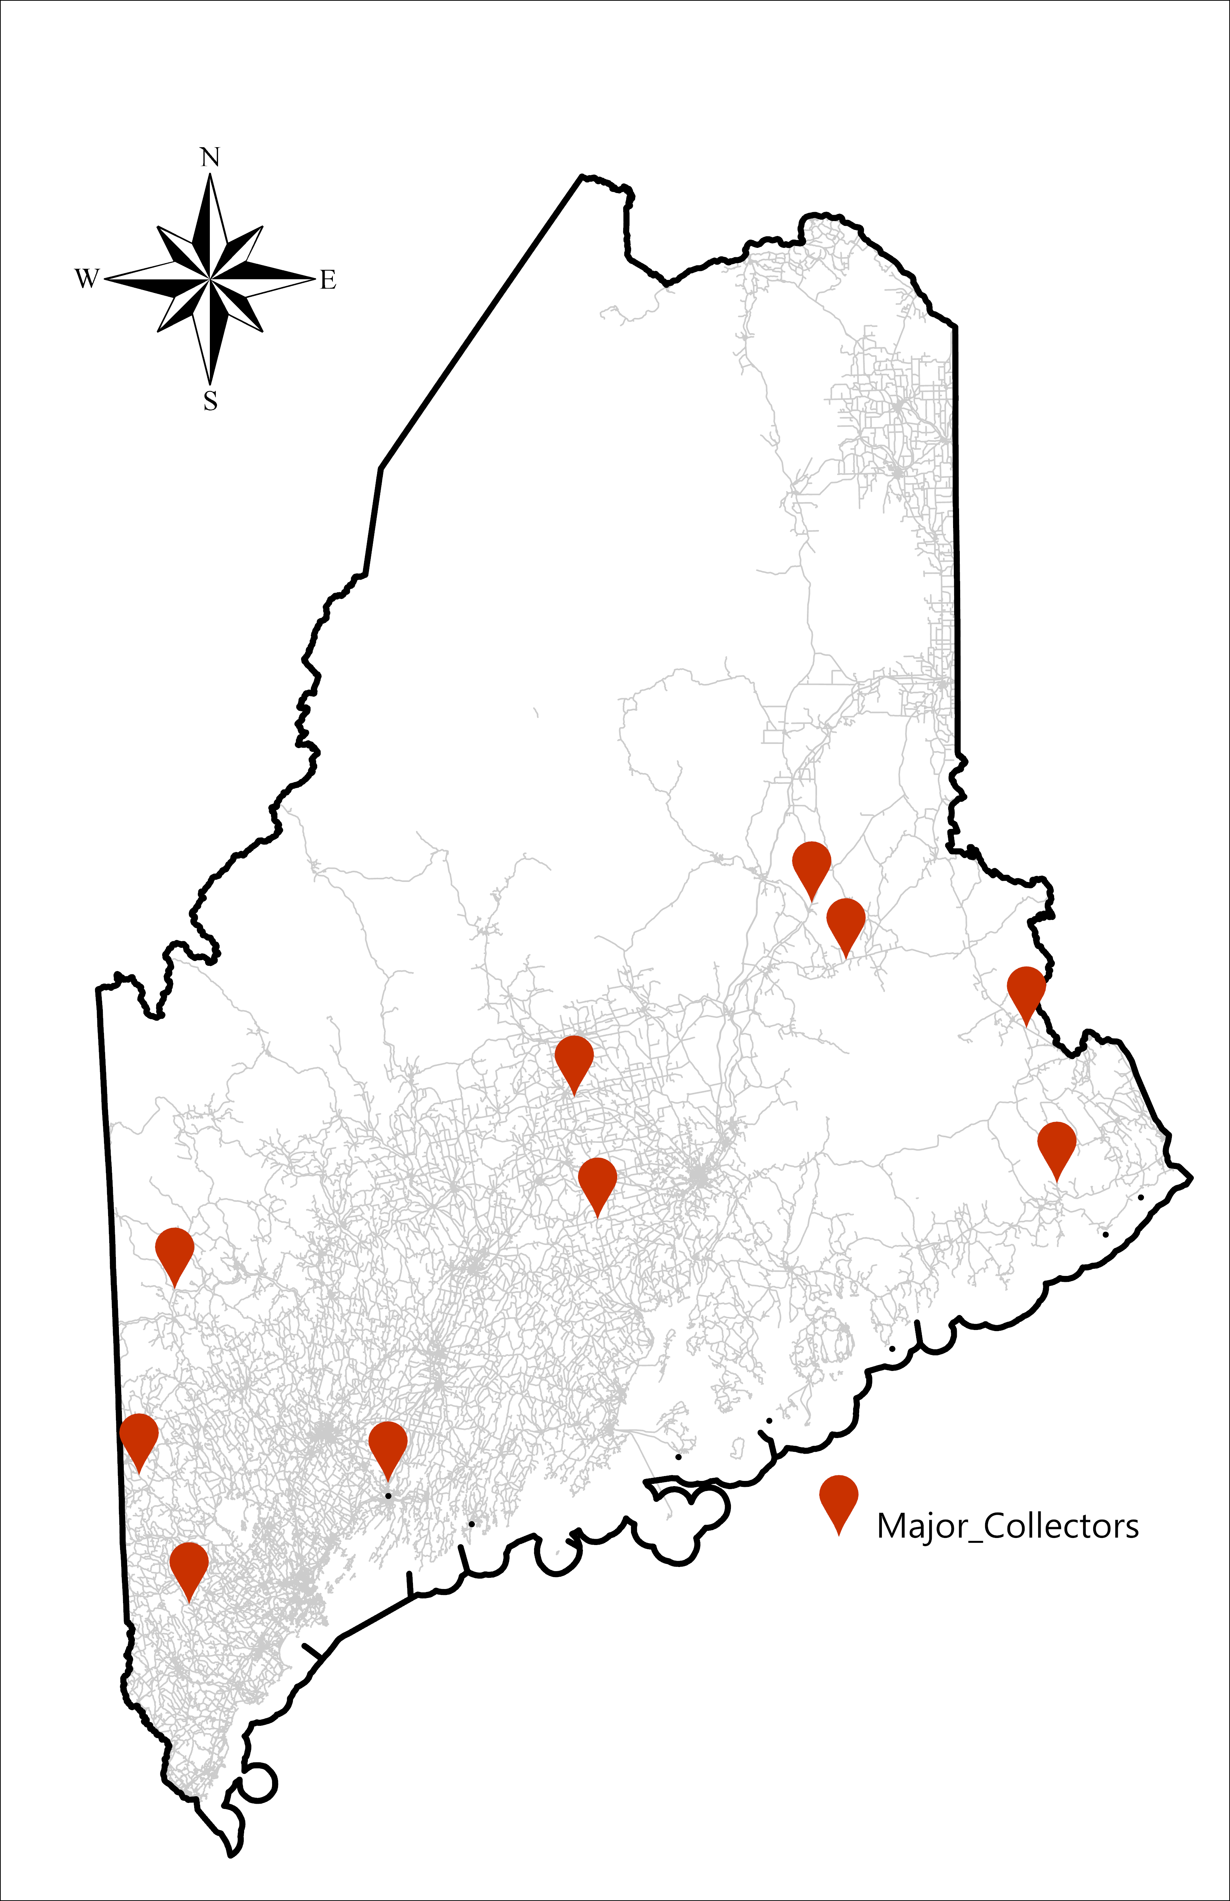
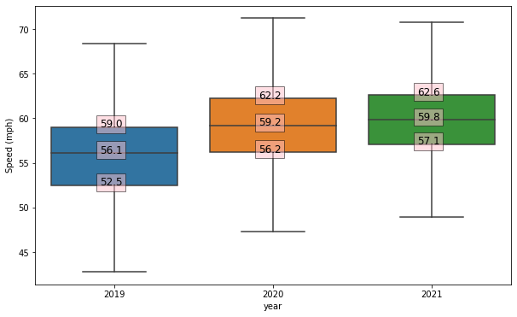
Analyzing Traffic Speeding Behavior during Covid-19 in Maine
Amirhossein Shahlaeegilan, Civil and Environmental Engineering, University of Maine Advisor: Dr. Ali Shirazi
Introduction
During Stay-at-home order, the number of severe crashes increased in Maine. Similar trend was observed across the United States.
Traffic Flow reduced significantly during stay-at-home order.
Crash severity has a direct relationship with speed. It is hypothesized that speeding increased as traffic volume decreased.
Analysis
The proportion of vehicles driving above certain speeds are shown in the table below for a select station with speed limit of 45 mph.
Statistical Analysis
The modeling results and Odds ratios are shown in the table
Time of Day | Month/Year | >50mph | >60mph | >70mph | Traffic Volume
Morning Rush Hour (6 AM - 10 AM) | April, 2019 | 44.95% | 5.03% | 0.22% | 5094
 | April, 2020 | 48.06% | 7.01% | 0.65% | 3683
 | April, 2021 | 48.39% | 6.33% | 0.47% | 5053
 | May, 2019 | 48.55% | 5.45% | 0.49% | 5912
 | May, 2020 | 50.42% | 6.73% | 0.50% | 4843
 | May, 2021 | 46.33% | 5.51% | 0.29% | 5877
Evening Rush Hour (3 PM - 7 PM) | April, 2019 | 54.57% | 5.38% | 0.30% | 8253
 | April, 2020 | 52.23% | 6.84% | 0.63% | 5859
 | April, 2021 | 52.48% | 6.25% | 0.47% | 8718
 | May, 2019 | 55.14% | 5.47% | 0.35% | 9663
 | May, 2020 | 56.53% | 7.20% | 0.53% | 8182
 | May, 2021 | 50.04% | 5.74% | 0.51% | 9651
Variables | +10 mph Speeding | +15 mph Speeding | +20 mph Speeding | +25 mph Speeding
 | Odd Ratio | Odd Ratio | Odd Ratio | Odd Ratio
Traffic Volume | 0.9543 | 0.9597 | 0.6194 | 0.6056
Weekend | 1.0768 | 1.0964 | 1.0793 | 1.0838
Morning Rush Hour | 1.2013 | 1.2506 | 1.1607 | insignificant
Evening Rush Hour | 1.1331 | 1.1085 | 1.0423 | insignificant
April | 1.3272 | 1.3105 | 1.4544 | 1.5914
May | 1.3173 | 1.2863 | 1.4724 | 1.682
Stay-at-home-order | 1.2673 | 1.3429 | 1.5402 | 1.6641
After Stay-at-home-order | 1.2123 | 1.2672 | 1.4285 | 1.5806
Limit50 | 0.228 | 0.2111 | 0.3705 | 0.5786
Limit55 | 0.4689 | 0.2807 | 0.2804 | insignificant
Data
We used data from 10 continuous count stations on major collectors.
We used 5-minutes aggregated traffic volume and speed.
Proportion of vehicles that are driving 10, 15, 20 and 25 mph above speed limit was calculated
The map shows the location of continuous count stations used in this study.
Traffic volume decreased significantly during stay-at-home order
Column >60mph and >70mph represents over 15 and 25 mph speeding respectively.
Green cells illustrates the percentage of vehicles before stay-at-home order, and red cells shows during and blue cells after stay-at-home order.
The proportion of vehicles driving above speed limit increased during and after stay-at-home order.
the proportion of vehicles that had over 15 mph speeding increased from 5.03% in April 2019 to 7.01% in April 2020 and increased from 0.22% in April 2019 to 0.65% in April 2020 during morning rush hours
The proportion of vehicles drive over 15 mph of speed limit increased from 5.38% in April 2019 to 6.25% in April 2021 during evening rush hours
Data shows an increase in speed during April and May 2020. increased speed continues even after 1 year. The following figure compares the traffic speed during 2019 (before stay-at-home order), 2020 (during stay-at-home order) and 2021 (after stay-at-home order)
Key Results
The results show that:
As traffic volume increases, speeding decreases.
The odds of speeding greater than 15 mph of speed limit increased by 34% during stay-at-home order.
Even 1 year after stay-at-home order, the odds of speeding greater than 15 mph, is still 28% higher than before Covid 19.
Having a positive coefficient for the stay-at-home order dummy variable shows that there are other factors (other than traffic volume) such as enforcement that impacted the traffic speeding.
Methodology
We had fractional response data (value between 0 and 1).
We converted that to number of speeding vehicles in each 5-minute interval.
We used a Binomial model with random intercept to find the relationship between speeding and various variables.
Variables used in the model:
Weekend dummy, equals one during weekends
Morning Rush hour, equals one during 6am to 10am
Evening rush hour, equals one during 3pm to 7 pm
April, equals one for data related to April
May, equals one for data related to may
During stay-at-home order, equals one for April and May 2020
After stay-at-home order, equals one for February, April and May 2021
Limit50, equals one for roadways with posted speed limit of 50 mph
Limit55, equals one for roadways with posted speed limit of 55 mph
Acknowledge
We are grateful for Transportation Infrastructure Durability Center (TIDC) for funding this project and Maine DOT for collaborative work and providing required data related to count stations.

