Slide 1
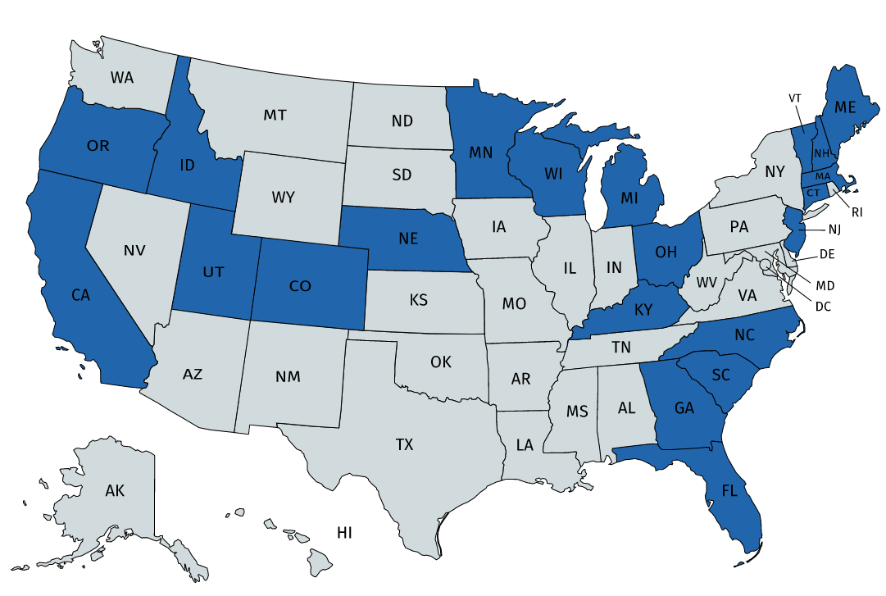
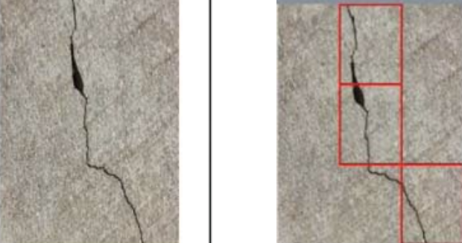
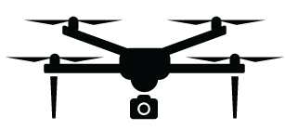
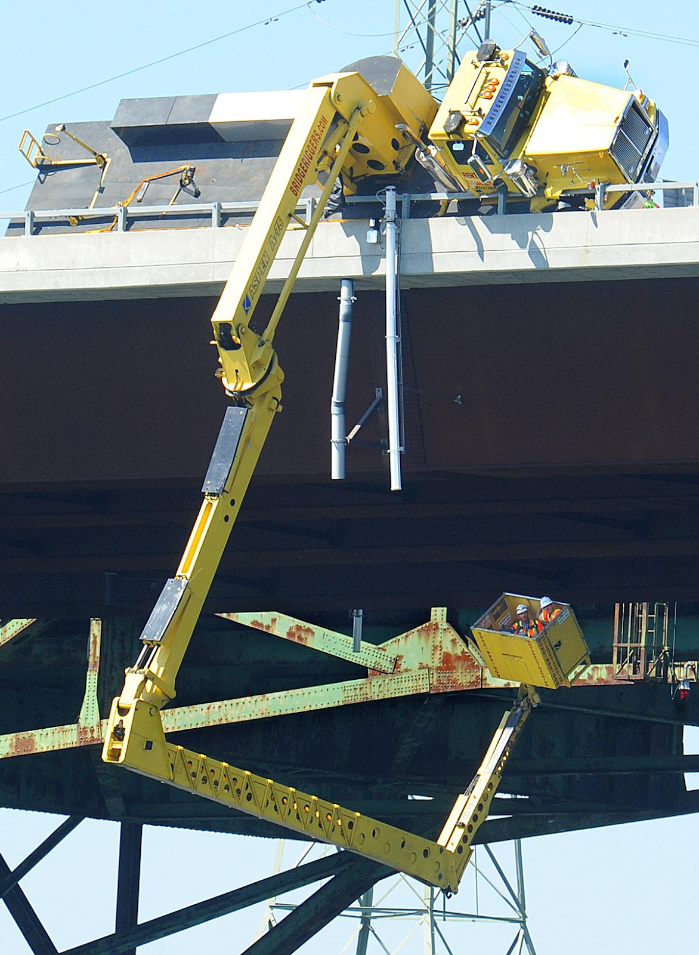
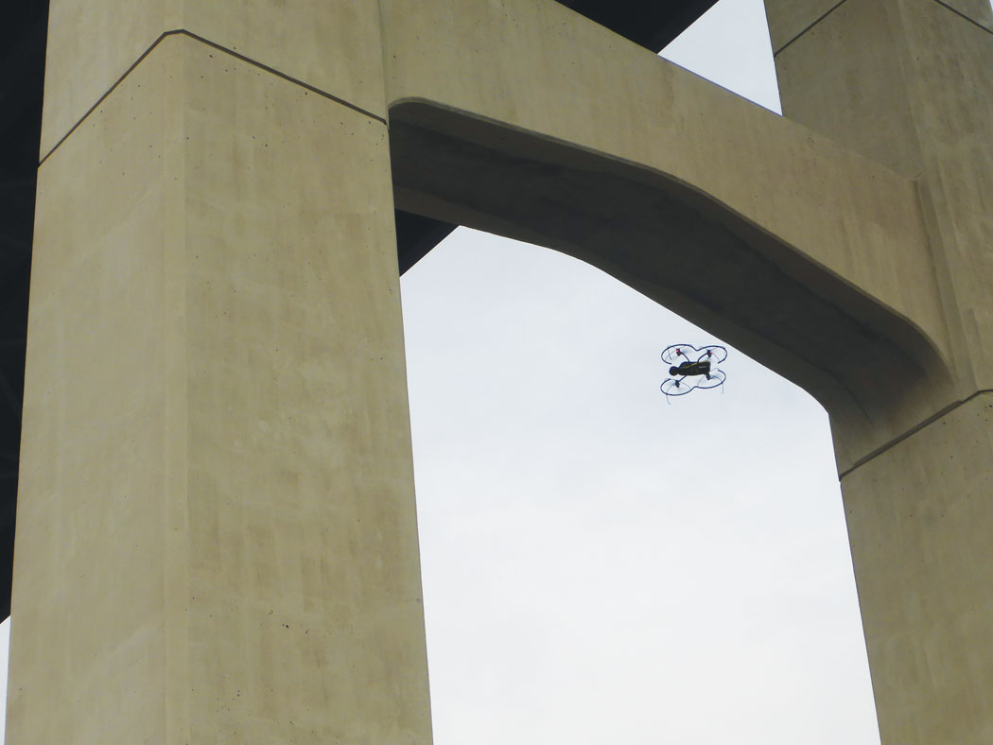


UAV Applications for Bridge Inspection
Zahra Ameli, Civil Engineering department, University of Maine Advisor: Eric Landis, Ph.D, P.E.
Background
Bridge conditions according to the Federal Highway Administration (FHWA) database (2021):
3D Model
Construction
Photorealistic
Model
a)
b)
Feature extraction and matching
Sparse and dense point reconstruction
Quality evaluation
Data acquisition
Image processing
Figure 1, Bridge condition a) The United States, Total number of bridges: 619,622 b) State of Maine, Total number of bridges: 2,485 [1]
Figure 2. The blue color represents states which are using or planning to use UAV in bridge inspection
Example Applications
Practical field studies using UAVs for bridge inspections have been conducted by individual state Departments of Transportation (DOTs) such as:
Connecticut, Kentucky, South Carolina and Alaska DOTs studies the applicability of UAV for bridge inspection purposes.
Minnesota DOT deployed UAV to inspect several bridges with various size and material and identifying concrete delamination using IRT sensors, efficiently document deficiencies and communicate inspection results.
Idaho DOT research team built a mockup bridge with pre-existing deficiencies and utilized UAV to find out optimal lighting and camera distance for fatigue crack detection.
Optimized sensor selection
Automated Flight path planning
Image registration
Deep learning algorithms to detect, classify and quantify the defects
Development of AB-BrIM
Figure2. a) UBIT overturns on a Bridge in Rhode Island [2] b) UAV capturing images of a bridge deck in Minnesota [3]
Defect growth tracking over time
Location mapping
All bridges should be inspected regularly to satisfy serviceability and safety criteria (National Bridge Inspection Standard (NBIS)).
Unmanned aerial vehicles (UAVs) have the potential to improve and automate the conventional bridge inspection through:
Improving data acquisition process and increasing public and inspector’s safety
Cutting inspection time and reducing traffic closure
Figure 3. future research direction for automating bridge inspection
Future research
Optimized sensor and drone selection based on the mission requirements and type of the bridge to be inspected
Automated flight path planning considering full/maximum coverage, collision avoidance, and minimum time of flight
UAV navigation in the GPS-denied environment
Accurate 3D reconstruction of bridge elements to visualize the structure in full detail and locate and map defects
Developing advanced ML algorithms such as convolutional neural network (CNN) for automotive detection, quantification and identification of defects
Conclusion
UAV is a versatile tool to capture high quality images in a short period of time but manually processing the images is still time consuming and subject to human errors.
The UAV-enabled inspection technology in conjunction with advanced sensing technologies and artificial intelligence algorithms provides the opportunity to robotically and accurately perform bridge inspections.
[1] https://www.fhwa.dot.gov/bridge/britab.cfm
[2] http://metroforensics.blogspot.com/2016/08/bridgeriggers-aspen-75-under-bridge.html
[3] https://www.roadsbridges.com/will-drones-transform-bridge-inspection

