Slide 1

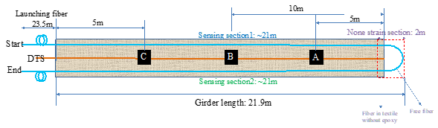
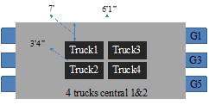
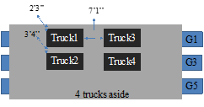

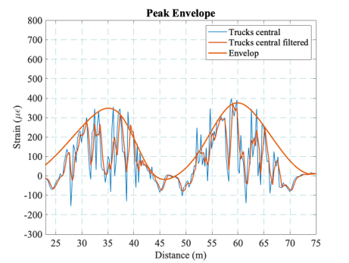
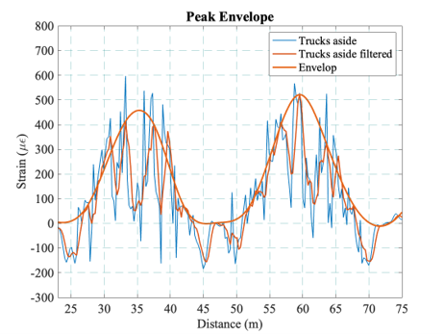



Composite Bridge Monitoring using Smart Fiber Optic sensing textile
Andres. Biondi¹, Rui Wu¹, Lidan Cao¹, TzuYang Yu², Balaji Gopalan³, Jackson Ivey³, Xingwei Wang^{1*}
Electrical and Computer Engineering¹, Environmental and Civil Engineering^{2 ,} University of Massachusetts Lowell
Saint-Gobain³
Advisor: Xingwei Wang
Introduction
The use of composite Bridges has increased, thanks to its light structure and the combination of steel bridges and some concretes bridges factor. Structural Health Monitoring (SHM) is important to continue to monitor the aging process of the structure. This approach allows the detection of structural damage and helps to plan maintenance procedures to keep structures in great condition.
Figure 2.Sensing Textile design
Figure 1.Mills Grills Bridge sensors in Maine
Field test results
The fiber sensing textile was installed inside girder 1 before the installation of the Bridge.
Loading trucks were placed at a specific location along the Bridge, and BOTDA measurements were collected
When trucks were located right above girder 1 the strain is larger than when trucks were placed in the center.
A sinusoidal response is observed since the sensing textile has a U-shape patter
Figure 4. BOTDA data for trucks on the center of the Bridge
Figure 3. BOTDA data for trucks located on top of Girder 1
Acknowledgement
Funding for this research is provided, partially or entirely, by the Transportation Infrastructure Durability Center at the University of Maine under grant 69A3551847101 from the U.S. Department of Transportation’s University Transportation Centers Program. We also thank the AFFOA (Advance Functional Fabric of America agency) for partially supporting this research through Grant W15QKN-16-3-0001 and would like to recognize our industry partners Saint-Gobain, Main DOT, AIT bridges
Conclusion
Smart sensing textiles allow easy installation of the fiber sensors before the bridge construction.
Larger strain values were observed with the trucks were placed on top of girder 1.
BOTDA can provide important information regarding the strain distribution during loading events.
June 2019 – www.tidc-utc.org
Notes:
HI Everyone, My name is Andres Biondi. I am a PhD student from the electrical and computer engineering department at UMASS Lowell. I work under professor Xingwei Wang and today I am here with my colleague Lidan to present our results from the Structural Health Monitoring of a composite Bridge using Smart Fiber Optic textile. Structural Health monitoring has become and important procedure to maintain and supervise the physical status of any structure. Distributed fiber optic sensing, has become a popular approach to monitor changes in strain and temperature, because of its ability to provide thousands of data point using a commonly used telecommunication fiber cable. Our research group, has develop a smart textile using distributed sensing fiber optics which facilitates and speeds up the installation process
A prototype was installed on a bridge named Gristl mill and located in Maine. The bridge has a total of 5 girders that were fabricated using a composite material. Inside girder 1, 3 and 5, a smart fiber optic sensing textile were installed using epoxy to adhere the textile to the girder. The sensors design is shown in figure 2. The fiber was embroidered into the textile using a U-shape pattern for a length of around 22m for each side. 23 meter of free fiber was extended to facilitate the connection of the sensor to interrogation system. The sensing interrogation system used to collect data was the Brillouin Optical Time Domain Amplification or also known as (BOTDA). This system allow us to measure the Brillouin backscatter signal to measure Strain and temperature changes with a minimum spatial resolution of 1m. After the Bridge was constructed, we proceeded to collect data which will be further explain by my colleague.

